Slide 1
Medication Adherence
www.ChangeThatMatters.UMN.edu
Special thanks to Anjoli Punjabi, PharmD, MPH for her contribution to this slide set

Slide 2
Brief Overview

Slide 3
Patient Case
Mr. Avery is a 62 year-old man who has “elevated blood sugar” since age 40. He has been encouraged to maintain a healthy weight and decrease carb/sugar intake. However, at his last PCP appointment, his hemoglobin A1C was 9.0. You see from his chart that he has “poor compliance.”
He has arrived for his first appointment with you. What do you hope to accomplish in this session?

Slide 4
Discussion Questions
What behaviors do you want to address?
What are the “modifiable factors” that might be impacting patient behavior?
What health behavior strategies could you apply?
Notes:
Behaviors: Medication adherence, eating habits, physical activity
Modifiable factors: Problem solve the barriers to engaging in these behaviors (e.g., stress, forgetfulness, life circumstances, etc.)
Health behavior strategies – many to choose from (goal setting, pill boxes, small changes, etc.)

Slide 5
Where Do We Start??
HTN
Elevated BMI
Psychosocial
Stressors
Heart Disease
DM
Depression
Lack of Activity
Smoking
Notes:
Adapted from: Kerr, J., Weitkunat, R., & Moretti, M. (2005). ABC of behavior change: A guide to successful disease prevention and health promotion. Edinburgh ; New York: Elsevier Churchill Livingstone
There are many possible factors that contribute to health outcomes. At times, it can feel overwhelming since there are so many possible targets. If we only focused on treating the end point (in this case, heart disease), we might miss many other factors that contribute to disease progression. The key with this model is to think about other contributors and to consider addressing upstream contributors to health and disease.

Slide 6
Defining Adherence
“The extent to which a person’s behavior (taking medication, following a diet, or making healthy lifestyle changes) corresponds with agreed-upon recommendations from a health-care provider”
World Health Organization, 2003
Notes:
Source: World Health Organization, 2003. http://apps.who.int/iris/bitstream/10665/42682/1/9241545992.pdf

Slide 7
Defining Medication Adherence
“The patient’s conformance with the provider’s recommendation with respect to timing, dosage, and frequency of medication-taking during the prescribed length of time”
Agency for Healthcare Research and Quality

Slide 8
Remember this…
“Drugs don’t work in patients who don’t take them.”
- C. Everett Koop
Notes:
This is the major problem– poor adherence to medication regimens reduces the effectiveness of those treatments.

Slide 9
Medication Adherence Statistics
Approximately ____ to ____% of prescriptions are never picked up from the pharmacy
____% of medications for chronic diseases are not taken as prescribed
An estimated ____% of hospitalizations in older adults may be caused by medication non-adherence
Up to $____ billion of avoidable health care costs have been attributed to non-adherence in the US annually
A retrospective claims-based study of 1,705 patients with diabetes and hyperlipidemia showed that adherence decreased all-cause medical costs by ____%
20
30
50
10
300
15
Notes:
Medication adherence can be challenging for many patients.
In fact, approximately 20 percent to 30 percent of prescriptions are never picked up from the pharmacy, and 50 percent of medications for chronic diseases are not taken as prescribed.
Between $100 and $300 billion of avoidable health care costs have been attributed to non-adherence in the US annually, representing 3% to 10% of total US health care costs
IMS Institute for Healthcare Informatics Avoidable costs in US health care. 2013. Available at: http://www.imshealth.com/deployedfiles/imshealth/Global/Content/Corporate/IMS%20Institute/RUOM-2013/IHII_Responsible_Use_Medicines_2013.pdf. Accessed March 13, 2018
Sokol MC, McGuigan KA, Verbrugge RR, Epstein RS. Impact of medication adherence on hospitalization risk and healthcare cost. Med Care. 2005 Jun; 43(6):521-30.
Wu J, Seiber E, Lacombe VA, Nahata MC, Balkrishnan R. Medical utilization and costs associated with statin adherence in Medicaid enrollees with type 2 diabetes. Ann Pharmacother. 2011 Mar; 45(3):342-9.
Iuga A, McGuire M. Adherence and Health Care Costs. Risk Manag Healthc Policy. 2014; 7: 35–44.

Slide 10
The Problem With Non-Adherence
Clinical/Health Outcomes
Poor therapeutic outcomes
Further disease progression
Decreased quality of life
Economic Outcomes
Increased costs to healthcare system
Increased hospitalization
Increased frequency of Emergency Department visits
Increased physician visits
Loss of productivity
Notes:
Non-adherence is associated with poor therapeutic outcomes, further progression of disease, and decreased quality of life.
IMS Institute for Healthcare Informatics Avoidable costs in US health care. 2013. Available at: http://www.imshealth.com/deployedfiles/imshealth/Global/Content/Corporate/IMS%20Institute/RUOM-2013/IHII_Responsible_Use_Medicines_2013.pdf. Accessed March 13, 2018
Sokol MC, McGuigan KA, Verbrugge RR, Epstein RS. Impact of medication adherence on hospitalization risk and healthcare cost. Med Care. 2005 Jun; 43(6):521-30.
Wu J, Seiber E, Lacombe VA, Nahata MC, Balkrishnan R. Medical utilization and costs associated with statin adherence in Medicaid enrollees with type 2 diabetes. Ann Pharmacother. 2011 Mar; 45(3):342-9.
Iuga A, McGuire M. Adherence and Health Care Costs. Risk Manag Healthc Policy. 2014; 7: 35–44.

Slide 11
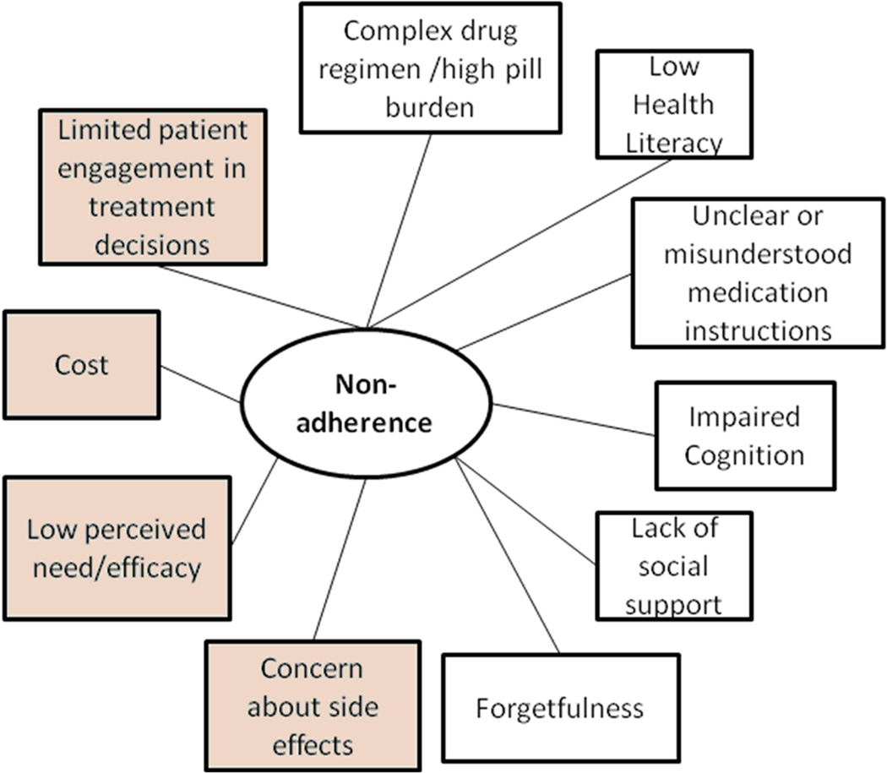
Most Common Reasons for Non-Adherence
Forgetfulness
Concern about side effects
High drug costs
Perceived lack of efficacy
or low need
Notes:
Studies show:
To help patients improve medication adherence, physicians must determine the reason for non-adherence. The most common reasons are forgetfulness, fear of side effects, high drug costs, and a perceived lack of efficacy (areas that are circled)
Unni, E. J., Shiyanbola, O., & Farris, K. B. (2013). Medication adherence: a complex behavior of medication and illness beliefs. Aging health, 9(4), 377-387.

Slide 12
How Can We Predict Adherence?
Insurance Coverage
Organizational Context
Healthcare Encounter
Personality
Health Beliefs
Attitudes
Treatment Modality/ Disease Characteristics
Social Context
Patient & Provider Interactions
Social Support Social Barriers
Notes:
There are many possible influences on medication nonadherence – this model is similar to the socioecological model which defines influence on different levels. At the individual level, there are factors that the patient contributes, such as personality (e.g., conscientiousness, organizational ability), overall health status (e.g., multiple chronic conditions, cognitive impairment), beliefs (e.g.,. beliefs about medications and their side effects), and attitudes (e.g., like the medication/treatment or not). At the social level, people interact with others and that influences their adherence. For example, some patients may have a partner or other family member who helps them fill their pill boxes and reminds them to take medications, whereas others do not. At the healthcare encounters, providers may do a great job explaining the medication, potential side effects, and the plan for administration. Other providers may not communicate this as well. Finally, at the level of the organization, many factors come into play, such as whether or not the medication/treatment is covered by insurance and what different treatments are available for the disease. There many be many places to intervene and predict adherence.

Slide 13
Assessment Strategies

Slide 14
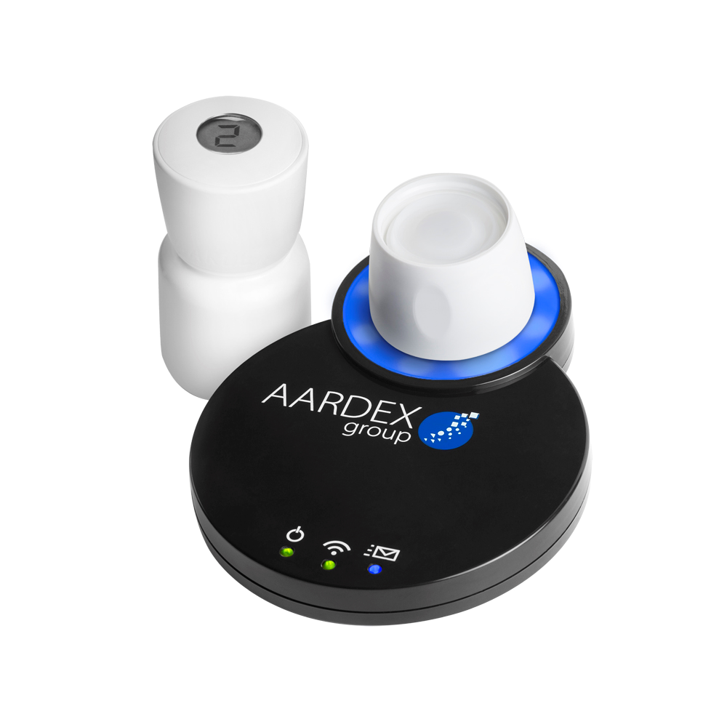
Assessing Adherence
Self report
Homework/written materials
Technology
Lab values

Slide 15
Asking About Adherence
Most people forget sometimes. How often do you forget to take your medicine?
When you feel better, do you sometimes stop taking medicine?
When you feel worse, do you sometimes stop taking your medicine?
Notes:
Adapted from Morisky Scale (1986)
Important to normalize non-adherence in order to elicit honest information from patients

Slide 16
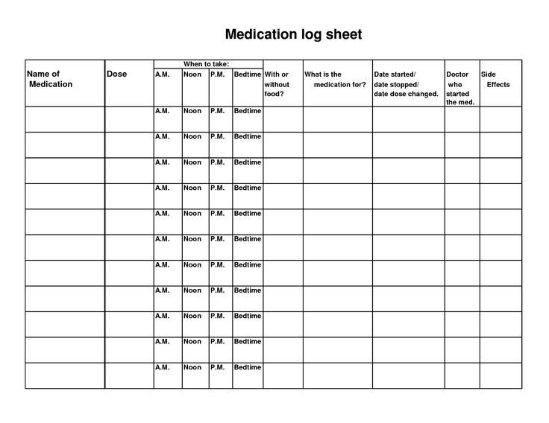
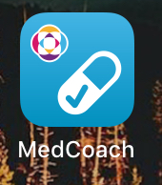
Self-monitoring
Notes:
There are many different ways to keep track of medication use. Sometimes patients prefer a paper log so they can check off if they took their medication. There are also many apps, such as Mango Health and MedCoach, that offer medication tracking and digital alerts that remind patients to take their medication. Patients can also devise their own strategy that works for them.

Slide 17
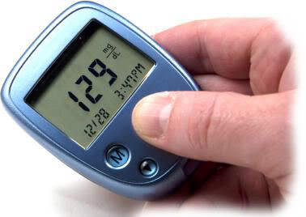
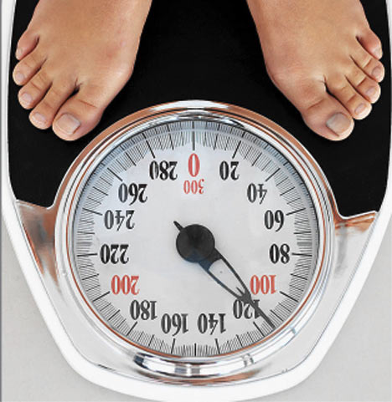
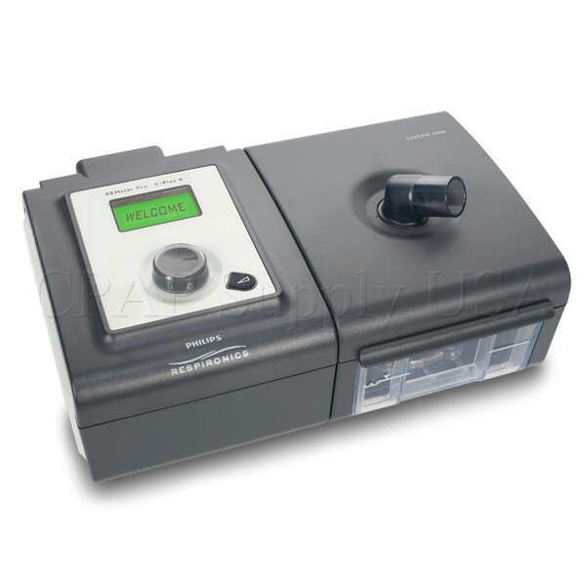
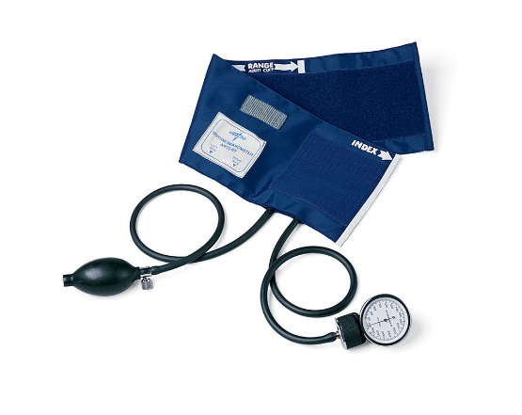
Types of “Objective” Data
Objective Recordings
Laboratory Values
Notes:
There many devices that provide some measure of adherence. For example, there are pill bottles that record whether or not somebody opened them as a way to determine adherence. These are generally used in research and not in clinical practice. CPAP machines all come with digital records of adherence, including the length of nightly use. This data is usually uploaded to the cloud and providers can access the data remotely to monitor adherence to CPAP therapy. Other laboratory values give you a sense of adherence to treatment, such as blood glucose levels, blood pressure, and weight.

Slide 18
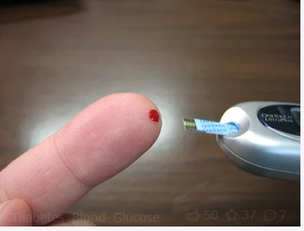
What About Conflicting Data?
Mr. Avery says he has been watching his diet and monitoring his glucose.
“More vegetables, fewer desserts – I’ve been making a lot of changes.”
“I’ve also been checking my blood sugar and it’s been below 150 most of the time.”
BUT….his hemoglobin A1c today was 8.0 (indicative of poor control). AND…he left his glucometer at home.

Slide 19
Questions for Discussion
How do you review data?
What do you “believe?”
Do you confront him with conflicting data?
Notes:
Encourage open-ended questions with patients. There may be multiple “truths” – patients may truly believe they are doing better and progress may be slow. Be careful about being too confrontational about conflicting data; this may push patients away and discourage honesty. Can consider using motivational interviewing to frame the conflicting data “I hear you say that you have been eating healthier and taking your medicines. At the same time, I see that your lab value is still too high. What do you make of this?”

Slide 20
“Okay… so maybe I haven’t been as taking my medications as I should…and maybe I’ve been eating too much ice cream in the evenings…”
What do you do?
Notes:
Sometimes during these discussions, patients admit that they are not being as adherent as they had originally reported. This can open the door for a nonjudgmental, empowering discussion using the tools outlined in the next section.

Slide 21
Evidence-Based Approaches

Slide 22
5 Approaches
Education
Motivational Interviewing
Address Specific Barriers
Self-Management Training
Making Taking Medication a Habit

Slide 23
Education
Indication, Effectiveness, Safety & Adherence
Indication Reason for taking medication
Effectiveness What patient should expect
Safety Potential side effects and/or interactions
Adherence Cost, memory aids, swallowing problems
Notes:
Pharmacy Quality Alliance. PQA Medication Therapy Problem Categories Framework. August 2017. Available at: https://www.pqaalliance.org/assets/Measures/PQA%20MTP%20Categories%20Framework.pdf

Slide 24
Motivational Interviewing
Facilitate patient sharing his/her story
Active and reflective listening, positive affirmations
Explore importance and build confidence (e.g. engage in “change talk”)
Importance and confidence rulers
Make a change plan WITH the patient
Notes:
Importance: On a scale from 0 to 10, where 0 is not at all important, and 10 is extremely important , how important is it to you to take this medication?
Why are you a X and not a Y (Y=X-2)? (encourages patients to state reasons it is important to take the medication)
Confidence: On a scale from 0 to 10, where 0 is not at all confidence, and 10 is completely confident, how confident are you that you can take this medication daily in the next few weeks?
Why are you a X and not a Y (Y=X-2)? (question gets at self-efficacy)

Slide 25
Understand the Patient’s Story
How do they understand their disease?
How do they understand their treatment?
Decisional balance:
 | Good | Bad
“Doing” treatment
Not “doing” treatment

Slide 26
Address Specific Barriers
What might be specific barriers to adherence?
A few patients will need true exposure treatment (refer to behavioral health) for phobias (needles, taking pills)
Help patients set reminders if they are forgetful

Slide 27
Smart Phone Applications for Adherence
Application Name | Shape/Size | Notifications | Status Notes | Snooze Feature | Bedtime Adjustment | Time Zone Adjustment | Interactions | Refill Alerts | Family Profiles | Exportable | Gamified
Medisafe |  |  |  |  |  |  |  |  |  | 
Dosecast |  |  |  |  |  |  |  |  | 
Medhelper |  |  |  |  |  |  |  |  |  | 
My Pillbox |  |  |  |  |  |  |  |  |  | 
Mango Health |  |  |  |  |  |  |  |  |  |  | 
Notes:
Everything listed here is free
Medisafe: With over one million downloads in the Google Play store alone, Medisafe is obviously a crowd favorite for managing medications. Described as a “virtual pillbox,” the app captures the color and shape of a patient’s medications along with their dosages and schedules. It sends the patient push notifications when it’s time to take their meds, and notifies a friend or family member if the patient forgets.
Dosecast: Dosecast boasts a range of smart scheduling features for patients. The app adjusts notifications to fit users’ bedtimes, provides back-up reminders, and gives users a chance to hit the snooze button on notifications when they’re in the middle of something. The frequent traveler never has to worry about missing a dose, since Dosecast tracks any changes in time zone and adjusts scheduling accordingly. The premium edition is perfect for patients taking multiple medications or managing prescriptions for their whole family.
Medhelper: Medhelper has many of the same features of Dosecast (a log of past doses, snoozable reminders, flexible scheduling). But, this little app also has an exportable reports feature that makes tracking your patients’ medication adherence easy. Also, the free lite edition comes with many of the premium edition features of Dosecast, such as multiple profiles for different family members.
My Pillbox: This app may not be as robust as the others, but there’s a reason it’s been downloaded 100,000 times in the Google Play store. The design layout of My Pillbox is clean and visually pleasing. At each dosage, patients can note whether they feel “worse, the same, or better” with a friendly emoticon and then add a memo. My Pillbox’s streamlined design makes it a good option for users who just need a couple daily reminders.
Mango Health (free). The app features a schedule for creating reminders, drug interaction warnings, refill alerts, and a diary. There is also a gamified points system; take your medication and earn points, earn enough and you could win prizes (donation to ASPCA, $5 Target, $10 GAP, $25 Whole Foods).
Resource: http://blog.evisit.com/top-apps-improve-medication-adherence
Heldenbrand, Seth & Dayer, Lindsey & Renna, Catherine & Shilling, Rebecca & Martin, Bradley. (2015). Navigating the Flooded Adherence App Marketplace: Rating the Quality of Medication Adherence Apps.

Slide 28
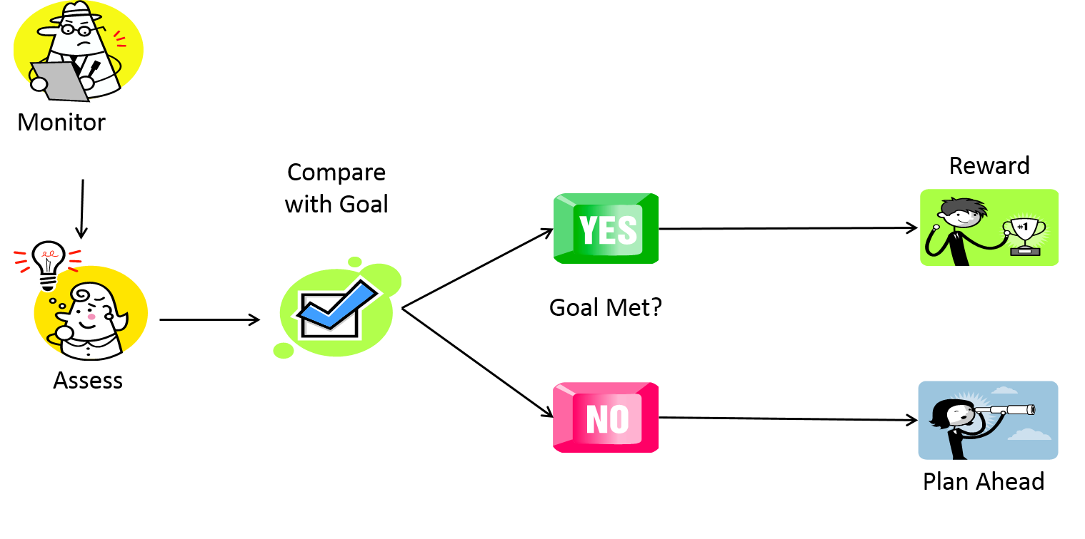
Self-Management Training

Slide 29
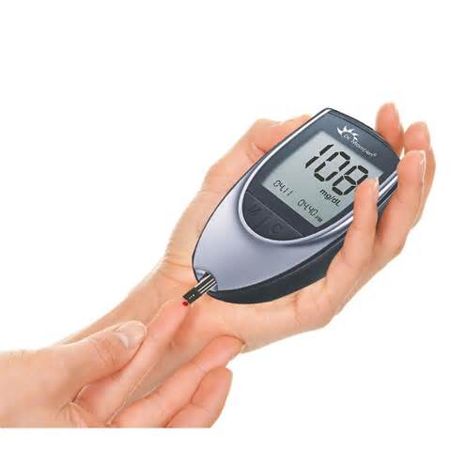
Choosing Good Self-Reinforcements
Notes:
When patients meet their goals, ensure that rewards do not undermine progress (e.g., don’t reward with high sugar foods if the goal was to manage blood sugar)

Slide 30
Making Taking Medication a Habit
Help with organizing medications (i.e. pillbox)
Encourage patient to store all medications together and out of reach of children (i.e. bathroom or kitchen cabinet)
Attach the timing of taking the medication to an existing habit
With breakfast
When brushing teeth (AM and PM)
Before bedtime

Slide 31
Making Taking Medication a Habit
Have a contingency plan if away from home
Single-compartment pill carriers
Carry medicine in purse or bag
Keep in car temporarily (most medications are temperature sensitive)
Engage social supports (i.e. family, friends) to help organize medicines and remind patient

Slide 32
Change That Matters’ Focus on Values/Meaning in Life

Slide 33
Connect Adherence to Values and Meaning
Invite patient to reflect upon:
Why do you want to improve how you take your medicines?
How will improving your use of your medicines impact your life?
How will this change allow you to engage in other, meaningful areas of your life?

Slide 34
Patient Brochure

Slide 35
Noteworthy Features
Handout encourages reader to:
Identify challenges in adherence with a specific medication
Reflect on why this medicine is important
Consider linking taking medication with a daily behavior (e.g., brushing teeth)
Ask someone to help with medication organization and reminders
Use alarms, apps, and pill organizers

Slide 36
EHR Template

Slide 37
Documentation Template
Assess:
Pt IS/IS NOT using a pill box.
Pt takes medications *** times/day.
Frequency of missing a dose of any prescribed medication: {Never, Almost never, 1-2 times/week, More than 2x/week}
Barriers to adherence: {Memory, confusion, side effects, cost, dislike taking pills, insurance coverage/restrictions, access, sheer quantity of pills, Other}
Reasons to improve adherence: {Health, mood, family, other)

Slide 38
Documentation Template (cont.)
Plan:
Ask patient to write goal on back page of handout
Specific goal: ***
Referral to Pharmacy : Yes/No
Follow up
Change That Matters Getting the Most from your Medicine handout given.
*** minutes spent counseling patient regarding medication adherence to improve overall health.

Slide 39
After Visit Summary (AVS) Template
Today we talked about improving how you take your medicine.
You stated you want to ***. To do this, you plan to ***.
Here are some other ideas to help with your medicines:
Set up automatic refills with your pharmacy
Put your medications in a pill box at the start of every week
Link taking your medicines with a specific behavior every day.
Ask a family member or friend to remind you
Set a reminder alarm on your phone
Download a free mobile app to give you reminders and track your medications

Slide 40
Structured Practice

Slide 41
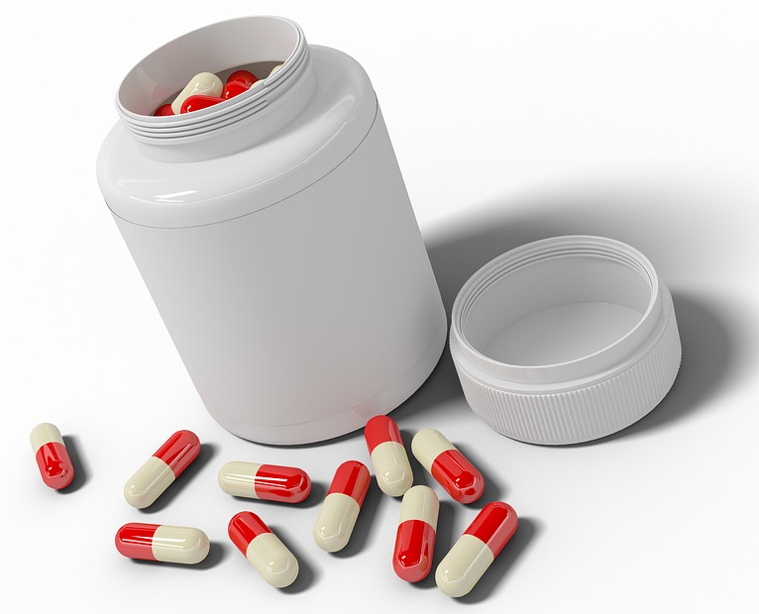
Practice Activity
Partner with someone near you!
One person will be the patient
One person with be the provider
Think of a patient on your panel that you would like to improve their adherence (e.g., using CPAP, taking pills, insulin regimen). Imagine him/her for the role play.
Using the pamphlet and EHR template, role play the discussion.
Take about 5 minutes and then switch roles

Slide 42
Responding to Common Challenges

Slide 43
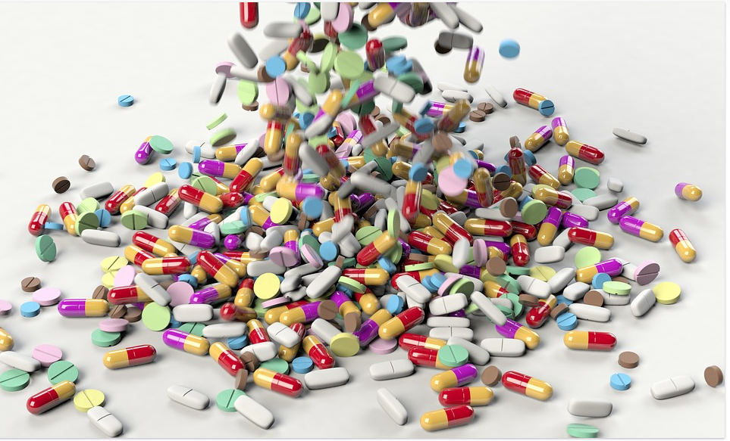
But Doc…
I hate taking pills.
It seems like every time I come
to the doctor I get MORE pills!
Acknowledge taking pills can be difficult.
Re-focus on why the medicine is important.
Brainstorm options: taking with food, consulting with pharmacy regarding possible decreases in quantity of pills.

Slide 44
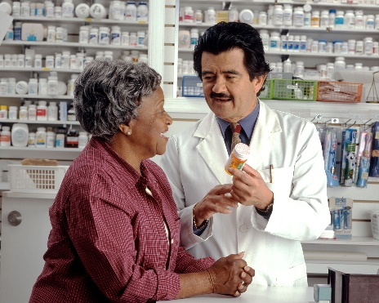
But Doc…
I cannot tell that it really does anything…
Actually, I feel worse than before I started!
Acknowledge and explore ways to manage side effects.
Explain how some medicines may prevent the development of more serious problems.
Use shared decision making regarding dose and/or trying other options

Slide 45
Resources for Further Learning

Slide 46
Apgar, T., & Nunlist, M. M. (2016). Practical Ways to Improve Medication Adherence. Family Practice Management, 23(5), 52-52.
Brown, M. T., & Sinsky, C. A. (2013). Medication adherence: We didn't ask and they didn't tell. Family Practice Management, 20(2), 25-30.
Costa E, Giardini A, Savin M, et al. (2015). Interventional tools to improve medication adherence: review of literature. Patient Prefer Adherence, 9, 1303–1314.
Hooker S, Punjabi A, Boyle L, et al. (2018). Encouraging health behavior change: Eight evidence-based strategies. Family Practice Management, 25(2), 31-36
Viswanathan M, Golin CE, Jones CD, et al. (2012). Interventions to improve adherence to self-administered medications for chronic diseases in the United States: A systematic review. Ann Intern Med, 157(11), 785-795.

Slide 47
Change That Matters Team
Stephanie A. Hooker, PhD, MPH (co-PI)
Michelle D. Sherman, PhD, ABPP (co-PI)
Katie Loth, PhD, MPH Jean Moon, PharmD, BCACP
Kacey Justesen, MD Andrew Slattengren, DO
Sam Ngaw, MD Anne Doering, MD
Marc Uy, BA, MPH

Slide 48
Special Thanks
University of Minnesota Academic Health Center
and
National Institute for Integrated Behavioral Health
for financial support for their development and evaluation
of Change that Matters

