Slide 1
Depression
www.ChangeThatMatters.umn.edu

Slide 2
Consider this Vignette
24 year old female (“Kate”).
1st time at your primary care clinic. No available past medical records.
Presenting symptoms: insomnia, crying spells, low energy, irritability, and social isolation. Hopes you can help her to “feel better.”
Been depressed for years, but worsened over past couple months.
PHQ9 = 24 (denies suicidal thoughts)
What’s your default treatment approach?

Slide 3
Break into groups of 3-4 people
Brainstorm. List as many possible etiologies you can, including but not limited to:
DSM diagnoses
Medical issues
Other potential causes
Come back to large group
Create list of all possible causes.
Discuss appropriate treatment for each cause.
Notes:
Key point: Depressive symptoms can be rooted in many different causes. While the knee-jerk (& perhaps quickly) reaction may be to prescribe a medication, it’s important to take the time to explore the etiology to provide effective treatment.

Slide 4
Brief Overview

Slide 5
DSM Diagnoses including Prominent Depressive Symptoms
Adjustment disorder with depressed mood
Persistent depressive disorder (formerly dysthymia)
Major depressive disorder
Bipolar disorder
PMDD (premenstrual dysphoric disorder)
Schizoaffective disorder

Slide 6
Other DSM diagnoses that commonly have comorbid depressive symptoms
PTSD
Substance use disorder and other addictions
Personality disorders (especially borderline)
Anxiety disorders
Panic, Social phobia, Generalized anxiety disorder, Obsessive compulsive disorder (OCD)
Eating disorders
Gender dysphoria

Slide 7
Medications than can cause depressive symptoms (use of several of these medications may increase risk of depression)
Narcotics
Antihypertensive medications
Proton pump inhibitors
Hormone replacement therapy (HRT)
Steroids
Beta-blockers
Benzodiazepines
Parkinson’s medications
Anticonvulsants
Stimulants
Statins
Anticholinergic drugs
Notes:
Five 2-year cycles (2005-2006 through 2013-2014) of the National Health and Nutrition Examination Survey, representative cross-sectional surveys of US adults aged 18 years or older, were analyzed for use of medications with depression as a potential adverse effect (n = 26 192 adults)
Qato DM, Ozenberger K, Olfson M. Prevalence of Prescription Medications With Depression as a Potential Adverse Effect Among Adults in the United States. JAMA. 2018;319(22):2289–2298. doi:10.1001/jama.2018.6741

Slide 8
Life situations and medical issues that often involve depressive symptoms
Grief
Partner relational problem
End of a relationship / divorce
Infertility
Miscarriage
Abuse / Intimate partner violence
Post-partum depression
Hypothyroidism
Parkinson’s disease
Dementia / delirium
Stroke
Cardiac issues
Chronic pain
Fibromyalgia
Multiple Sclerosis
Diabetes
Notes:
Among 12.9% of those with lifetime MDD, all episodes occurred just after the death of someone close and lasted less than 2 months (Hasin et al. 2018; national survey of MDD)

Slide 9
Take Home Message
Depressive symptoms can be rooted in many different causes.
Assessment takes time and energy.
Appropriate treatment follows accurate assessment

Slide 10
Major Depressive Disorder (DSM-5)
5 or more of the following symptoms for at least 2 weeks and representing a change from previous functioning (must include depression or anhedonia)
Depressed mood
Anhedonia
Significant change in weight or appetite
Insomnia or hypersomnia
Psychomotor agitation or retardation
Fatigue or loss of energy
Feelings of worthlessness or excessive or inappropriate guilt
Diminished ability to think or concentrate
Recurrent thoughts of death, suicidal ideation without a specific plan, or a suicide attempt or a specific plan for committing suicide
Must cause clinical significant distress or impairment. Need to rule out substance or medical condition as cause. Not better explained by another psychiatric disorder.

Slide 11
Prevalence of MDD (US adults)
10%: One-year prevalence
21%: Lifetime prevalence
Higher rates among
Women than men
Young adults (18-29)
People with lower incomes
White people (than African American, Asian & Hispanic) – however, chronicity and burden of depression may be higher in non-White adults; non-Whites may be less likely to receive treatment as well
Notes:
National survey of 36 309 US adults
National Epidemiologic Survey on Alcohol and Related Conditions III (NESARC-III) is a nationally representative 2012-2013 survey of DSM-5 psychiatric and SUDs in adults 18 years or older
Hasin DS, Sarvet AL, Meyers JL, et al. Epidemiology of Adult DSM-5 Major Depressive Disorder and Its Specifiers in the United States. JAMA Psychiatry. 2018;75(4):336–346. doi:10.1001/jamapsychiatry.2017.4602
McQuaid et al 2019

Slide 12
Course of MDD
Mean age of onset of MDD: 29 years
Mean of 3.85 episodes in a lifetime
Median duration of longest (or only) episode: 26 weeks
~1 in 3 with lifetime MDD receive no treatment
Notes:
Hasin DS, Sarvet AL, Meyers JL, et al. Epidemiology of Adult DSM-5 Major Depressive Disorder and Its Specifiers in the United States. JAMA Psychiatry. 2018;75(4):336–346. doi:10.1001/jamapsychiatry.2017.4602

Slide 13
Persistent Depressive Disorder (DSM-5) Lifetime prevalence: 3-6%
A. Depressed mood for most of the day, for more days than not, as indicated by either subjective account of observation by others, for at least two years.
B. Presence while depressed of >2 of the following:
1. Poor appetite or overeating
2. Insomnia or hypersomnia
3. Low energy or fatigue
4. Low self-esteem
5. Poor concentration or difficulty making decisions
6. Feelings of hopelessness
Must cause clinical significant distress or impairment. Need to rule out substance or medical condition as cause. Not better explained by another psychiatric disorder.
Notes:
Kriston L, von Wolff A, Westphal A, et al. Efficacy and acceptability of acute treatments for persistent depressive disorder: a network meta-analysis. Depress Anxiety 2014;31:621-30

Slide 14
Why Important in Primary Care?
Major Depression is
COMMON: lifetime prevalence of a major depressive episode is 30%
OFTEN MANAGED EXCLUSIVELY BY GENERAL MEDICAL PROVIDERS (~70%)
COMMON CAUSE OF DISABILITY: 2nd leading cause of disability – both in USA & worldwide
RECURRENT: 75% of depressed patients successfully treated by PCP experience another major depressive episode in the decade following their initial treatment
HIGHLY COMORBID WITH MEDICAL PROBLEMS
Notes:
Kessler RC, Petukhova M, Sampson NA, Zaslavsky AM, Wittchen H. Twelve-month and lifetime prevalence and lifetime morbid risk of anxiety and mood disorders in the United States. Int J Methods Psychiatr Res 2012;21:169-184.
Olfson M, Blanco C, Marcus SC. Treatment of Adult Depression in the United States. JAMA Intern Med. 2016;176(10):1482–1491. doi:10.1001/jamainternmed.2016.5057
Vos, T., Barber, R.M., Bell, B., Bertozzl-Villa, A., Blrukov, S.,Bolliger, I., . . . Murray, C.J.L. (2015). Global, regional, and national incidence, prevalence, and years lived with disability for 301 acute and chronic diseases and injuries in 188 countries, 1990-2013: Asystematic analysis for the global burden of disease study 2013. The Lancet, 386(9995), 743–800
Conradi HJ, Bos EH, Kamphuis JH, de Jonge P. The ten-year course of depression in primary care and long-term effects of psychoeducation, psychiatric consultation and cognitive behavioral therapy. J Affect Disorders 2017;217:174-182.

Slide 15
Suicide
Suicide rates in the US have risen by 30% from 2000-2016
Age-adjusted suicide rate in 2017: 14/100,000
2nd leading cause of death ages 10-34
4th leading cause of death ages 35-54
2/3 of those who die by suicide had depression at time of the act
Suicide management is beyond the scope of this lecture.
Excellent resource listed in resources section
Notes:
National Center for Health Statistics analysis of data from the National Vital Statistics System.
Centers for Disease Control and Prevention (CDC) WISQARS Leading Causes of Death Reports,
https://afsp.org/about-suicide/suicide-statistics/
Centers for Disease Control and Prevention(CDC). (2012). Web-based injury statistics query and reporting system (WISQARS™).

Slide 16
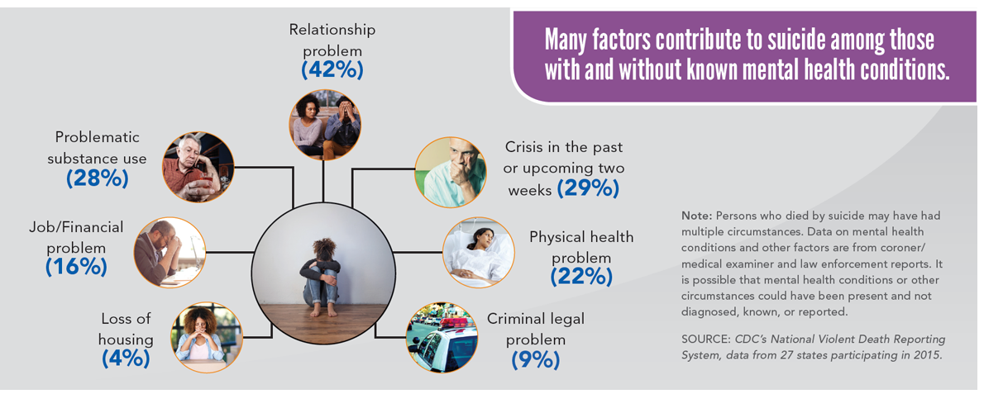
Notes:
https://www.cdc.gov/vitalsigns/suicide/infographic.html#graphic3
Just remember that many life stressors may increase the risk of suicide. Consider suicide risk when you hear these factors

Slide 17
Assessment Strategies

Slide 18
Guidelines
U.S. Preventive Services Task Force (USPSTF) recommendation
Routine screening for depression of the general adult population, pregnant and postpartum women
Notes:
Siu AL, US Preventive Services Task Force (USPSTF), Bibbins-Domingo K, et al. Screening for depression in adults: U.S. preventive services task force recommendation statement. JAMA 2016;315:380-87

Slide 19
Assessment Tools
PHQ2 / PHQ9
Geriatric Depression Scale (15 yes/no questions and can be used with patients with mild to moderate dementia)
Beck Depression Inventory (BDI)

Slide 20
Assessment
When you see elevated score on screener:
Suggested wording:
Thanks for completing this form about depression.
I noticed that your score is somewhat high today.
I wonder if we could talk a bit about your mood today.
How have you been feeling lately?
Given high comorbidity with anxiety, may consider giving GAD7

Slide 21
Important to rule out mania / hypomania, especially if considering an antidepressant
Have you experienced sustained periods of feeling uncharacteristically energetic?
Have you had periods of not sleeping, but not feeling tired?
Have you felt that your thoughts were racing and couldn't be slowed down?
Have you had periods where you were excessive in sexual interest, spending money, or taking unusual risks?
Episodes lasting for most of the day for at least 4 days?
Impact on daily & occupational functioning?

Slide 22
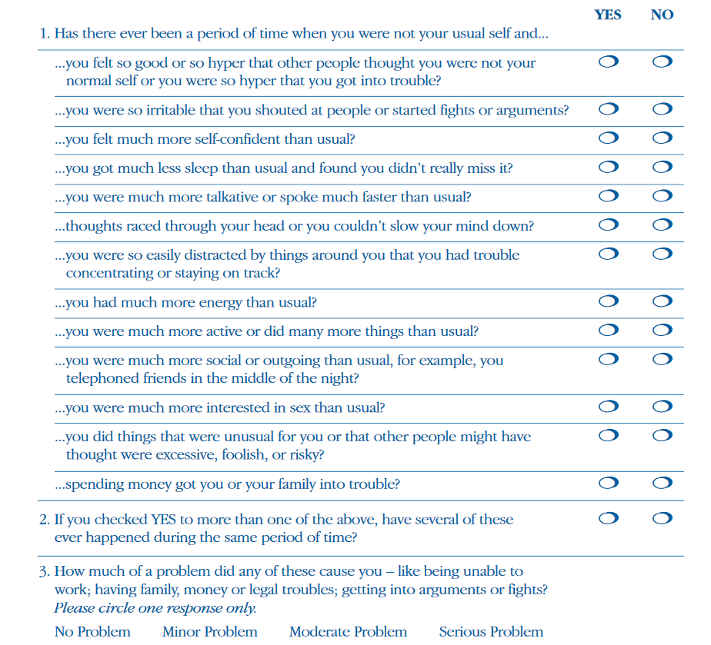
Formal Assessment of Bipolar Disorders
Mood Disorder Questionnaire
(MDQ)
Hirshfeld et al (2000)
Notes:
Hirschfeld, Robert M.A., M.D., Janet B.W. Williams, D.S.W., Robert L. Spitzer, M.D., Joseph R. Calabrese, M.D., Laurie Flynn, Paul E. Keck, Jr., M.D., Lydia Lewis, Susan L. McElroy, M.D., Robert M. Post, M.D., Daniel J. Rapport, M.D., James M. Russell, M.D., Gary S. Sachs, M.D., John Zajecka, M.D.,“Development and Validation of a Screening Instrument for Bipolar Spectrum Disorder: The Mood Disorder Questionnaire.” American Journal of Psychiatry157:11 (November 2000) 1873-1875
http://www.sadag.org/images/pdf/mdq.pdf
Scoring:
1. “Yes”to seven or more of the 13 items in question number 1; AND
2. “Yes”to question number 2; AND
3. “Moderate”or “Serious”to question number 3; you have a positive screen. All three of the criteria above should be met. A positive screen should be followed by a comprehensive medical evaluation for Bipolar Spectrum Disorder

Slide 23
Evidence-Based Treatments

Slide 24
Treatment guidelines summarized herein are based on:
Clinical Practice Guideline for the Treatment of Depression Across Three Age Cohorts (2019)
Expert panel led by a psychologist and family medicine physician
Reviewed 10 systematic reviews and meta-analyses as well as other literature (that met IOM or ASTAR requirements)
American Psychological Association
Notes:
McQuaid et al (2019)

Slide 25
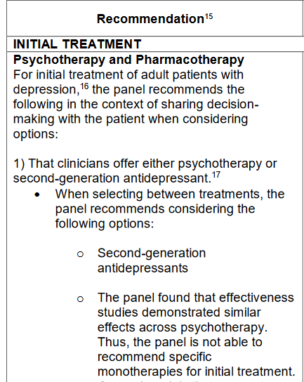
Beginning Treatment of Depression in Adults
Second generation antidepressants
SSRIs and SNRIs
Psychotherapy models with
similar effectiveness:
CBT
interpersonal therapy (IPT)
behavioral therapy
cognitive therapy
psychodynamic therapy
supportive therapy
Notes:
McQuaid et al (2019)

Slide 26
If starting with combined treatment, recommend
Second generation antidepressant
CBT or interpersonal therapy (IPT)
Notes:
McQuaid et al (2019)

Slide 27
If therapy or medications are ineffective or unacceptable, recommend:
Exercise monotherapy
St John’s Wort Monotherapy
If neither of those are acceptable or available, consider
Bright light therapy
Yoga
(conditional recommendations for use)
Notes:
McQuaid et al (2019)

Slide 28
Subclinical depression, recommend
Psychotherapy
Notes:
McQuaid et al (2019)

Slide 29
Facts on Psychotherapy
Average effects of therapy are larger than that produced by many medical treatments.
Therapy teaches life skills that last beyond the course of treatment. The results last longer than medications.
Therapy rarely produces harmful side effects.
CBT and Interpersonal therapy have been found to be effective in the primary care setting (compared to usual care or placebo)
Non-face-to-face adaptations also show promise
Notes:
Linde, Klaus, et al. "Effectiveness of psychological treatments for depressive disorders in primary care: systematic review and meta-analysis." The Annals of Family Medicine 13.1 (2015): 56-68.

Slide 30
Medications
No demonstrated clear superiority in efficacy across antidepressants.
Consider Mayo clinic’s shared decision making website
https://shareddecisions.mayoclinic.org/decision-aid-information/decision-aids-for-chronic-disease/depression-medication-choice/
Patients consider medication choices based on:
Cost, sexual issues, sleep, weight change, and stopping approach
Notes:
Gartlehner, Gerald, et al. "How should primary care doctors select which antidepressants to administer?." Current psychiatry reports 14.4 (2012): 360-369.
Simon, Gregory, and P. Ciechanowski. "Unipolar major depression in adults: Choosing initial treatment." UpToDate. http://www. uptodate. com/contents/unipolar-major-depression-in-adults-choosing-initial-treatment. Accessed November 8 (2016).

Slide 31
Select medication based on factors such as:
Specific depressive symptoms
Comorbid conditions
Safety
Side effect profile (e.g., sedating, weight gain, impact on sexual functioning)
Concurrent medications (potential interactions)
Ease of use (e.g., frequency of administration)
Patient preference or expectations
Cost and insurance coverage
Response to antidepressants during prior episodes
Family (first degree relative) history of response to antidepressants
Notes:
Gartlehner, Gerald, et al. "How should primary care doctors select which antidepressants to administer?." Current psychiatry reports 14.4 (2012): 360-369.
Simon, Gregory, and P. Ciechanowski. "Unipolar major depression in adults: Choosing initial treatment." UpToDate. http://www. uptodate. com/contents/unipolar-major-depression-in-adults-choosing-initial-treatment. Accessed November 8 (2016).

Slide 32
Key messages to give patients when starting antidepressants
Side effects often precede therapeutic benefit.
Side effects typically recede over time.
Most people should be on medication at least 6-12 months after adequate response to the medicine.
Although you may start feeling better in as little as 2 weeks, it takes more time for full response and remission.
Take the medication as prescribed, even after you feel better.
Do not stop taking the medication without calling your clinician.
Notes:
Without long-term antidepressant treatment, major depressive relapses and recurrences occur in 50-80% of patients (American Psychiatric Association, 2010).
Trangle M, Gursky J, Haight R, Hardwig J, Hinnenkamp T, Kessler D, Mack N, Myszkowski M. Institute for Clinical Systems Improvement. Adult Depression in Primary Care. Updated March 2016

Slide 33
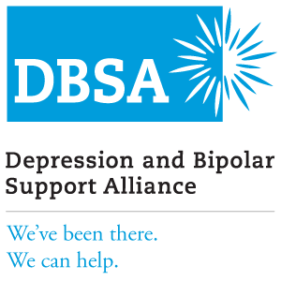
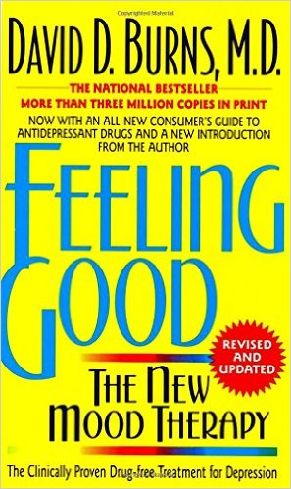
Other Treatment Options
Peer Support groups – Depression and Bipolar Support Alliance: https://www.dbsalliance.org/
Physical exercise
Meditation
Self-help books
Mobile apps
Online CBT– Beating the Blues
Notes:
Haq, Aazaz U., et al. "Response of depression to electroconvulsive therapy: a meta-analysis of clinical predictors." (2015): 1374-1384.
Van Diermen, Linda, et al. "Prediction of electroconvulsive therapy response and remission in major depression: meta-analysis." The British journal of psychiatry 212.2 (2018): 71-80.
Rebar, Amanda L., et al. "A meta-meta-analysis of the effect of physical activity on depression and anxiety in non-clinical adult populations." Health psychology review 9.3 (2015): 366-378.
Cooney, Gary M., et al. "Exercise for depression." Cochrane database of systematic reviews 9 (2013).
Goyal, Madhav, et al. "Meditation programs for psychological stress and well-being: a systematic review and meta-analysis." JAMA internal medicine 174.3 (2014): 357-368.

Slide 34
Electroconvulsive Therapy (ECT)
Brief electrical stimulation of the brain while under anesthesia.
Response rate:
Patients with major depression: 70%
Patients with treatment-resistant depression: 58%
Indications:
Depression with psychotic features (American Psychiatric Association recommends ECT as 1st line treatment)
Severe depression / Catatonia
Treatment-resistant depression
Elderly patients
Pregnancy
Risks
Common side effects: Confusion, headaches, nausea, fatigue
Retrograde amnesia (usually temporary)
Notes:
Haq, Aazaz U., et al. "Response of depression to electroconvulsive therapy: a meta-analysis of clinical predictors." (2015): 1374-1384.
Van Diermen, Linda, et al. "Prediction of electroconvulsive therapy response and remission in major depression: meta-analysis." The British journal of psychiatry 212.2 (2018): 71-80.

Slide 35
Emerging Treatments
Ketamine infusion therapy
Vagus nerve stimulation (VNS)
Repetitive transcranial magnetic stimulation (rTMS)
Deep brain stimulation (DBS)
Light therapy

Slide 36
Family Support
NAMI: National Alliance on Mental Illness
Family to Family Course
Free peer-led, manualized education classes for adults who care about someone living with a mental illness
www.nami.org
Research (RCT) has found participants have improved coping, illness knowledge, problem-solving skills, & empowerment
Notes:
Dixon, Lisa B., et al. "Outcomes of a randomized study of a peer-taught family-to-family education program for mental illness." Psychiatric Services 62.6 (2011): 591-597.

Slide 37
Support for Offspring of Parents living with Depression
Especially important in Family Medicine to think systemically
Offspring are at elevated risk for developing mental illness
Opportunity for prevention and early intervention by identifying and providing supports early
Notes:
2 books created specifically for these youth: “Wishing Wellness: A workbook for children of parents with mental illness” – Lisa Clarke
“I’m not alone: A teen’s guide to living with a parent who has a mental illness” – Michelle & DeAnne Sherman (www.SeedsofHopeBooks.com)
Children whose parent has major depression are at many times increased risk for developing both externalizing (acting out) and internalizing (depression and anxiety) problems.
Rates of child psychiatric diagnosis among offspring of depressed parents range from 30-50% (vs. 20% in general population).
These children are more likely to experience developmental delays, poorer school performance, and problems with peers than children whose parents do not have mental illness.
Goodman SH, Rouse MH, Connell A, Broth M, Hall C, and Heyward D. Maternal depression and child psychopathology: A meta-analytic review. Clin Child Fam Psych 2011; 14: 1–27.
Reupert AE, and Kowalenko NM. Children whose parents have a mental illness: Prevalence, need and treatment. The Medical Journal of Australia 2013; 199(3 Suppl): S7-9.

Slide 38
Change That Matters’ Focus on Values and Meaning in Life

Slide 39
Depression and Meaning
When people feel depressed, they often withdraw from meaningful activities
A powerful intervention is to reconnect to a source of meaning and engage in activities that are meaningful, such as:
Relationships
Work or volunteering
Education or training (growth)
Citizenship or community life

Slide 40
You only have 24 hours a day…
How do you want to spend those hours?
Questions to ask:
What really matters to me?
What makes my life meaningful?
How can I help someone else?
How can I use my skills/talents to make a difference

Slide 41
Tool for Addressing in Primary Care
Behavioral Activation

Slide 42
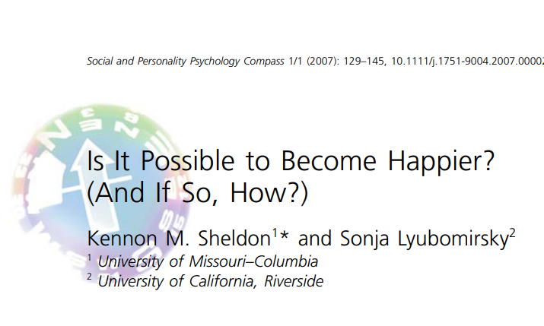
What determines happiness?
Life happens
Genetics
Your choices, actions, thoughts (under your control)
Notes:
Line of research by Sonja Lyubomirsky, PhD., psychologist at University of California-Riverside examining predictors of happiness.
Her research has found that 40% of happiness is due to intentional activity – our choices, actions & thoughts. That is the 40% we’re striving to focus on. Admittedly some things cannot be changed (genetics, some life circumstances), but behavioral activation specifically empowers patients to make changes in their behavior.

Slide 43
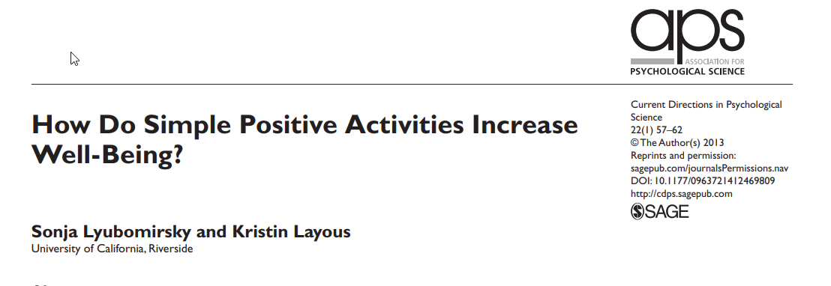
Positive activity model

Slide 44
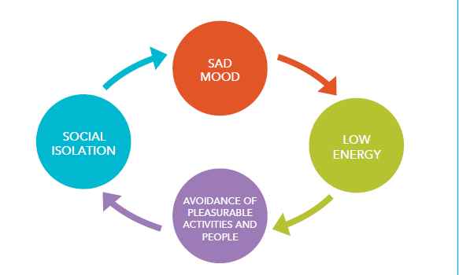
The Depression Spiral
Notes:
When people feel down, they tend to avoid people and activities that they used to enjoy. People often isolate themselves, lose hope, and spend a lot of time resting in bed, watching TV, or playing videogames. Unfortunately, choosing those types of activities can lead people to feel worse
Behavioral activation involves making a CHOICE to do something differently to break the cycle

Slide 45
Behavioral Activation (BA)
enjoyable activities to depressive symptoms
Goal: Help people engage in meaningful activities that align with their values
Low risk and no side effects
Research:
BA is as effective as therapy (CBT) and medication
Improvements in mood persist after active treatment has ended
Notes:
Martel, Addis, Jacobson, 2001
Easy to understand – hard to do
BA May be part of other treatment approaches or used alone
13. Richards DA, Ekers D, McMillan D, et al. Cost and outcome of behavioural activation versus cognitive behavioural therapy for depression (COBRA): A randomised, controlled, noninferiority trial. Lancet 2016;388:871-880. 14. Dobson KS, Hollon SD, Dimijian S et al. Randomized trial of behavioral activation, cognitive therapy and antidepressant medication in the prevention of relapse and recurrence of major depression. J Consult Clin Psych 2008;76(3):468-477.

Slide 46
Rationale for BA
 | Avoidance | Values-based behavior
In the moment | Easy | Hard
Long-term consequences | Being stuck | Rewards and growth
Notes:
Puspitasari, A., L’Amoeureax, T., & Schak, K. (2019). Introduction to behavioral activation. Minnesota Psychological Association workshop.

Slide 47
Role of Physician in BA
Encourage selecting and engaging in pleasant activities
What did you used to like to do?
What were you doing when you were feeling happier?
What gives you a sense of meaning or accomplishment?
Help set SMART goals (specific, measurable, attainable, realistic & timely)
Encourage picking SMALL goals.
Help break large goals into small action steps
Pick first step that has high likelihood of success.
Notes:
Avoid using this to suggest health behavior change (e.g., quitting smoking, weight loss)
Trangle M, Gursky J, Haight R, Hardwig J, Hinnenkamp T, Kessler D, Mack N, Myszkowski M. Institute for Clinical Systems Improvement. Adult Depression in Primary Care. Updated March 2016

Slide 48
Role of Physician in BA
Follow up appointments
Ask about progress and reinforce effort (even if small)
Celebrate success
Explore barriers
Engage in problem-solving
Modify goals if appropriate
Set specific small goal
Notes:
Trangle M, Gursky J, Haight R, Hardwig J, Hinnenkamp T, Kessler D, Mack N, Myszkowski M. Institute for Clinical Systems Improvement. Adult Depression in Primary Care. Updated March 2016

Slide 49
Patient Handout

Slide 51
Noteworthy Features of the Handout
Depression cycle
Specific goal setting for behavioral activation
Tie goal to values
Elicitation of social support
Specific tips (e.g., volunteer, gratitude log, psychotherapy, daily schedule, physical activity)
Crisis resources
Instillation of hope

Slide 52
EHR Templates

Slide 53
Depression Template
Most distressing current depressive symptoms: *** (list of symptoms)
*If patient reports significant SI or intent/plan to harm oneself, consider using .SUICIDEASSESSMENT
Psychosocial stressors: ***
Comorbid psychiatric concerns: (substance use, anxiety, trauma, psychosis, mania, personality, other)
Current treatments: (medication, therapy, exercise, self-help, social support, other ***)
Barriers to behavioral activation: *** (fatigue, low motivation, pain, lack of money/resources to do activities, anhedonia, fear of rejection from others, rumination, other ***)
Reasons to improve mood / engagement with life: *** (more energy, better health, improve relationships with family/friends, feel better about myself, progress toward goals, other ***)

Slide 54
Depression Template (cont.)
Plan: Ask patient to write goal on back page of handout
Specific goal: ***
Referrals: (BFM behavioral health, outside MH facility, psychiatry, IOP, other ***)
Follow-up: ***
Change that Matters Improving Mood handout given.
*** minutes spent counseling patient on behavioral activation to reduce depressive symptoms.

Slide 55
Depression AVS Template
Today we talked about ways to improve your mood.
You set a goal to *** because you want to ***
We will follow up on this plan at your next appointment.
Here are some other ideas to improve your mood:
Get active. Find small ways to be active. A simple walk around the block can lift your mood! Get outside daily.
Reach out to a family member or friend. You may want to talk about how you’re feeling. You might just want to do something to distract yourself. Let people close to you know how they can support you.
Make a daily schedule. Creating routines brings structure to your day. Following through can give you a sense of accomplishment.
Set small goals. Make a list of small goals. Checking things off a list can help you feel good about yourself. Keep working on your goals and don’t give up!
Volunteer. Helping others is a great way to boost your own spirits!
Make a gratitude log. Write down 1-2 things every day that you are grateful for in your life.
Consider therapy. Asking for help takes courage. Having a professional listen and offer support can be very helpful.
Consider medications. Many options are now available to help people living with depression

Slide 56
Structured Practice

Slide 57
Practice Activity
Partner with someone near you!
One person will be the patient
One person with be the provider
Meeting Kate (patient discussed at beginning of lecture) for the first time. You determine diagnosis of major depressive disorder.
Using the handout and EHR smartphrase, work through the behavioral activation intervention
Take about 5-10 minutes

Slide 58
Responding to Common Challenges

Slide 59
But Doc…
I don’t feel like doing it…
Don’t wait until you “feel” like doing it or think too much about it…
The key to changing how you FEEL is changing
what you DO!

Slide 60
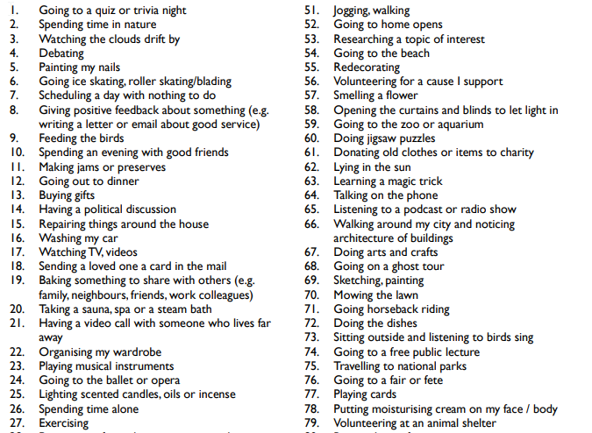
But Doc…
I cannot do what I used to do… Nothing is fun anymore
Acknowledge the loss.
Emphasize importance of trying
new things.
Consider a fun activity list.

Slide 61
But Doc..
I’ve avoided (behavior) for so long. It’s going to be really hard to try again…
Acknowledge avoidance as understandable.
Help patient balance short-term benefits of avoidance with long-term negative consequences
Remind patient WHY he/she wants to do this (tie to his/her values)
Encourage patient to ACT even if he/she doesn’t feel like it
Set specific goal
Notes:
Puspitasari, A., L’Amoeureax, T., & Schak, K. (2019). Introduction to behavioral activation. Minnesota Psychological Association workshop.

Slide 62
Resources for Further Learning

Slide 63
Clinical Practice Guidelines
Trangle M, Gursky J, Haight R, Hardwig J, Hinnenkamp T, Kessler D, Mack N, Myszkowski M. Health Care Guideline: Depression in Primary Care. Institute for Clinical Systems Improvement. Adult Depression in Primary Care. Updated March 2016 https://www.icsi.org/wp-content/uploads/2019/01/Depr.pdf
McQuaid, J.R. et al (2019). Clinical Practice Guideline for the Treatment of Depression Across Three Age Cohorts. American Psychological Association’s Guideline Development Panel for the Treatment of Depressive Disorders. https://www.apa.org/depression-guideline/guideline.pdf

Slide 64
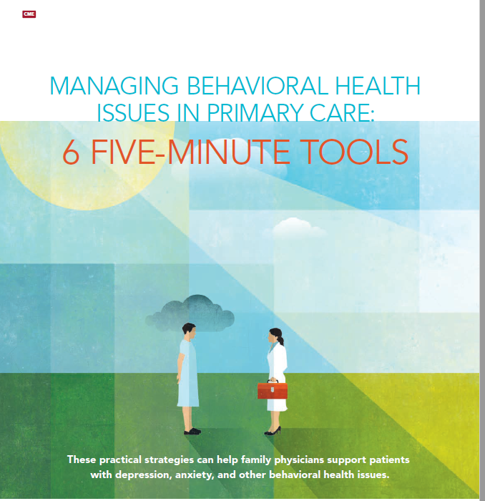
Managing depression in primary care
Sherman, M.D., Miller, L., Keuler, M., Trump, L., & Mandrich, M. (2017). Managing behavioral health issues in primary care: Six 5-minute tools. Family Practice Management, 24(2), 30-35.

Slide 65
Suicide Management in Primary Care
LeFevre, Michael L. Screening for suicide risk in adolescents, adults, and older adults in primary care: US Preventive Services Task Force recommendation statement. Annals of Internal Medicine 160.10 (2014): 719-726.
Richards, J., Parrish, R, et al. (2019). An integrated care approach to identifying and treating the suicidal person in primary care. Psychiatric Times, 36(1).

Slide 66
Change That Matters Team
Stephanie A. Hooker, PhD, MPH (co-PI)
Michelle D. Sherman, PhD, ABPP (co-PI)
Katie Loth, PhD, MPH Jean Moon, PharmD, BCACP
Kacey Justesen, MD Andrew Slattengren, DO
Sam Ngaw, MD Anne Doering, MD
Marc Uy, BA, MPH

Slide 67
Special Thanks
University of Minnesota Academic Health Center
and
National Institute for Integrated Behavioral Health
for financial support for their development and evaluation
of Change that Matters

