Slide 1
Chronic Pain
www.ChangeThatMatters.umn.edu

Slide 2
Patient Scenario
Imagine you are looking ahead at your schedule for the day, and you see a patient, who is new to you, on your schedule. You open their chart, and see the visit is for “chronic pain.”
What thoughts go through your head?
What emotions do you feel?
Notes:
Helpful to consider providers’ internal reactions and possible biases when working with patients living with chronic pain. How might they affect how we provide care?

Slide 3
Brief Overview

Slide 4
Pain Definitions
"an unpleasant sensory and emotional experience arising from actual or potential tissue damage or described in terms of such damage" (International Association for the Study of Pain, 2014)
Acute pain lasts for days to a month after a physiologic insult or injury
Subacute pain lasts from one to three months after an injury
Chronic pain is pain that persists longer than three months

Slide 5
Acute Pain
Normal, predicted physiologic response to an adverse chemical, thermal or mechanical insult associated with surgery, trauma or acute illness/injury
Results from the activation of the pain receptors (nociceptors) at the site of tissue damage
Plays a vital survival role for the individual as it provides a warning that something is wrong and prompts remedial action
Acute pain is thus referred to as having "biologic utility”
Notes:
ICSI Health Care Guideline: Pain: Assessment, Non-Opioid Treatment Approaches and Opioid Management Care for Adults
September 2019

Slide 6
Chronic Pain
Pain that persists beyond the normal time expected for healing
Initial peripheral pain generation is followed by central neuroplastic changes in the brain and spinal cord
Pathophysiologic changes in the central nervous system along with a complex interplay of emotional, psychological and social factors contribute to an individual's worsening ability to function
Persistent, underlying discomfort punctuated with acute flare-ups that may last minutes to hours to several days and lead to impaired functioning. These episodes do not reflect new tissue injury and are almost always self-limiting
Chronic pain has no biologic utility and offers the individual little protection from further injury
Notes:
ICSI Health Care Guideline: Pain: Assessment, Non-Opioid Treatment Approaches and Opioid Management Care for Adults
September 2019

Slide 7
Prevalence
20.4% (50 million) of U.S. adults have chronic pain
8.0% (19.6 million) of U.S. adults have high-impact chronic pain
chronic pain that frequently limits life or work activities
Chronic pain contributes to an estimated $560 billion each year in direct medical costs, lost productivity, and disability programs
Notes:
Chronic pain was defined as pain on most days or every day in the past 6 months, as recommended by the International Association for the Study of Pain,§ modified to account for intermittent pain, and used in both the National Pain Strategy and National Institutes of Health Task Force on Chronic Back Pain (6). As suggested in the National Pain Strategy, high-impact chronic pain was defined as chronic pain that limited life or work activities on most days or every day during the past 6 months (5).
Dahlhamer J, Lucas J, Zelaya, C, et al. Prevalence of Chronic Pain and High-Impact Chronic Pain Among Adults — United States, 2016. MMWR Morb Mortal Wkly Rep 2018;67:1001–1006
Institute of Medicine. Relieving pain in America: a blueprint for transforming prevention, care, education, and research. Washington, DC: National Academies Press; 2011

Slide 8
Factors associated with higher prevalence of chronic pain
Poverty
Less than high school education
Public health insurance
Women
Previously worked but not currently employed
Rural residents
Non-Hispanic whites
Notes:
Dahlhamer J, Lucas J, Zelaya, C, et al. Prevalence of Chronic Pain and High-Impact Chronic Pain Among Adults — United States, 2016. MMWR Morb Mortal Wkly Rep 2018;67:1001–1006

Slide 9
Co-occurring Concerns
Restrictions in mobility
Restrictions in daily activities
Poor perceived health
Reduced quality of life
Anxiety
Depression
Opioid dependence
Notes:
Schappert SM, Burt CW. Ambulatory care visits to physician offices, hospital outpatient departments, and emergency departments: United States, 2001–02. Vital Health Stat 13 2006;13:1–66. PubMedexternal icon
Gureje O, Von Korff M, Simon GE, Gater R. Persistent pain and well-being. A World Health Organization study in primary care. JAMA 1998;280:147–51. CrossRefexternal iconPubMedexternal icon
Smith BH, Elliott AM, Chambers WA, Smith WC, Hannaford PC, Penny K. The impact of chronic pain in the community. Fam Pract 2001;18:292–9. CrossRefexternal icon PubMedexternal icon
Institute of Medicine. Relieving pain in America: a blueprint for transforming prevention, care, education, and research. Washington, DC: National Academies Press; 2011.
Dahlhamer J, Lucas J, Zelaya, C, et al. Prevalence of Chronic Pain and High-Impact Chronic Pain Among Adults — United States, 2016. MMWR Morb Mortal Wkly Rep 2018;67:1001–1006

Slide 10
Assessment and Medical Intervention

Slide 11
Pain Generators
Neuropathic pain
Musculoskeletal pain
Inflammatory pain
Visceral pain
Opioid-induced pain
Notes:
An important factor in treating pain is making the correct diagnosis for the origin of the pain. All treatment flows from here. After taking a comprehensive history and completing a detailed physical, the clinician needs to feel confident that the correct diagnosis has been determined. If there continue to be questions in this regard, further consultation should be sought sooner rather than later to avoid unnecessary burden or harm to the patient.

Slide 12
Neuropathic Pain
Pain caused by a lesion or disease of the central or peripheral somatosensory nervous system
Examples of conditions:
Diabetic peripheral neuropathy, post-herpetic neuralgia
Historical features:
Pain characterized as burning, stinging or "pins and needles" sensation
Physical exam findings:
Allodynia (pain due to a stimulus that does not provoke pain)
Hyperalgesia (increased sensitivity to pain) with or without sensory or motor deficits
Notes:
(International Association for the Study of Pain, 2014).

Slide 13
Neuropathic Pain

Slide 14
Musculoskeletal Pain
Pain caused by a lesion or disease of the musculoskeletal system including muscles, ligaments, tendons, cartilaginous structures and joints
Examples of conditions:
Axial or radicular spine pain, degenerative joint disease
Historical features:
Anatomically localized or more diffuse pain characterized as aching, dull with or without sharp exacerbations with movement or weight-bearing activities
Physical exam:
Localized tenderness, joint deformity with or without weakness attributed to pain
Notes:
(International Association for the Study of Pain, 2014).

Slide 15
Musculoskeletal Pain

Slide 16
Inflammatory Pain
Pain caused by an inflammatory process (e.g., infection, autoimmune), which is generally associated with the infiltration of immune cells and tissue damage
Examples of conditions:
Rheumatoid arthritis, infected joint
Historical features:
Progressive pain characterized as sharp, lancinating with or without increased pain with movement of the involved anatomical region or signs and symptoms of an infectious process
Physical exam:
Tenderness, erythema, swelling, increased warmth of the involved anatomical region with or without signs and symptoms of an infectious process
Notes:
(International Association for the Study of Pain, 2014).

Slide 17
Inflammatory Pain

Slide 18
Visceral Pain
Pain caused by a lesion or disease involving the thoracic, abdominal or pelvic viscera
Examples of conditions:
Dyspepsia, irritable bowel syndrome, endometriosis, non-cardiac chest pain, chronic angina
Historical features:
Intermittent pain characterized as sharp or dull with increased pain with engagement of the involved anatomical region with or without signs and symptoms of an infectious process
Physical exam:
Localized tenderness of the involved anatomical region with or without signs and symptoms of an infectious process

Slide 19
Opioid-induced Pain
Pain caused by adaptation of the opioid receptors to chronic exposure to opioids or a physiologic reaction to withdrawal of opioids or as a side effect of opioids
Examples of conditions:
Opioid withdrawal, opioid-induced hyperalgesia and opioid tolerance
Historical features:
Dependent upon condition
Physical exam:
Dependent upon condition
Notes:
Historical features
Opioid withdrawal: Occurs following abrupt cessation or acute opioid dose reduction. Clinical symptoms of withdrawal may occur within 24 hours of the dose change, and latent symptoms may persist for up to six to eight weeks. Complete resolution of discomfort with administration of opioids also suggests withdrawal. Asking patients if they have opioids remaining at home provides valuable information. Opioid-tolerant patients without any opioids are more likely to be in withdrawal.
Opioid-induced hyperalgesia: Refers to a pronociceptive process that develops in response to longer- term opioid exposure and is manifested clinically by a change in the characteristics of preexisting pain (e.g., burning, diffuse pain), extension of pain beyond the dermatomal distribution of preexisting pain, worsening of pain with opioid dose escalation, and improved analgesia with opioid dose reduction.
• Opioid tolerance: Refers to a desensitization process manifested clinically as reduced analgesia to previously therapeutic dosages of opioids, no change in the characteristics or dermatomal distribution of preexisting pain, improved analgesia with dose escalation, and reduced analgesia with opioid dose reduction.
Physical exam:
Opioid withdrawal: Withdrawal is characterized by myalgias, arthalagias, anxiety, gastrointestinal complaints (diarrhea, emesis), chills, diaphoresis, opioid craving, piloerection, dilated pupils, rhinor- rhea, yawning, tachycardia, hypertension and sleep disruption.
Opioid hyperalgesia: The physical exam is non-localizing.
Opioid tolerance: Patients who are chronically exposed to opioids may have an unremarkable exam despite being on opioids. If anything, they demonstrate miosis and mild psychomotor slowing, including slowed speech.

Slide 20
Opioid-induced Pain

Slide 21
Addressing Chronic Pain
Conduct a comprehensive medical assessment initially, periodically and whenever there is a lack of improvement
- Use of validated tools to assess quality-of-life, function and pain
- Determination of the pain generator
- Assessment for comorbidities
- Discussion of patient barriers
Notes:
ICSI Health Care Guideline: Pain: Assessment, Non-Opioid Treatment Approaches and Opioid Management Care for Adults
September 2019

Slide 22
Addressing Chronic Pain
Active patient engagement in the creation and execution of the biopsychosocial treatment plan is a critical factor of success
Develop a treatment plan for pain that uses all available modalities and avoids making medications, especially opioids, the sole focus of treatment
Treatment should focus on restoration of function, not elimination of pain
Notes:
ICSI Health Care Guideline: Pain: Assessment, Non-Opioid Treatment Approaches and Opioid Management Care for Adults
September 2019

Slide 23
Assessment Tools

Slide 24
Pain Rating Scale
0 | 1 | 2 | 3 | 4 | 5 | 6 | 7 | 8 | 9 | 10
No pain |  |  |  |  |  |  |  |  |  | Worst pain imaginable
*Ratings of 4 or higher should get further assessment
Issues:
Hard to compare across patients
Pain ratings may not change but function can
Notes:
McGeary, D., McGeary C., & Gatchel, R. J. (2014). Managing chronic pain in primary care. In C. M. Hunter, C. L. Hunter, & R. Kessler (Eds.), Handbook of clinical psychology in medical settings: Evidence-based assessment and intervention (pp. 589-623). New York, NY: Springer.

Slide 25
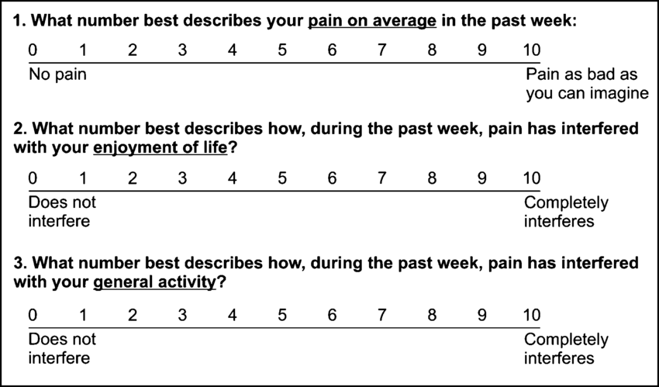
PEG
PEG (3-items)
Notes:
Krebs, E. E., Lorenz, K. A., Bair, M. J., Darnush, T. M., Wu, J., Sutherland, J. M., Asch, S. M., Kroenke, K. (2009). Development and initial validation of the PEG, a three-item scale assessing pain intensity and interference. Journal of General Internal Medicine, 24, 733-738.

Slide 26
Evidence-Based Treatments

Slide 27
Evidence-based Behavioral Interventions
Developing realistic expectations and goals
Relaxation training
Cognitive behavioral therapy
Activity pacing
Family interventions

Slide 28
Developing realistic expectations
Sometimes patients believe that treatment will substantially decrease or eliminate pain
Shift goal to:
Increased distress tolerance
Improved ability to achieve valued goals (despite pain)
Decrease importance of medications as the primary (or sole) method of managing pain
Increase physical activity across multiple life domains
Notes:
Dobmeyer, A. (2018). Psychological treatment of medical patients in integrated primary care. Washington, DC: American Psychological Association.

Slide 29
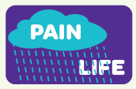
Developing realistic expectations
Notes:
The first box often represents where patients with chronic pain are at when they first come to see us. Pain is consuming their life. Ideally, many would want that pain cloud to go away completely, but that is not usually a realistic expectation when it comes to chronic pain. Alternatively, we say we want to help patients broaden their life by having more activities that enrich life, and we will use multimodal approaches to manage pain, which could decrease it some, but pain will likely still be there.

Slide 30
Relaxation Training
Relaxation exercises can lead to decreased perception of pain
Provide rationale
Practice relaxation exercises
Deep breathing
Progressive muscle relaxation
Autogenic relaxation
Sources
YouTube
Apps (e.g., Headspace, Calm, Breathe)
Therapy
Notes:
Dobmeyer, A. (2018). Psychological treatment of medical patients in integrated primary care. Washington, DC: American Psychological Association.

Slide 31
Cognitive Behavioral Therapy
Target maladaptive thoughts related to pain
“This pain should completely resolve.”
“My functioning should completely return to normal.”
“My pain is a warning that I should stop doing activities.”
“I am a burden to others.”
“My future is bleak if my pain continues.”
Thought
“Pain means to stop doing activity”
Emotions
Fear
Relief
Sadness
Behavior
Disengage
Stop moving
Notes:
Dobmeyer, A. (2018). Psychological treatment of medical patients in integrated primary care. Washington, DC: American Psychological Association.

Slide 32
Cognitive Behavioral Therapy
Help patient change thoughts that get in the way of successful pain management
Refer to psychologist with specialty in pain
New Thought
“Pain is just a signal; I can move despite being in pain”
Emotions
Courage
Determination
Behavior
Engage in values-based action
Notes:
Dobmeyer, A. (2018). Psychological treatment of medical patients in integrated primary care. Washington, DC: American Psychological Association.

Slide 33
A Note on Pain and Suffering
Pain is the physical signal; Suffering is the emotional experience
Patients who experience more negative emotion about the pain (i.e., who suffer) actually experience worse pain
It may be helpful to help patients distinguish the difference between pain and suffering

Slide 34
Pain and Depression
There is a significant overlap between pain & depressive symptoms
Approximately 34% of people in a depressive episode experience “severe pain”
60% of patients with chronic pain meet criteria for depression
CBT can treat depression and pain simultaneously
Notes:
Outcalt, S. D., Kroenke, K., Krebs, E. E., Chumbler, N. R., Wu, J., Yu, Z., & Bair, M. J. (2015). Chronic pain and comorbid mental health conditions: independent associations of posttraumatic stress disorder and depression with pain, disability, and quality of life. Journal of behavioral medicine, 38(3), 535-543.
Stubbs, B., Vancampfort, D., Veronese, N., Thompson, T., Fornaro, M., Schofield, P., ... & Koyanagi, A. (2017). Depression and pain: primary data and meta-analysis among 237 952 people across 47 low-and middle-income countries. Psychological medicine, 47(16), 2906-2917.
Rayner, L., Hotopf, M., Petkova, H., Matcham, F., Simpson, A., & McCracken, L. M. (2016). Depression in patients with chronic pain attending a specialised pain treatment centre: prevalence and impact on health care costs. Pain, 157(7), 1472.

Slide 35
Pacing
Often, activity levels become contingent on pain
Patients have patterns of overuse-underuse
Need to shift activity levels to be contingent on time or goals
Approach:
Establish baseline (e.g., how long can
patient walk now)
Set goal (e.g., increase time by 5%
each day)
Encourage patient to reach goal (not more or less)
Notes:
Dobmeyer, A. (2018). Psychological treatment of medical patients in integrated primary care. Washington, DC: American Psychological Association.

Slide 36
Family Interventions
Sometimes family members’ response to patients’ pain can influence patients’ pain experience
Encourage family members to:
Support patient self-management
Ignore unhelpful coping behaviors, such as resting and inactivity
Reward positive behaviors, such as exercise and paced activities
Decrease hovering and overhelping
Notes:
Dobmeyer, A. (2018). Psychological treatment of medical patients in integrated primary care. Washington, DC: American Psychological Association.

Slide 37
Tool for Addressing in Primary Care

Slide 38
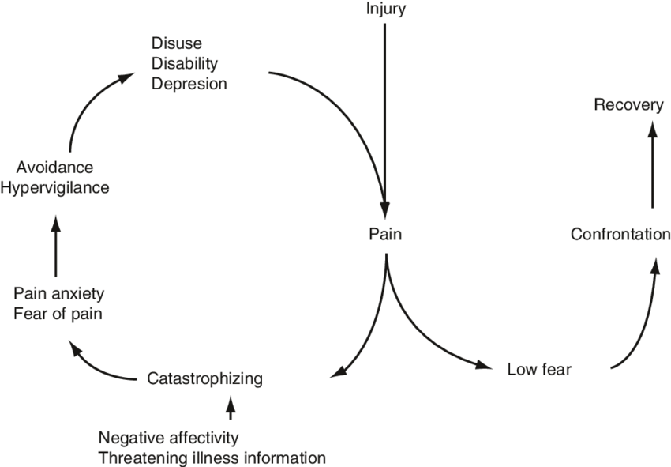
Rationale
Patients in pain tend to avoid activities involving any movement for fear of exacerbating pain
Although this approach may be adaptive for acute pain, it is commonly results in adverse impacts on physical, emotional, and occupational functioning
Fear Avoidance Model of Chronic Pain
Vlaeyen & Linton, 2000
Notes:
Vlaeyen, J. W., & Linton, S. J. (2000). Fear-avoidance and its consequences in chronic musculoskeletal pain: a state of the art. Pain, 85(3), 317-332.

Slide 39
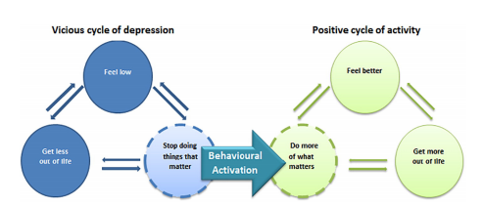
Behavioral Activation
A therapeutic technique that encourages patients to engage in pleasurable activities
Breaks the depression cycle and decreases depressed mood
As effective as cognitive behavioral therapy and medications (Dobson et al., 2008)
Simpler and more cost-effective than cognitive therapy (Richards et al., 2016)
Pass et al., 2018
Notes:
Richards, D. A., Ekers, D., McMillan, D., Taylor, R. S., Byford, S., Warren F. C., …& Finning, K. (2016). Cost and outcome of behavioural activation versus cognitive behavioural therapy for depression (COBRA): A randomized, controlled, non-inferiority trial. Lancet, 388, 871-880. doi: 10.1016/S1040-6736(16)31140-0
Pass, L., Lejuez, C. W., & Reynolds, S. (2018). Brief behavioural activation (Brief BA) for adolescent depression: A pilot study. Behavioural and cognitive psychotherapy, 46(2), 182-194.
Dobson, K. S., Hollon, S. D., Dimidjian, S., Schmaling, K. B., Kohlenberg, R. J., Gallop, R. J., ... & Jacobson, N. S. (2008). Randomized trial of behavioral activation, cognitive therapy, and antidepressant medication in the prevention of relapse and recurrence in major depression. Journal of consulting and clinical psychology, 76(3), 468.

Slide 40
Values
Values are the things we find most meaningful or important to us in life
Patients with chronic pain often disconnect from valuable activities and focus on the pain, which can make people feel “off”
Values-based interventions ask patients to reflect on what is valuable to them and encourage increased engagement in valued activities

Slide 41
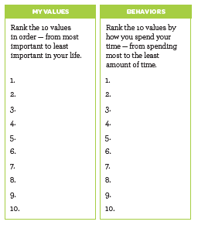
Step 1: Rank Values & Time
Step 1a: Rank values from most to least important (VALUES)
Step 1b: Rank values by how he/she spends their time (BEHAVIOR)

Slide 42
Step 2: Identify discrepancies
Ask patient to reflect on what they notice, including differences between the two lists
What value do they want to spend more time on?

Slide 43
Step 3: Set a SMART goal
Pick one value area to work on. What is a specific goal that they can meet in the next two weeks that works on this goal?
Specify where, when, how much, and with whom.
Elicit potential barriers; problem solve possible solutions.
Set follow-up with patient to see how it went.

Slide 44
Patient Handout

Slide 45
Noteworthy Features of the Handout
Tips to manage chronic pain
Setting realistic expectations
Values assessment
Setting SMART values-based behavioral activation goal
Message to instill hope

Slide 46
EHR Templates

Slide 47
Documentation Template
Assess: Top three values: ***
Identified discrepancies: ***
Plan: Specific goal: ***
Referrals: (BFM behavioral health, outside MH facility, interdisciplinary chronic pain program, other ***)
Follow-up: ***
Change that Matters Managing Chronic Pain handout given.
*** minutes spent counseling patient on managing chronic pain to improve overall health

Slide 48
After Visit Summary (AVS) Template
Today we talked about ways to manage your chronic pain.
You set a goal to ***
We will follow up on this plan at your next appointment.
Here are some other ideas to manage chronic pain:

Slide 49
AVS Template (cont)
Use relaxation and deep breathing strategies to calm your mind and body. Many phone apps and online videos can guide you through progressive muscle relaxation, guided imagery, or meditation.
Move! Regular physical activity can help with muscle aches, pain, and depression. Pace yourself and listen to your body.
Distract yourself. Focusing on the pain can make it feel worse. Get your mind off of the pain by doing a fun activity.
Use heat or ice. Take a warm shower or bath or use a heating pad for 20 minutes a day. Ice packs or cold showers may also help.
Consider alternative therapies. Try chiropractic care, acupuncture, or osteopathic manipulative treatment (OMT).
Try physical therapy. Stretches and strengthening exercises can be helpful.
Consider therapy. Counseling can help you learn strategies to manage pain and get back to enjoying life again.

Slide 50
Structured Practice

Slide 51
Practice Activity
Partner up!
Have one person be the physician, the other the patient
Use pamphlet and EHR template (take 5-10 minutes)
Patient: Rank values & the way you spend your time
Physician – prompt patient to reflect on differences, brainstorm ways to engage in one value area
Co-create an action plan for the patient to do a valued activity in the next week

Slide 52
Responding to Common Challenges

Slide 53
But Doc…
My pain is so bad I don’t think I can do it.
Acknowledge pain is unavoidable
Encourage patient to do what he/she can, despite being in pain
The goal is to live life, with pain

Slide 54
But Doc…
I’ve avoided (behavior) for so long. It’s going to be really hard to try again…
Acknowledge avoidance as understandable.
Help patient balance short-term benefits of avoidance with long-term negative consequences
Remind patient WHY he/she wants to do this (tie to his/her values)
Encourage patient to act even if he/she doesn’t feel like it
Set specific goal
Notes:
Puspitasari, A., L’Amoeureax, T., & Schak, K. (2019). Introduction to behavioral activation. Minnesota Psychological Association workshop.

Slide 55
Resources for Further Learning

Slide 56
Clinical Practice Guidelines
ICSI Health Care Guideline: Pain: Assessment, Non-Opioid Treatment Approaches and Opioid Management Care for Adults (September 2019): https://www.icsi.org/guideline/pain/
Owen GT, Bruel BM, Schade CM, et al. Evidence-based pain medicine for primary care physicians. Proc (Bayl Univ Med Center). 2018;31(1):37-47. doi:10.1080/08998280.2017.1400290

Slide 57
Books
De Mesa C, Sheth SJ, Keenan C, McCarron RM, John J. Primary care pain management. 2020; China: Wolters Kluwer.
Caudill MA. Managing pain before it manages you (4th Ed.). 2016; New York, NY: The Guilford Press.
Otis JD. Treatments that work: Managing chronic pain: A cognitive behavioral approach. 2007; New York, NY: Oxford University Press.

Slide 58
Change That Matters Team
Stephanie A. Hooker, PhD, MPH (co-PI)
Michelle D. Sherman, PhD, ABPP (co-PI)
Katie Loth, PhD, MPH Jean Moon, PharmD, BCACP
Kacey Justesen, MD Andrew Slattengren, DO
Sam Ngaw, MD Anne Doering, MD
Marc Uy, BA, MPH

Slide 59
Special Thanks
University of Minnesota Academic Health Center
and
National Institute for Integrated Behavioral Health
for financial support for their development and evaluation
of Change that Matters

