Slide 1
Alcohol Use Reduction
www.ChangeThatMatters.UMN.edu

Slide 2
Brief Overview

Slide 3
Risky Health Behaviors
Alcohol use is considered a “health risk behavior”
Behavioral extinction is goal
Notes:
Health risk behaviors = behaviors that threaten your health and possible the health of others (e.g., smoking, illicit drug use)

Slide 4
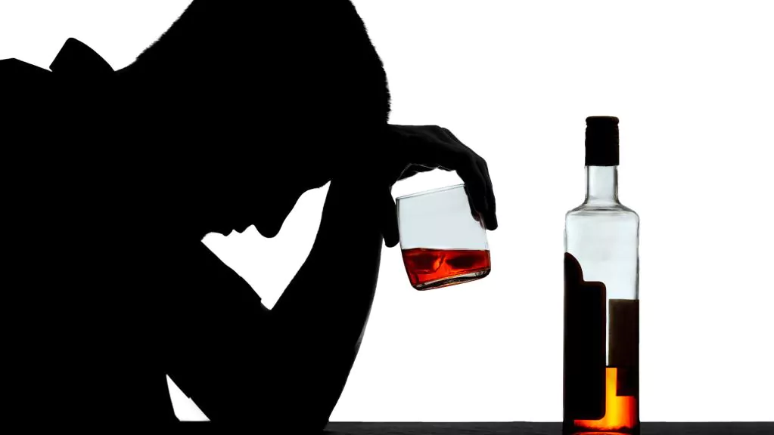
Alcohol Misuse
Alcohol Misuse: A spectrum of behaviors that includes risky or hazardous alcohol consumption
30% of adults drink at elevated risk levels
Contributes to 88,000 deaths each year
Increased risk of developing:
Diabetes
Cardiovascular disease
Digestive diseases
Cancer
Psychological and interpersonal problems
Notes:
Centers for Disease Control and Prevention. Alcohol and public health: Alcohol related disease impact (ARDI). https://www.cdc.gov/ardi
Esser, M. B., Hedden, S. L., Kanny, D., Brewer, R. D., Gfroerer, J. C., & Naimi, T. S. (2014). Prevalence of Alcohol Dependence Among US Adult Drinkers, 2009–2011. Preventing Chronic Disease, 11, 140329. doi: http://dx.doi.org/10.5888/pcd11.140329

Slide 5
What is Risky Alcohol Use?
For women:
8 or more drinks per week
4 or more drinks per occasion
For men:
15 or more drinks per week
5 or more drinks per occasion

Slide 6
Assessment Tools

Slide 7
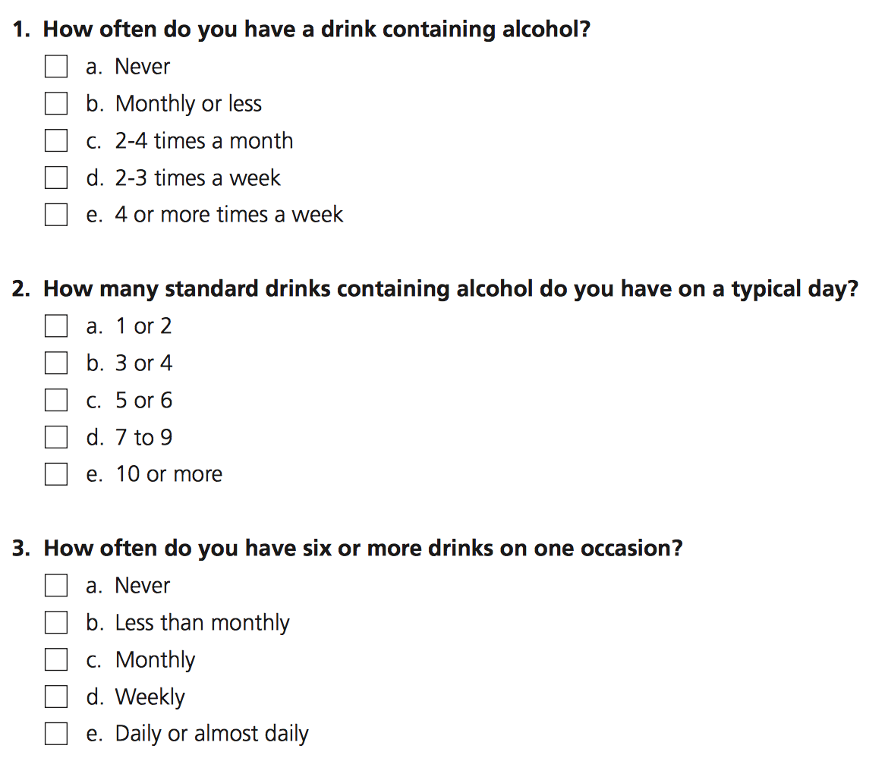
AUDIT-C
Scoring: 0-4 for each item
Potential Alcohol Misuse:
≥5 for men
≥4 for women

Slide 8
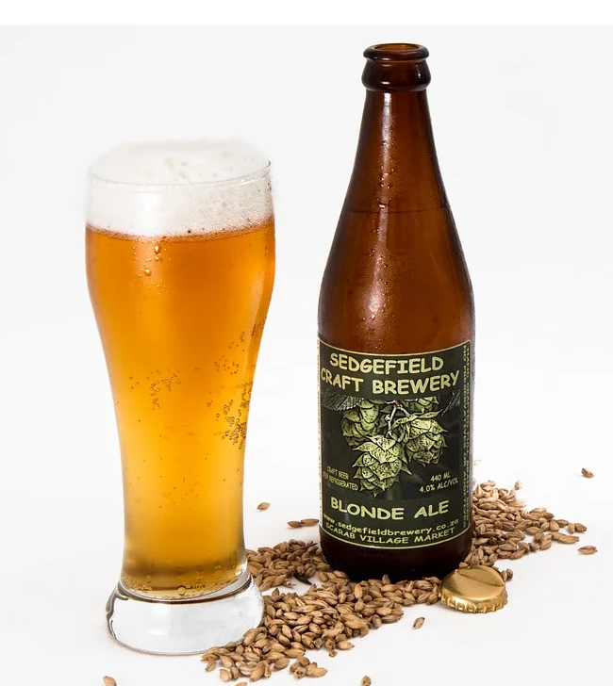
Alcohol Use Disorder (AUD)
Presence of 2 or more symptoms in the past year:
Tolerance
Withdrawal
Cravings
Drinking more than intended
Desire or unsuccessful efforts to cut down
Much time spent drinking alcohol
Recurrent use resulting in a failure to fulfill major role obligations
Important social/job/fun activities are given up or reduced
Use where it is physically dangerous (e.g., driving)
Continued use despite resultant social or interpersonal problems
Continued use despite depression or anxiety
Notes:
DSM-5: Mild (2-3 symptoms); Moderate (4-5 symptoms); Severe (6 or more symptoms)

Slide 9
Evidence-Based Treatments

Slide 10
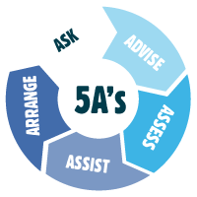
Brief Intervention: 5 A’s Approach

Slide 11
Step 1: Ask: Screening for Alcohol Misuse
USPSTF recommends
annual screening
for adults >18 years of age
Notes:
Many screeners available. AUDIT-C is used commonly

Slide 12
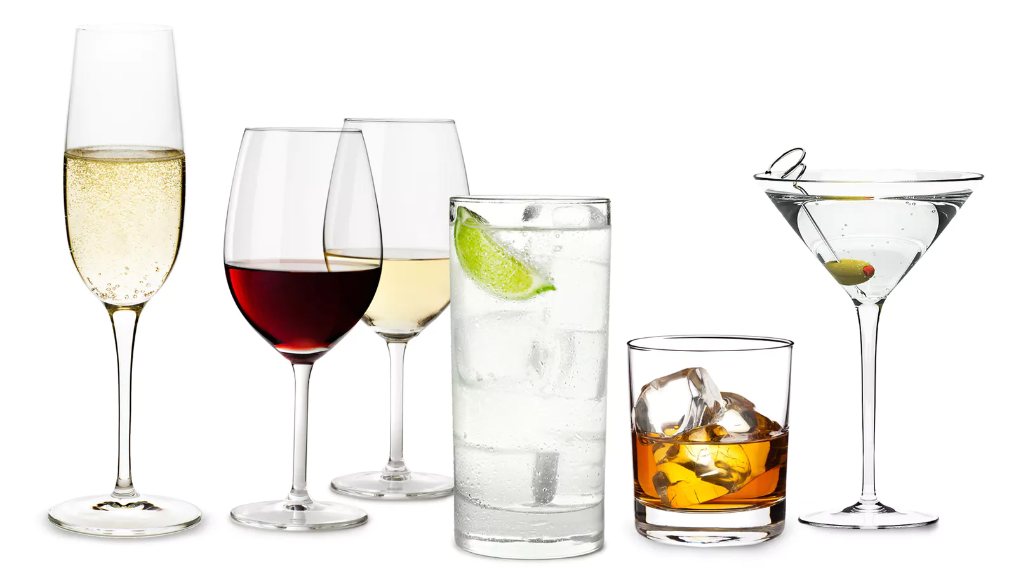
Step 2: Assess for an Alcohol Use Disorder
“How has your alcohol use affected your life?”
Don’t need to ask every symptom; you may know the answers just by listening to the patient.

Slide 13
For At-risk Drinkers (does NOT meet criteria for Alcohol Use Disorder)
Step 3: Advise
State your conclusion and recommendation clearly.
You are drinking more than is medically safe.
I strongly recommend that you cut down (or quit).
I'm willing to help.

Slide 14
At-risk Drinkers (cont.)
Step 4: Assist
Gauge readiness to change drinking habits.
Are you willing to consider making changes in your drinking?
If Yes:
Great! What would be a good goal for you?
Discuss plans:
What specific steps will you take?
How will you track your drinking?
How will you manage high-risk situations?

Slide 15
At-risk Drinkers (cont.)
Step 4: Assist
Gauge readiness to change drinking habits.
Are you willing to consider making changes in your drinking?
If No:
Re-state your concern about his/her health.
Encourage reflection (pros/cons of drinking, barriers to change).
Reaffirm your willingness to help when he/she is ready.

Slide 16
For Patients with AUD
Step 3: Advise
State your conclusion and recommendation clearly.
I believe that you have an alcohol use disorder.
I strongly recommend that you quit drinking.
I'm willing to help.

Slide 17
For Patients with AUD
Step 4: Assist
Negotiate a drinking goal.
Abstinence is safest course
Patients with mild AUD may be able to cut down
Consider medical need (medically managed withdrawal or medication such as Naltrexone).
Encourage patient to consider:
Support group (such as AA)
Inpatient treatment

Slide 18
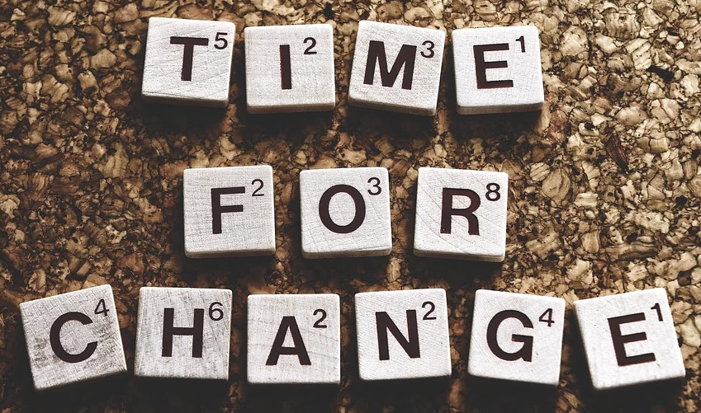
Step 5: Arrange (both AUD and At-risk Drinkers)
Clarify specific goal with the patient
Schedule follow-up appointment
At follow-up, continue to support patient towards his/her goals
Consider higher level of treatment if necessary

Slide 19
Change That Matters’ Focus on Values/Meaning in Life

Slide 20
Connect Reducing Alcohol Use to Values and Meaning
Invite patient to reflect upon:
Why do you want to cut back on drinking?
How will reducing your alcohol use impact your life?
How will this change allow you to engage in other, meaningful areas of your life?

Slide 21
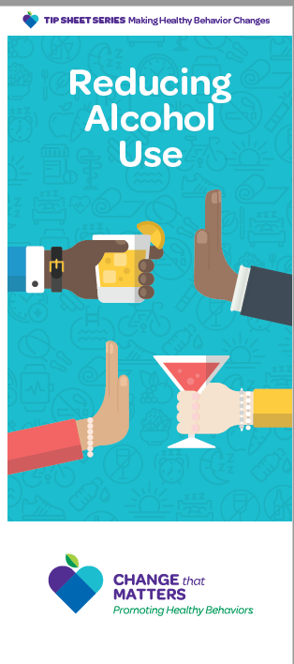
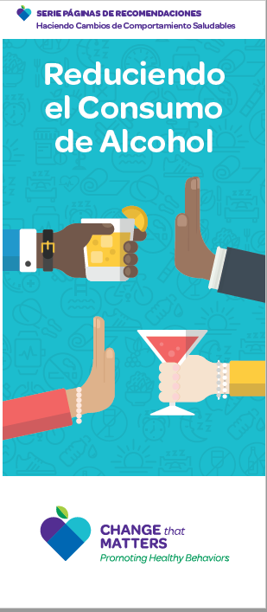
Patient Brochure

Slide 22
Noteworthy Features
Handout encourages reader to:
Reflect on reasons to reduce alcohol use
Consider readiness to reduce drinking
Identify triggers to drink and plans to manage urges
Define barriers to cutting back
Consider who could help
Consider 12-step or other support groups

Slide 23
EHR Templates

Slide 24
Documentation Template
Assess:
If AUDIT-C positive
How has your drinking affected your life? ***
What problems has drinking alcohol caused you? ***
Plan:
Set specific goal: ***
Identify barriers to reducing alcohol use/quitting: {fear of withdrawal; social interactions; enjoyment of alcohol or its effects; stress; lack of helpful coping mechanisms; other}
Identify reasons to quit or cut back: {health; mood; family; friends; self-worth; appearance; cost; legal issues; employment issues; other}

Slide 25
Documentation Template (cont.)
Plan (cont.):
Identify supports: {family, friends, coworkers, 12-step programs, spirituality, therapist, minister, other}
Offer referrals: {treatment, AA/NA, Referral to mental health, other}
Follow up ***
Change that Matters Reducing Alcohol Use handout given.
*** minutes spent counseling patient regarding reducing alcohol use to improve overall health.

Slide 26
After Visit Summary (AVS) Template
Today we talked about cutting back on your drinking.
You stated you want to ***. To do this, you plan to ***.
Here are some helpful tips for reducing your alcohol use:
Consider 12-step programs like AA for support
Ask family members or friends to support you in making this change.
Count and measure your drinks to know how many standard drinks you are having.
Set goals. How many days a week do you want to drink?
Pacing and spacing. When you drink, sip or have a non-alcoholic drink in between alcoholic drinks.
Don’t drink on an empty stomach. Eat first so alcohol is absorbed more slowly in the system.
Know how to say “no.” Plan a polite, convincing way to say no to offers to drink.

Slide 27
Structured Practice

Slide 28
Practice Activity
Partner with someone near you
One person will be the patient
One person with be the provider
Think of a patient on your panel that you would like to reduce/quit drinking. Imagine him/her for the role play.
Using the pamphlet and EHR template, role play the discussion.
Take about 5 minutes and then switch roles

Slide 29
Responding to Common Challenges

Slide 30
But Doc….
I’ve tried many times in the past...
I just start drinking again!
Acknowledge quitting is difficult.
Every day you don’t drink is a positive step.

Slide 31
But Doc….
I’m too stressed to quit! Drinking helps me relax.
Drinking is a habit. It’s perhaps your primary way to cope with stress.
Would you be open to trying other ways of managing stress?

Slide 32
But Doc….
I need a few drinks to help me feel comfortable
in social situations
Would you be open to trying other ways of managing this anxiety?

Slide 33
But Doc….
I need a few drinks to fall asleep.
Although alcohol may help you fall asleep, it actually makes the quality of your sleep worse. Would you be open to trying other ways of improving your sleep?

Slide 34
Resources for Further Learning

Slide 35
Centers for Disease Control and Prevention (CDC). (2014). Planning and implementing screening and brief interventions for risky alcohol use: A step-by-step guide for primary care practices. Atlanta, GA: Centers for Disease Control and Prevention (CDC).
National Institute on Alcohol Abuse, & Alcoholism (US). (2007). Helping Patients who Drink Too Much: A Clinician's Guide: Updated 2005 Edition (No. 7). US Department of Health and Human Services, National Institutes of Health, National Institute on Alcohol Abuse and Alcoholism.
Screening and Behavioral Counseling Interventions to Reduce Unhealthy Alcohol Use in Adolescents and Adults: Recommendation Statement. (2019, June 15). American Family Physician, 99(12).
Zoorob, Roger J., Grubb, J., Gonzales, Z. & Kowalchuk, A. (2017). Using alcohol screening and brief intervention to address patients' risky drinking. Family Practice Management 24(3), 12-16.

Slide 36
Change That Matters Team
Stephanie A. Hooker, PhD, MPH (co-PI)
Michelle D. Sherman, PhD, ABPP (co-PI)
Katie Loth, PhD, MPH Jean Moon, PharmD, BCACP
Kacey Justesen, MD Andrew Slattengren, DO
Sam Ngaw, MD Anne Doering, MD
Marc Uy, BA, MPH

Slide 37
Special Thanks
University of Minnesota Academic Health Center
and
National Institute for Integrated Behavioral Health
for financial support for their development and evaluation
of Change that Matters

