Slide 1
Managing Stress / Anxiety
www.ChangeThatMatters.umn.edu

Slide 2
Brief Overview

Slide 3
Stress vs Anxiety
Everyone experiences stress!
Can be useful to motivate.
Can be debilitating when overwhelming
Stress is generally a response to a THREAT
Is temporary
Anxiety is the REACTION to the stress
Mental health issue
Many interventions are helpful with both stress and anxiety

Slide 4
Some anxiety is normal

Slide 5
What are anxiety disorders?
Anxiety disorders are a combination of fear (emotional response to real/perceived threat) and anxiety (anticipation of FUTURE threat).
People may engage in a lot of efforts to AVOID to minimize anxiety – doing so perpetuates the anxiety

Slide 6
DSM5 Organization: Anxiety Disorders (lifetime prevalence from international research)
Specific phobia (7%)
Generalized anxiety disorder (GAD) (4-5%)
Social anxiety disorder (4%)
Panic disorder (1.7%)
Lifetime prevalence of a panic attack is 13%
Agoraphobia (1.5%)
Separation anxiety disorder (childhood)
Selective mutism (childhood)
Notes:
Note: OCD & PTSD/acute stress disorder are no longer classified as anxiety disorders
Stein et al (2017). The cross-national epidemiology of social anxiety disorder: Data from the World Mental Health Survey Initiative. BMC Med. 15(1):143.
Ruscio et al (2017). Cross-sectional Comparison of the Epidemiology of DSM-5 Generalized Anxiety Disorder Across the Globe. JAMA Psychiatry. 74(5):465-475.
Wardenaar et al. (2017). The cross-national epidemiology of specific phobia in the World Mental Health Surveys. Psychol Med. 47(10):1744-1760
Roest et al. (2019). A comparison of DSM-5 and DSM-IV agoraphobia in the World Mental Health Surveys. Depress Anxiety. 36(6):499-510
deJong et al (2016). Cross-national epidemiology of panic disorder and panic attacks in the world mental health surveys. Depress Anxiety. 33(12):1155-1177

Slide 7
Prevalence
Anxiety disorders are actually MORE prevalent than depression…
Prevalence in the US of all anxiety disorders
Lifetime prevalence: ~30%
12-month prevalence: 10%
Notes:
Comer JS, Blanco C, Hasin DS, et al. Health-related quality of life across the anxiety disorders.J Clin Psychiatry. 2011;72(1):43-50.

Slide 8
Anxiety disorders
Onset: Many start in childhood & persist
Gender: Most occur more often in women than men (overall 2:1 ratio)
Need to cause distress or impairment in social, occupational, or other important areas of functioning

Slide 9
Anxiety can be impactful
Consequences of anxiety disorders
Lower quality of life
Decreased productivity
Increased rates of medical service use
Disability caused by GAD is considered equal to that of Major Depressive Disorder

Slide 10
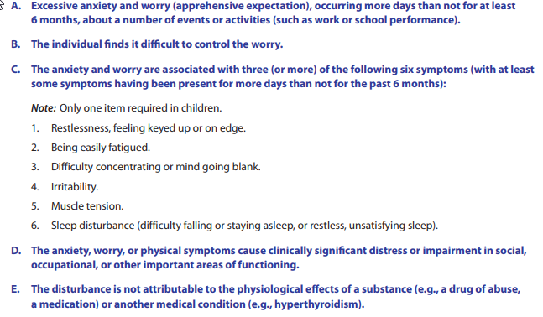
Generalized Anxiety Disorder

Slide 11
Generalized Anxiety Disorder
Lifetime prevalence: 4-5%
Lifetime comorbidity: 82%
Mood disorder comorbidity: 63%
Other anxiety disorders: 52%
Treatment is sought by about 50% of people with GAD (more in higher income countries)
Notes:
Ruscio et al (2017). Cross-sectional Comparison of the Epidemiology of DSM-5 Generalized Anxiety Disorder Across the Globe. JAMA Psychiatry. 74(5):465-475.

Slide 12
Why Important in Primary Care?
Anxiety disorders are:
Common
Highly comorbid with medical problems
Very commonly missed or misdiagnosed by PCPs
Research shows rates of misdiagnosis as high as
70% for GAD
86% for panic disorder
98% for social anxiety disorder
Notes:
Vermani M, Marcus M, Katzman MA. Rates of detection of mood and anxietydisorders in primary care: a descriptive, cross-sectional study. Prim Care Com-panion CNS Disord 2011;13(2).http://dx.doi.org/10.4088/PCC.10m01013.

Slide 13
Why Often Missed in Primary Care?
70-90% of patients with anxiety present with somatic complaints
What do you hear?
Headaches, GI distress, muscle tension, chest pain, heart palpitations
Patient lack of insight/resistance to idea of anxiety
“Are you saying I’m CRAZY, Doctor?”

Slide 14
Why Often Missed in Primary Care?
Challenge of comorbidity
Over 90% of patients w/ GAD have a comorbid psychiatric diagnosis (about ½ have Major Depressive Disorder)
Anxious patients with comorbid mental health disorders have lower remission rates and higher rates of suicide
Commonly comorbid medical issues
Chronic pain, headaches, IBS, sleep problems
Notes:
Wittchen HU, Zhao S, Kessler RC, et al. DSM-III-R generalized anxiety disorderin the National Comorbidity Survey. Arch Gen Psychiatry 1994;51(5):355–64

Slide 15
Assessment Strategies

Slide 16
Assessment
Need to rule out other causes
Metabolic panel, thyroid, cortisol levels to rule out electrolyte abnormalities, hyperthyroidism, Cushing syndrome
Other medications, illicit substances, vitamins, herbs
Caffeine, alcohol, nicotine

Slide 17
Assessment Tools
No concrete data suggesting benefit to routine screening
GAD7
Scoring: 5 (mild), 10 (moderate), 15 (severe)
GAD2
86% sensitive, 83% specific for GAD

Slide 18
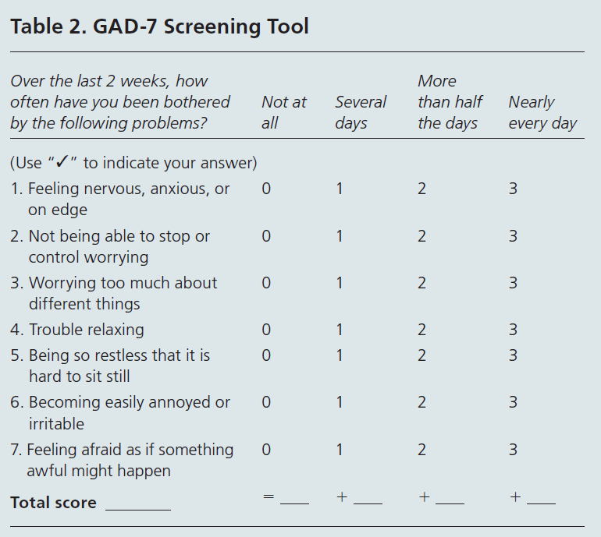
Formal Assessment of Generalized Anxiety Disorder
Generalized Anxiety Disorder - 7

Slide 19
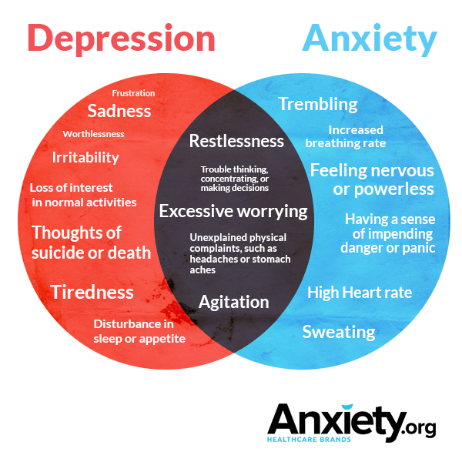
Comorbidity with Depression
Given the huge overlap between depression & anxiety, if you see one, assess for the other!

Slide 20
Evidence-Based Treatments

Slide 21
FDA Approved Medications (as of November 2019)
GAD
Lexapro, Paxil, Effexor, Cymbalta
Panic
Prozac, Paxil, Zoloft, Effexor, Klonopin, Xanex
Social anxiety disorder
Paxil, Zoloft, Effexor XR

Slide 22
Only Grade A recommendation for anxiety
Psychotherapy can be as effective as medications for GAD & Panic Disorder.
Cognitive behavioral therapy has the best level of evidence.
Notes:
systematic review and meta-analysis of 69 randomized clinical trials including 4118 patients, cognitive behavioral therapy for anxiety-related disorders is associated with improved outcomes compared with control conditions until 12 months after treatment completion. After 12 months, effects were small to medium for generalized anxiety disorder and social anxiety disorder, large for PTSD, and not significant or not available for other disorders. High-quality randomized clinical trials with more than 12 months of follow-up and reported relapse rates are needed.
van Dis, E. A., van Veen, S. C., Hagenaars, M. A., Batelaan, N. M., Bockting, C. L., van den Heuvel, R. M., ... & Engelhard, I. M. (2019). Long-term Outcomes of Cognitive Behavioral Therapy for Anxiety-Related Disorders: A Systematic Review and Meta-analysis. JAMA psychiatry.

Slide 23
Grade B recommendations
Physical activity is a cost-effective treatment for GAD & Panic Disorder
SSRIs are a first-line therapy for GAD
and Panic Disorder

Slide 24
Grade B recommendations
Benzodiazepines (BZ) do not improve long-term outcomes. Should be used only short-term during crises (due to risk for tolerance/dependence)
BZs are to anxiety what Opioids are to pain
Highly effective in the short term
Abused by some
Discouraged but sometimes indispensable for chronic use
Avoid in patients with a history of addiction

Slide 25
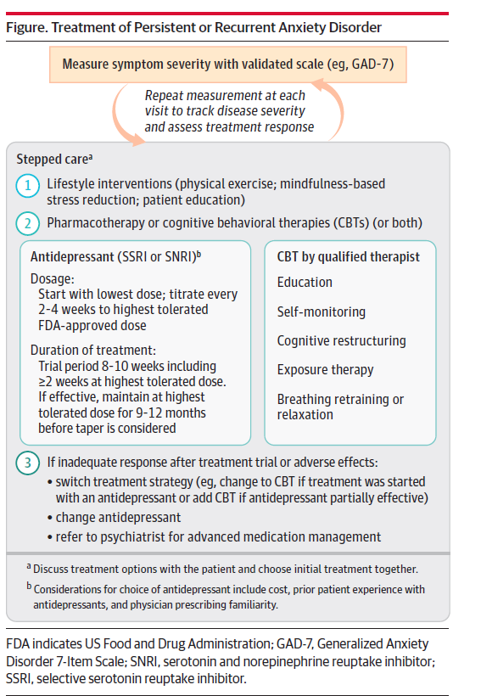
Model by Murray Stein & Michelle Craske JAMA, 2017
JAMA 2017

Slide 26
Model by Murray Stein & Michelle Craske
Often stepped care – may start with exercise & stress management (e.g., via apps)
If SSRI or SNRI, start at lowest available dose & titrate up every 2-4 weeks to minimize adverse effects
If antidepressant helps, continue for 9-12 months before stopping/tapering

Slide 27
Change That Matters’ Focus on Values and Meaning in Life

Slide 28
Anxiety and Meaning
When people feel stressed or anxious, they often withdraw from meaningful activities
A powerful intervention is to reconnect to a source of meaning and engage in activities that are meaningful, such as:
Relationships
Work or volunteering
Education or training (growth)
Citizenship or community life

Slide 29
You only have 24 hours a day…
How do you want to spend those hours?
Questions to ask:
What really matters to me?
What makes my life meaningful?
How can I help someone else?
How can I use my skills/talents to make a difference

Slide 30
Two Tools for Addressing Stress / Anxiety in Primary Care
Catch/Challenge/Change
Controllable vs Uncontrollable Stressors

Slide 31
What tips do you give patients who are dealing with anxiety?
Ask for help
Exercise
Mobile apps
Pray / meditate

Slide 32
Catch, Challenge, Change
CATCH
CHALLENGE
CHANGE

Slide 33
Catch

Slide 34
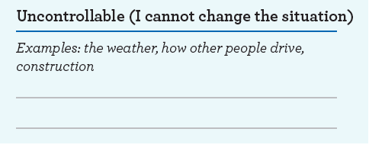
Challenge: What is under my control?

Slide 35
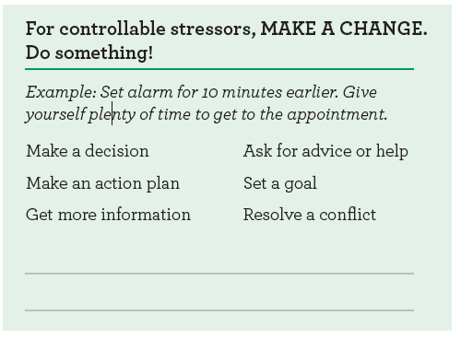
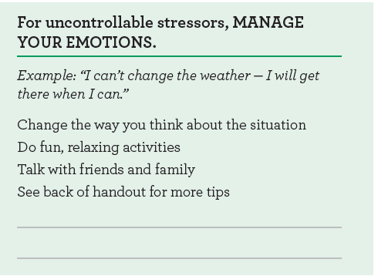
Change how you cope

Slide 36
Role of Physician
Anxiety
Physiological Arousal
Increased muscle tension, tightening, cramping
Explore cycle
of anxiety/stress
and somatic complaints

Slide 37
Role of Physician
Encourage selection of a goal
Exercise, relaxation, deep breathing, phone app
Acknowledge some relationship/family situations can be stressful.
Set limits with some people?
Explore who can help with stress/anxiety
Personal life
Psychotherapy
Spiritual leaders

Slide 38
Patient Handout

Slide 39
Noteworthy Features of the Handout
Education regarding stress
Identification of personal experience of stress/anxiety
Reflection on controllable versus uncontrollable stressors
Tips on how to deal with different stressors
Goal setting
Elicitation of social support
Specific tips (e.g., physical activity, distraction, therapy, mobile apps)

Slide 40
EHR Templates

Slide 41
Documentation Template
Current major life stressors ***
How patient experiences stress (e.g., body, thoughts, behavior): ***
Current treatments: (medication, therapy, exercise, self-help, social support, other ***)
Support person who can help manage stress effectively: ***
Plan:
Specific goal (patient will try this to manage stress): ***
Referrals: (Behavioral health, outside MH facility, psychiatry, Intensive Outpatient, other ***)
Follow-up: ***
Change that Matters Managing Stress handout given.
*** minutes spent counseling patient on managing stress/anxiety to improve health

Slide 42
After Visit Summary (AVS) Template
Today we talked about ways to manage stress.
You set a goal to ***
We will follow up on this plan at your next appointment.
Here are some other ideas to help manage stress:
Get active!
Spend time reflecting, praying, or meditating.
Ask yourself a simple 4-word question: IS IT WORTH IT?
If the stressor is really important, use healthy coping tools. If not, can you let it go? How freeing might that feel?
Distract yourself.
Ask someone you trust for support.
Consider therapy.
Use relaxation and deep breathing strategies to calm your mind and body.

Slide 43
Structured Practice

Slide 44
Practice Activity
Partner with someone near you!
Patient: a resident, Frank, who is way behind on notes, feels the faculty are hypercritical, is worried about getting kicked out of residency, and worries his wife may leave as he’s never home
Other person is the provider
You determine diagnosis of generalized anxiety disorder.
Using the pamphlet and EHR template, work through the intervention
Take about 5 minutes; reverse roles.

Slide 45
Responding to Common Challenges

Slide 46
But Doc…
Are you saying this is all in my head?
I’m not crazy!
Legitimize suffering– it’s REAL
Acknowledge: Sometimes the precise etiology of somatic symptoms is unknown. May be both
We DO know that there’s a vicious cycle – and managing stress well can help in coping with somatic symptoms

Slide 47
But Doc…
I’m just TOO anxious to try
any of these things!
Acknowledge that the anxiety is real.
Explore: Is what you’re doing working now?
Reassure patient he/she is in control; can make small steps whenever ready.

Slide 48
But Doc..
I’ve avoided (behavior) for so long. It’s going to be really hard to try again…
Acknowledge avoidance as understandable.
Help patient balance short-term benefits of avoidance with long-term negative consequences
Remind patient WHY he/she wants to do this (tie to his/her values)
Encourage patient to ACT even if he/she doesn’t feel like it
Set specific goal
Notes:
Puspitasari, A., L’Amoeureax, T., & Schak, K. (2019). Introduction to behavioral activation. Minnesota Psychological Association workshop.

Slide 49
Resources for Further Learning

Slide 50
Locke, Kirst, & Shultz. (2015). Diagnosis and management of generalized anxiety disorder and panic disorder in adults. American Family Physician, 91(9) 617-624
Stein, M., & Craske, M. (2017). Treating anxiety in 2017: Optimizing care to improve outcomes. JAMA, 318(3), 235-236

Slide 51
Change That Matters Team
Stephanie A. Hooker, PhD, MPH (co-PI)
Michelle D. Sherman, PhD, ABPP (co-PI)
Katie Loth, PhD, MPH Jean Moon, PharmD, BCACP
Kacey Justesen, MD Andrew Slattengren, DO
Sam Ngaw, MD Anne Doering, MD
Marc Uy, BA, MPH

Slide 52
Special Thanks
University of Minnesota Academic Health Center
and
National Institute for Integrated Behavioral Health
for financial support for their development and evaluation
of Change that Matters

