Slide 1
Improving Sleep
www.ChangeThatMatters.umn.edu

Slide 2
Brief Overview

Slide 3
Sleep is Important for Health
Occupies 20-40% of every day
Socially driven
When
Where
With whom
Increased risk of mortality for short sleep
(< 6 hours/night) and long sleep (> 9 hours/night)

Slide 4
Sleep Disorders
Insomnia
Circadian Rhythm Disorders
Sleep apnea
Hypersomnia/Narcolepsy
Parasomnias
Notes:
There are many kinds of sleep disorders. Our focus here in is Chronic Insomnia

Slide 5
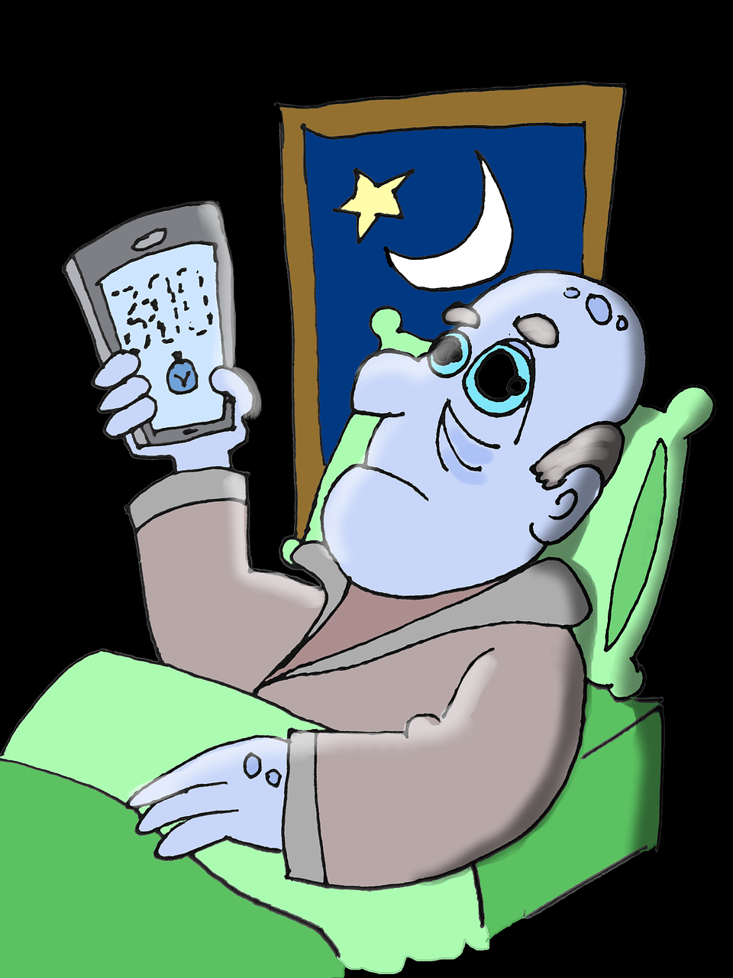
Chronic Insomnia Disorder International Classification of Sleep Disorders (ICSD) Criteria
At least one of the following sleep difficulties:
Falling asleep
Staying asleep
Waking up too early
At least one associated problem:
Fatigue
Attention, concentration or memory impairment
Impaired social, family, occupational or academic performance
Mood disturbance/irritability
Daytime sleepiness
Reduced motivation or energy
Prone to errors or accidents
Concerns about or dissatisfaction with sleep
At least 3 months in duration

Slide 6
Prevalence of Insomnia
More than 33% of adults experience insomnia intermittently
10-22% suffer chronic sleep difficulties
In the US, the number of office visits for insomnia increased from 4.9 million visits in 1999 to 5.5 million visits in 2010 (13% increase)
Prescriptions for sleep aids increased by nearly 300% during same period
Notes:
Edinger, J. D., Buysse, D. J., Deriy, L., Germain, A., Lewin, D. S., Ong, J. C., & Morgenthaler, T. I. (2015). Quality measures for the care of patients with insomnia. J Clin Sleep Med, 11(3), 311-334. doi: 10.5664/jcsm.4552
Ford, E. S., Wheaton, A. G., Cunningham, T. J., Giles, W. H., Chapman, D. P., & Croft, J. B. (2014). Trends in outpatient visits for insomnia, sleep apnea, and prescriptions for sleep medications among US adults: findings from the National Ambulatory Medical Care survey 1999-2010. Sleep, 37(8), 1283-1293.

Slide 7
Etiology of Insomnia
Insomnia
No insomnia
Notes:
This is the cognitive behavioral model that explains how someone would develop insomnia. The different bars correspond to different points in the time course of insomnia. The dashed horizontal line represents the threshold for when someone would meet criteria for an insomnia disorder diagnosis. The pre-morbid period is prior to any development of insomnia symptoms. The blue bar corresponds to “predisposing factors” – these are any given person’s susceptibility to developing insomnia, which may be based on genetics or life experiences. Predisposing factors are not enough for someone to have an insomnia problem. There is usually an event, or “precipitating factor,” that kicks off an insomnia episode. This could be a stressful life event, such as the loss of a job, an illness, etc. Or, it may be a life circumstance, such as having a child that cannot sleep. The event alone causes significant insomnia symptoms. Over time, in the early phase of insomnia, the effects of that specific event on sleep wanes. For example, the stressful life event is not as stressful anymore. Or, the child learns how to sleep on their own. However, over time, the person has developed habits to try to get more sleep, such as going to bed earlier or playing on their phone in bed to distract themselves. These habits are called “perpetuating factors” – they are the habits that actually maintain insomnia after the precipitating event is lessened or gone. Perpetuating factors are the targets of behavioral treatment for chronic insomnia – as you can see in the chronic insomnia scenario, if the perpetuating factors were removed, the person would no longer meet criteria for insomnia.

Slide 8
Perpetuating Factors
Getting in bed too early
Staying in bed late
Spending extra time in bed
Caffeine
Sleep medications
Worrying about sleeping or daytime functioning
Alcohol
Reading/Watching TV/ Listening to radio in bed
Noise
Bedroom temperature
Bedroom darkness
Frequent travel across time zones
Sleeping in on weekends or days off
Notes:
This is a list of perpetuating factors that may be relevant in maintaining insomnia and would also be targets of behavioral treatment.

Slide 9
Mental Health Correlates of Insomnia
Depression: Insomnia is risk factor for new-onset major depressive episode
Among those with insomnia, 8% have major depression
Among those with depression, 80% have insomnia symptoms
Treating sleep problems improves depression
Anxiety
27% of patients with insomnia also have anxiety disorder
Among patients with anxiety disorders, 90% have insomnia
60-90% of those with trauma have insomnia
Notes:
Insomnia is a common diagnostic feature of several mental disorders.
Ohayon, M. M. (2002). Epidemiology of insomnia: what we know and what we still need to learn. Sleep Med Rev, 6(2), 97-111. doi: 10.1053/smrv.2002.0186
Geoffroy, P. A., Hoertel, N., Etain, B., Bellivier, F., Delorme, R., Limosin, F., & Peyre, H. (2018). Insomnia and hypersomnia in major depressive episode: Prevalence, sociodemographic characteristics and psychiatric comorbidity in a population-based study. J Affect Disord, 226, 132-141. doi: 10.1016/j.jad.2017.09.032
Manber, R., Edinger, J. D., Gress, J. L., San Pedro-Salcedo, M. G., Kuo, T. F., & Kalista, T. (2008). Cognitive behavioral therapy for insomnia enhances depression outcome in patients with comorbid major depressive disorder and insomnia. Sleep, 31(4), 489-495.
Ohayon, M. M., & Reynolds, C. F., 3rd. (2009). Epidemiological and clinical relevance of insomnia diagnosis algorithms according to the DSM-IV and the International Classification of Sleep Disorders (ICSD). Sleep Med, 10(9), 952-960. doi: 10.1016/j.sleep.2009.07.008

Slide 10
Physical Health Correlates of Insomnia
Common comorbid conditions:
Obesity
Sleep apnea
Cardiopulmonary diseases
Chronic renal failure
Diabetes
Neurologic disorders
Chronic pain
Hypertension
Cardiovascular disease
Notes:
Taylor, D. J., Mallory, L. J., Lichstein, K. L., Durrence, H. H., Riedel, B. W., & Bush, A. J. (2007). Comorbidity of chronic insomnia with medical problems. Sleep, 30(2), 213-218.

Slide 11
Evidence-Based Treatments

Slide 12
Treatments
Cognitive Behavioral Therapy
Light/melatonin
Exercise

Slide 13
Cognitive Behavioral Therapy for Insomnia (CBT–I)
First line recommended treatment by the American College of Physicians
Meta-analysis of RCTs compared CBT-I to control CBT-I had moderate to large effects on:
Time to fall asleep
Total time awake at night
Wake time after falling asleep
Time in bed
Early morning awakenings
Proportion of time in bed asleep efficiency (sleep efficiency)
Longer lasting effects than medications
Notes:
Okajima, I., Komada, Y., & Inoue, Y. (2011). A meta-analysis on the treatment effectiveness of cognitive behavioral therapy for primary insomnia. Sleep and Biological Rhythms, 9(1), 24-34. doi: 10.1111/j.1479-8425.2010.00481.x

Slide 14
Stages of CBT-I
Assessment
Sleep diaries
Clinical interview
Sleep education
Sleep scheduling/sleep restriction
Additional cognitive/behavioral treatments as appropriate
Notes:
These are the stages of CBT-I, starting with assessment, then providing education about sleep, working on sleep scheduling and restriction, and providing additional treatments as appropriate.

Slide 15
Sleep Diary
Each row corresponds to 24 hours (from noon today to noon tomorrow)
Each column corresponds to 1 hour
Shade in the time you are actually sleeping
Arrow down ( ↓ ) when you get in bed
Arrow up ( ↑ ) when you get out of bed
Notes:
There are multiple options for completing sleep diaries – there are two options below. The two variables that are most important for the patient to track include: (1) time in bed and (2) duration of sleep. These will be essential to do sleep scheduling and sleep restriction. Patients can also keep track in whatever method works for them – for example, notes on a piece of paper or on their phone.
Encourage patients to complete sleep diaries in the morning after they get up for the day, and not to stress about being too accurate (i.e., don’t watch the clock to do this perfectly).
Carney, C. E., Buysse, D. J., Ancoli-Israel, S., Edinger, J. D., Krystal, A. D., Lichstein, K. L., & Morin, C. M. (2012). The consensus sleep diary: standardizing prospective sleep self-monitoring. Sleep, 35(2), 287-302. doi: 10.5665/sleep.1642
Consensus Sleep Diary
http://drcolleencarney.com/wp-content/uploads/2013/10/Final-CSD-Morning-only-with-instructions.pdf
Two-Week Sleep Diary
http://yoursleep.aasmnet.org/pdf/sleepdiary.pdf

Slide 16
Assessment
Clinical Interview
What wakes them up in the middle of the night?
When did the insomnia start? Specific trigger?
Has it gotten worse, better, or stayed the same?
Mental health symptoms?
Physical health symptoms?
What are their sleep habits?
Other sleep problems? (e.g., Obstructive Sleep Apnea - OSA, nightmares, sleep walking, etc.)
Notes:
These are important questions to ask to determine targets for treatment. For example, if patients have comorbid depression or anxiety, it would be important to make sure treatment for those conditions are optimized. Or, if there is a specific trigger waking them up in the night (snoring partner), work with the patient to figure out the solutions for reducing that environmental trigger.

Slide 17
Sleep Education
Discussion of how many hours of sleep a night is “normal”
Three factors that regulate sleep:
Sleep Drive
Circadian rhythms (Sleep Timing)
Arousal
Notes:
Sleep education has two parts: (1) normalizing expectations for the amount of sleep they may get and (2) understanding the factors that drive sleep.

Slide 18
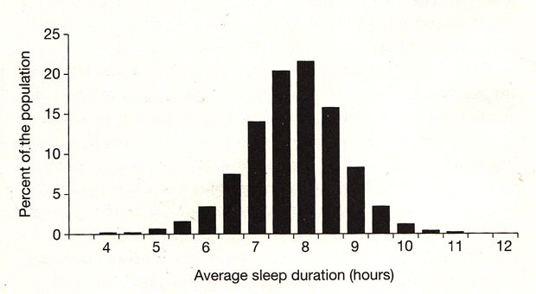
Average Amount of Sleep
Notes:
Most adults need between 7-8 hours of sleep. However, there are people who are short sleepers (need 6 or fewer hours of sleep) and people who need more sleep (9 or more hours). Every person has a unique sleep need – part of behavioral treatment is figuring out how much sleep that person needs.

Slide 19
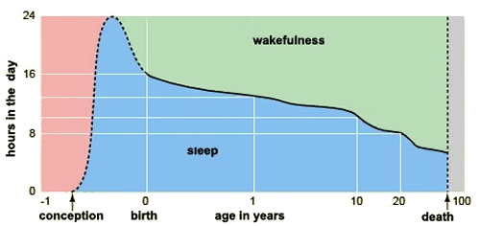
Sleep Need and Age
Notes:
Sleep needs change over the course of the life span. Infants sleep most of the day, and that gradually decreases over the first year. Children around age 10 need 9-11 hours of sleep. In adulthood, that sleep need continues to decrease, and older adults usually need fewer than 8 hours of sleep, on average. This decline in sleep need in older age contributes to insomnia as older adults spend similar or more time in bed, and then have difficulty sleeping the amount of time that they used to sleep.

Slide 20
Processes That Regulate Sleep
Sleep Pressure or Sleep Drive (Homeostasis)
Notes:
The first process the regulates sleep is called sleep pressure or sleep drive, and it is a homeostatic process.

Slide 21
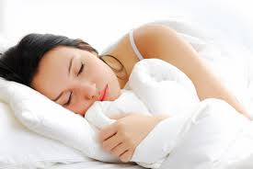
Sleep Drive (Homeostasis)
“Same level”
Body attempts to keep all systems in balance
Notes:
Homeostasis means “same level.” Our bodies have several homeostatic processes (e.g., when we need to eat, our bodies signal that we are hungry to encourage eating behavior). Similarly, when our temperature rises, our bodies initiate a sweat response to cool down our body temperatures. Sleep is another homeostatic process – after we have been awake for a long period of time, our bodies encourage us to initiate sleep.

Slide 22
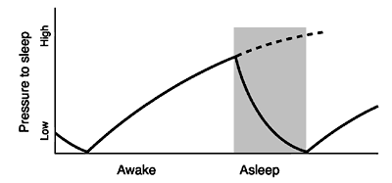
Sleep Drive (Homeostasis)
Notes:
This graph represents sleep drive. On the Y axis, the pressure to sleep goes from low to high. The X axis represents time, with the shaded area corresponding to time asleep. On the graph where the line touches the X-axis, imagine that is the start of your day. You woke up feeling rested and have very little pressure to go back to sleep at that time. As the day goes on, the pressure to sleep slowly rises, and hits its peak right when you fall asleep at night. As you sleep, the pressure to sleep quickly falls. Thus, if you are an 8-hour sleeper, you have to be up for 16 consecutive hours to have optimal sleep drive at bed time. People can get in trouble if they take naps during the day, because that burns off some sleep pressure, so they have to stay up later in order to have enough pressure to fall asleep at night.

Slide 23
Processes That Regulate Sleep
Sleep Pressure or Sleep Drive (Homeostasis)
Circadian Rhythms (Biological Clock)
Notes:
The second process that regulates sleep is the circadian rhythm.

Slide 24
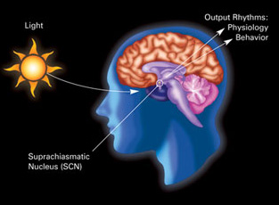
Circadian Rhythms (Biological Clock)
Notes:
Circadian means “about a day.” We have an area in our brain called the suprachiasmatic nucleus (SCN) that acts as a clock and regulates many of our 24 hour biological rhythms. The SCN takes in information about light through the eyes to reset time of day. If we were to be in a cave without any light, our natural circadian rhythm is about 24.2 hours, so the light helps reset the clock every day.

Slide 25
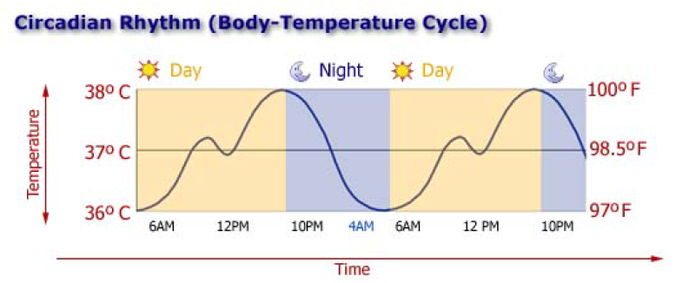
Circadian Rhythms (Biological Clock)
Notes:
In addition to sleep, another example of a circadian rhythm is our body temperature. It fluctuates around 98.6 degrees F on average, but the nadir occurs about 2 hrs before we wake up for the day and the apex occurs about 2 hrs before we go to bed at night.

Slide 26
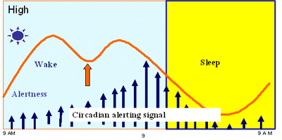
Circadian Rhythms (Biological Clock)
Notes:
This graph describes the impact of the circadian rhythm on our sleep wake cycle. The orange line corresponds to our level of alertness throughout the day. The arrows correspond to the circadian alerting signal, with taller arrows corresponding to more work from the circadian system to keep you awake. If you follow the graph from left to right, the circadian alerting signal does not have to work very hard to keep you awake in the morning because the sleep pressure is low at that time. Over the course of the day, as sleep pressure increases, the circadian clock has to do more to keep you awake. There is a little dip after lunch in alertness (see the orange arrow), but the circadian system works its hardest at 2 hours before bedtime to keep you awake. Over the course of the night, the circadian system plays more of a role in the second half of the night, as it keeps you asleep after the sleep drive has diminished. Thus, the two systems really have to work together to help you sleep.

Slide 27
Processes That Regulate Sleep
Sleep Pressure or Sleep Drive (Homeostasis)
Circadian Rhythms (Biological Clock)
Arousal
Notes:
Finally, there is a third process that affects sleep, and that is arousal.

Slide 28
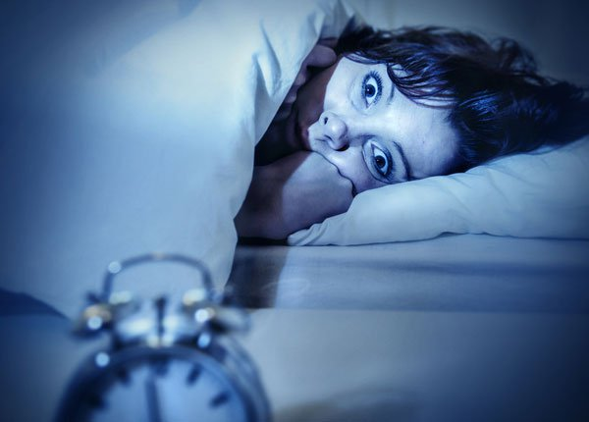
Arousal
Notes:
When I explain arousal to patients. I typically use the example of the soldiers in the trenches during World War I and II. The soldiers would often go for days on very little sleep, so their sleep pressure would be very high. Additionally, their circadian rhythms would work as normal, receiving light input about day/night. Yet, they would not be able to sleep. That is because their lives were at risk, and they had to be awake to fight at any minute. Anxiety and stress work much in the same way – they can keep us up even with optimal sleep pressure and circadian rhythms working together.

Slide 29
Sleep Scheduling and Sleep Restriction
Sleep Scheduling
Set a consistent wake time, 7 days a week
Pick a bedtime appropriate to the wake time
Sleep Restriction
Reduce time in bed to the average amount of time patients are sleeping, plus 30 min
Minimum window of 5 hours
Use sleep compression if restriction not tolerated (slowly decreasing the size of the sleep window)
Goal of >85% sleep efficiency (time asleep/time in bed)
Notes:
The two main behavioral interventions to improve sleep are sleep scheduling and sleep restriction.
With sleep scheduling, you ask the patient to pick a wake time that they can use 7 days a week, to set an alarm for that time, and to get out of bed at that time everyday, regardless of how the night went before. For example, they are not allowed to use the “snooze” button even if they only got a couple hours of sleep.
The bedtime must be consistent with the wake up time, but that is based on sleep restriction. For example, if the wake up time is 7:00 AM, and the optimal window is 7 hrs, bedtime would be midnight.
Sleep restriction is reducing the time in bed to increase sleep drive, with the hope of increasing total sleep time and sleep efficiency (= time asleep/time in bed). To determine the appropriate amount of time to schedule in bed, you take the sleep diary and average the nightly sleep over the past 2 weeks. Add 30 minutes to the average time to determine the appropriate sleep window. However, if the time is < 5 hrs, the minimum window should be 5 hours. The other option is to use sleep compression, if restriction is not tolerated. To do sleep compression, you could describe the time in bed gradually by 30 minutes every few nights. This approach takes longer to achieve desired effects. The sleep window is adjusted in subsequent visits until the optimal sleep window is achieved.

Slide 30
Stimulus Control
Use bed only for sleep and sex
Don’t toss and turn in bed
Don’t use phone, watch TV, or read in bed
If not able to sleep, get out of bed and do something relaxing
Read a book
Watch a TV show or movie
Look at a magazine
Listen to music
When sleepy, go back to bed and try again
Notes:
Stimulus control is used in conjunction with sleep scheduling and sleep restriction. Often, patients with insomnia associate their bed with a place they get frustrated and cannot sleep, or they do many things in bed other than sleep (read, play on phone, eat). The goal of stimulus control is to pair the bed with the sensation of falling asleep, so when patients get in bed, they fall asleep quickly. Thus, the instructions are to (1) use the bed only for sleep and sex; (2) don’t use phone, watch TV, or read in bed; (3) don’t toss and turn in bed; (4) if you are not falling asleep within 20-30 minutes, get out of bed -- when sleepy, go back and try again.
People often ask if TV is OK as a relaxing activity when you cannot fall asleep– in general yes, but it should be a show or a movie they can turn off. It shouldn’t be something they have to see until the end of the movie or an episode. A show or a movie they have seen many times works best. Similarly, a book shouldn’t be one that you can’t put down – it should be one you feel like you could stop at any time.

Slide 31
Other CBT Interventions
Limit caffeine and alcohol
Exercise (or just be more active during the day)
Sleep environment
Cognitive approaches (quieting the mind; correcting irrational thoughts about sleep)
Sleep medicine adjustments/CBT around sleep medicine
Nightmares (Imagery Rehearsal Therapy)
Relaxation (breathing, progressive muscle relaxation, guided imagery)
Successive changes in wake time to address circadian rhythm disorder
Notes:
There are a variety of adjunctive treatments that can be done to improve different aspects of sleep – working with behavioral health or a sleep psychologist to deliver these interventions could be helpful.

Slide 32
Light/Melatonin
Light and melatonin signal the circadian clock about times to go to bed and times to be awake
Melatonin: 2-3 hours before desired bedtime, very little is needed (0.5 mg)
Helpful for people who have a longer circadian rhythm, such as 25 hours
Light: In the morning for night owls, in the evening for early birds
Can backfire if done at the wrong time
Notes:
The circadian clock is regulated exogenously by light and endogenously by melatonin secretion. Melatonin is most useful for people who are not able to fall asleep quickly at night (or people with delayed sleep wake phase disorder).
With light, the important thing is to make sure that the light is on the right side of the temperature nadir (which occurs around 2 hrs prior to the typical wake up time). If the light is done after the temperature nadir, this will push the sleep schedule earlier (fall asleep earlier and wake up earlier). If the light is administered prior to the nadir, it will push the sleep schedule later (go to bed later and wake up later).

Slide 33
Exercise
For regular sleepers or those with sleep complaints:
Exercise has small positive effects on
Total sleep time
Sleep efficiency (time asleep/time in bed)
Shorter time to fall asleep
Large effects on overall sleep quality
Some evidence that exercise alone can improve insomnia
Greatest increases in sleep quality
Reductions in mental health symptoms
Notes:
Kredlow, M. A., Capozzoli, M. C., Hearon, B. A., Calkins, A. W., & Otto, M. W. (2015). The effects of physical activity on sleep: a meta-analytic review. Journal of Behavioral Medicine, 38(3), 427-449.
Passos, G. S., Poyares, D. L. R., Santana, M. G., Tufik, S., & Mello, M. T. d. (2012). Is exercise an alternative treatment for chronic insomnia? Clinics, 67(6), 653-660.

Slide 34
Change That Matters’ Focus on Values/Meaning in Life

Slide 35
Connect Sleep to Values and Meaning
Invite patient to reflect upon:
Why do you want to sleep better?
How will sleeping better impact your life?
How will this change allow you to engage in other, meaningful areas of your life?

Slide 36
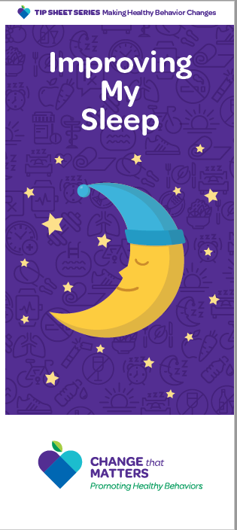
Patient Brochure

Slide 37
Noteworthy Features
Handout encourages reader to:
Select a regular wake-up time and bedtime
Create a wind-down routine
Define a relaxing activity to do (outside of bed) if cannot sleep after 15 minutes
Keep a sleep diary
Reflect on personal reasons to improve sleep
Define barriers to making changes

Slide 38
EHR Template

Slide 39
Documentation Template
Assess:
Current sleep routine (e.g., bedtime, wake time, total hours of sleep): ***
Main problems with sleep: {Falling asleep; Staying asleep; Waking up too often in the middle of the night; Waking up too early; Sleeping too much; Feeling sleepy during the day; Other)
Onset of problem: ***
Sleep-interfering behaviors/issues: {Watching TV in bed; Eating in bed; Reading in bed; Phone in bed; Tossing and turning; Worrying in bed; Conversations with partner in bed; Smoking; Alcohol; Inconsistent sleep schedule; Too much time in bed; Nightmares; Other sleep conditions (sleep apnea, RLS); Other)
Reasons to improve sleep: {Health; Mood/well-being; More energy; Better concentration; Family; Other)

Slide 40
Documentation Template
Plan:
Set regular wake-up time (7 days/week): ***
Set earliest bedtime (appropriate in relation to wake-up time): ***
Referral to Behavioral Health YES/NO
Follow-up: ***
Sleep diary given and discussed.
Health Behavior Change Improving my Sleep handout given.
*** minutes were spent counseling patient regarding sleep to improve overall health.

Slide 41
After Visit Summary (AVS) Template
Improving Your Sleep
Your wake-up time is: ***
Your target bed time is: ***
We are working on making changes to your habits to improve your sleep.
While you are working on this, we want you to keep a sleep diary. On the diary, please:
1. Shade in when you are actually sleeping.
2. Put an arrow pointing down when you get in bed and an arrow pointing up when you get out of bed

Slide 42
Who Should I Try CBT-I With and Who Should I Send to Behavioral Health?
PCP Try with Patient
Refer to Behavioral Health
Patients with mild to moderate insomnia
Shorter duration (< 6 months) of symptoms
Controlled mental health issues
People who will follow-up with you*
Patients who have severe insomnia
Long duration (lifelong or > 6 months) of symptoms
Significant mental health problems
Patients with difficulty following through on recommendations on their own
* Want to try to avoid the “I already tried that” problem

Slide 43
Other Sleep Issues to Refer to Behavioral Health
Adherence to CPAP
Nightmares
Parasomnias
Circadian rhythm disorders

Slide 44
Structured Practice

Slide 45
Practice Activity
Partner with someone near you
One person will be the patient
One person with be the provider
Think of a patient on your panel that really struggles with sleep. Imagine him/her for the role play.
Using the pamphlet and EHR template, role play the discussion.
Take about 5 minutes and then switch roles

Slide 46
Responding to Common Challenges

Slide 47
But Doc…
I forgot to fill out (or bring back) my sleep diary!
Acknowledge efforts to complete it.
Encourage patients to keep it near their bed and fill it out first thing in the morning (it only takes a few minutes)
Problem solve barriers to use

Slide 48
But Doc…
I like to sleep in on the weekends!
Acknowledge that it can be hard to get up when you don’t have anything scheduled
Encourage patients to identify an enjoyable activity they can do when they get up in the morning – have a cup of coffee, read the newspaper, etc.
The strict wake up time is only temporary until they have a good handle on their sleep
At most, let patients sleep in 1 hour on the weekends

Slide 49
But Doc…
It’s not working!
Encourage all efforts to make changes – changing habits is hard!
Note that this is a training process – it should take 2-3 weeks of practicing all the skills to start to see improvements in sleep
Review sleep diaries and ask about nights that went well and ones that did not to problem solve

Slide 50
Resources for Further Learning

Slide 51
Resources
Edinger, J. D., Wohlgemuth, W. K., Radtke, R. A., Marsh, G. R., & Quillian, R. E. (2001). Cognitive behavioral therapy for treatment of chronic primary insomnia: a randomized controlled trial. JAMA, 285(14), 1856-1864. doi: 10.1001/jama.285.14.1856
Germain, A., & Buysse, D. J. (2011). Brief behavioral treatment of insomnia. In Behavioral Treatments for Sleep Disorders (pp. 143-150). Academic Press.
Brief Behavioral Therapy for Insomnia (BBTI)
CBT-I Manual

Slide 52
Change That Matters Team
Stephanie A. Hooker, PhD, MPH (co-PI)
Michelle D. Sherman, PhD, ABPP (co-PI)
Katie Loth, PhD, MPH Jean Moon, PharmD, BCACP
Kacey Justesen, MD Andrew Slattengren, DO
Sam Ngaw, MD Anne Doering, MD
Marc Uy, BA, MPH

Slide 53
Special Thanks
University of Minnesota Academic Health Center
and
National Institute for Integrated Behavioral Health
for financial support for their development and evaluation
of Change that Matters

