Slide 1
Physical Activity
www.ChangeThatMatters.UMN.edu

Slide 2
Brief Overview

Slide 3
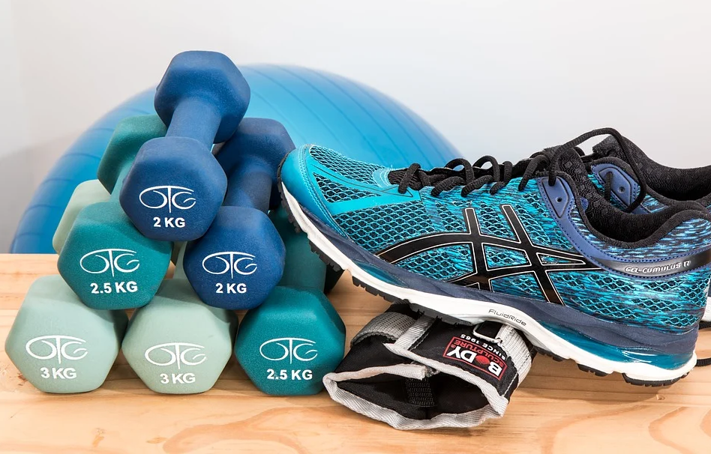
Physical Activity Has Numerous Health Benefits
Reduced risk of mortality
Reduced risk of chronic disease
Improved mental health
Improved energy
Greater quality of life
Notes:
Piercy, K. L., Troiano, R. P., Ballard, R. M., Carlson, S. A., Fulton, J. E., Galuska, D., . . . Olson, R. D. (2018). The physical activity guidelines for Americans. JAMA, 320(19), 2020-2028.
Rhodes, R. E., Janssen, I., Bredin, S. S. D., Warburton, D. E. R., & Bauman, A. (2017). Physical activity: Health impact, prevalence, correlates and interventions. Psychol Health, 32(8), 942-975. doi: 10.1080/08870446.2017.1325486

Slide 4
Reasons to Exercise
Improved
mood
energy
weight control
sleep
stress reduction
concentration
metabolism
cardiovascular functioning
Lowered
blood pressure
cholesterol
chronic pain
Notes:
Rhodes, R. E., Janssen, I., Bredin, S. S. D., Warburton, D. E. R., & Bauman, A. (2017). Physical activity: Health impact, prevalence, correlates and interventions. Psychol Health, 32(8), 942-975. doi: 10.1080/08870446.2017.1325486

Slide 5
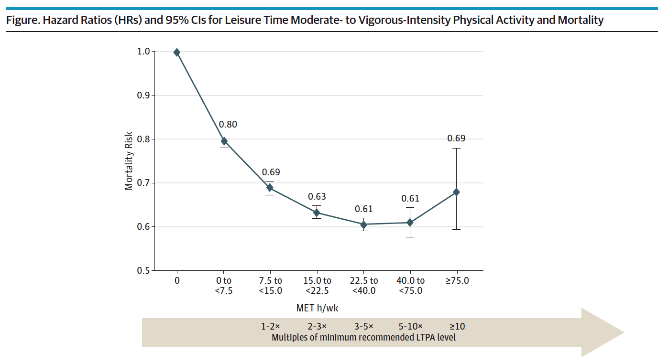
Reduced Risk of Death
Notes:
This graph shows the dose response benefit of engaging in physical activity on risk for mortality. The graph shows that doing any activity, compared to no activity, has a substantial benefit for improving longevity.
Arem, H., Moore, S. C., Patel, A., Hartge, P., Berrington de Gonzalez, A., Visvanathan, K., . . . Matthews, C. E. (2015). Leisure time physical activity and mortality: A detailed pooled analysis of the dose-response relationship. JAMA Internal Medicine, 175(6), 959-967. doi: 10.1001/jamainternmed.2015.0533

Slide 6
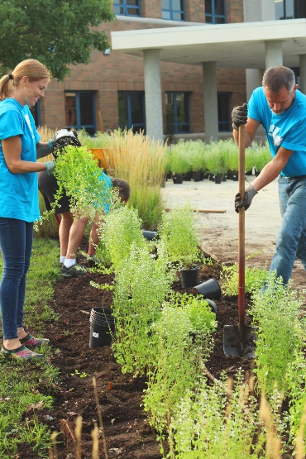
Exercise vs. Physical Activity
Exercise
Physical Activity
Purposeful bouts of activity
Designed to increase heart rate
Activity integrated into daily routine
May increase heart rate, but not an intentional outcome

Slide 7
Aspects of Physical Activity to Consider
Frequency
How often?
Intensity
Duration
How hard?
How long?
Type
What?
Notes:
Moderate activity – brisk walking
Vigorous – Jogging or greater

Slide 8
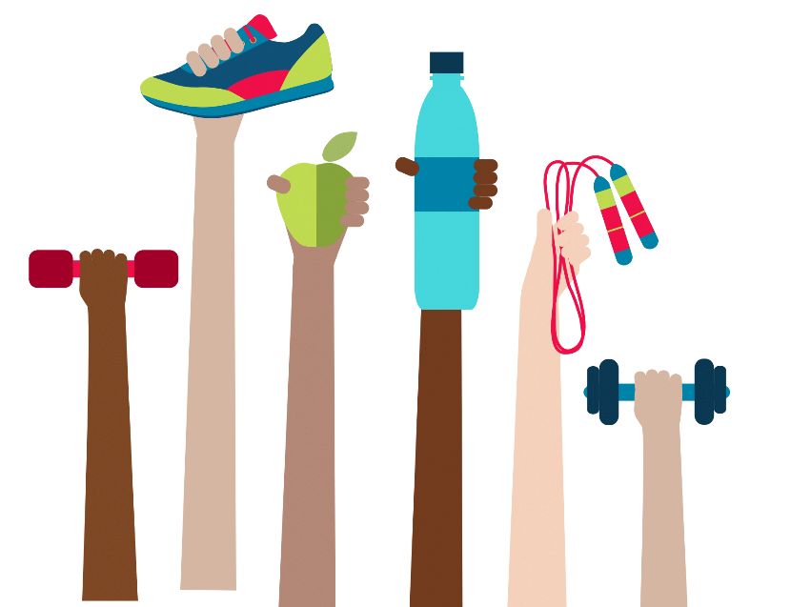
Most Adults Don’t Get Enough Activity
Current American College of Sports Medicine (ACSM) guidelines recommend >150 min/week of moderate-to-vigorous physical activity
Many adults do not engage in regular physical activity
Self-report: 45-65% meet guidelines
Objective: 5% meet guidelines
Notes:
Adabonyan, I., Loustalot, F., Kruger, J., Carlson, S. A., & Fulton, J. E. (2010). Prevalence of highly active adults--Behavioral Risk Factor Surveillance System, 2007. Prev Med, 51(2), 139-143. doi: 10.1016/j.ypmed.2010.05.014
Piercy, K. L., Troiano, R. P., Ballard, R. M., Carlson, S. A., Fulton, J. E., Galuska, D., . . . Olson, R. D. (2018). The physical activity guidelines for Americans. JAMA, 320(19), 2020-2028.
Troiano, R. P., Berrigan, D., Dodd, K. W., Masse, L. C., Tilert, T., & McDowell, M. (2008). Physical activity in the United States measured by accelerometer. Medicine & Science in Sports & Exercise, 40(1), 181-188. doi: 10.1249/mss.0b013e31815a51b3

Slide 9
Why Aren’t People Getting Enough Activity?
Barriers to Exercise
Depression
Illness
Fatigue
Low energy
Pain
Too busy
No social support
Unattainable goals
Lack proper attire
Intimidated by gym people
Unsafe neighborhood / don’t have a place to exercise
Notes:
Steinhardt, M. A., & Dishman, R. K. (1989). Reliability and validity of expected outcomes and barriers for habitual physical activity. Journal of Occupational Medicine, 31(6), 537-546.

Slide 10
Physicians and Their Patients
Physicians don’t always talk about physical activity
36% of people report getting advice from their doctors to increase their activity
53% of overweight or obese adults report getting advice from their doctors to increase activity
Notes:
Lobelo, F., Rohm Young, D., Sallis, R., Garber, M. D., Billinger, S. A., Duperly, J., . . . Stroke, C. (2018). Routine Assessment and Promotion of Physical Activity in Healthcare Settings: A Scientific Statement From the American Heart Association. Circulation, 137(18), e495-e522. doi: 10.1161/CIR.0000000000000559
Loprinzi, P. D., & Beets, M. W. (2014). Need for increased promotion of physical activity by health care professionals. Preventive medicine, 69, 75-79.
Sreedhara, M., Silfee, V. J., Rosal, M. C., Waring, M. E., & Lemon, S. C. (2018). Does provider advice to increase physical activity differ by activity level among US adults with cardiovascular disease risk factors? Fam Pract, 35(4), 420-425. doi: 10.1093/fampra/cmx140

Slide 11
What Predicts Physical Activity?
Demographics & Clinical Characteristics
Male > Female
Normal body weight
Higher education
Higher income
Nonsmokers
History of being active
Psychological factors
Self-efficacy
Fewer perceived barriers
More perceived benefits
Greater intentions to be active
Positive attitudes about activity
Exercise enjoyment
Social environment
Physician support
Social support from friends/peers
Social support from spouse/partner
Environment
Access to facilities
Neighborhood walkability
Access to destinations (shops)
Public transport
Parks/open spaces
Less crime
Notes:
Amireault, S., Godin, G., & Vézina-Im, L.-A. (2013). Determinants of physical activity maintenance: a systematic review and meta-analyses. Health Psychology Review, 7(1), 55-91. doi: 10.1080/17437199.2012.701060
Buckworth, J., & Dishman, R. K. (2002). Determinants of exercise and physical activity. Exercise psychology. Champaign: Human Kinetics, 191-209.

Slide 12
Assessment Strategies

Slide 13
Physical Activity Assessment
Clinical interview questions:
What type of activity do you do now?
How often? How much?
What types of activities do you like to do?
What would you like to be doing more of?
Have you ever been regularly active? What changed or got in the way?

Slide 14
Evidence-Based Interventions

Slide 15
Interventions to Increase Activity
Match stage of change
Address motivation & connect with values
Identify enjoyable activities
Find a buddy
Planning and dealing with barriers
Self-monitoring
Physical activity prescriptions

Slide 16
Identify Stage of Change to Match Intervention
Pre-contemplation
Contemplation
Preparation
Action
Maintenance
Relapse
Not thinking about increasing physical activity
Was previously active but not currently
Thinking about increasing physical activity, no specific plan
Transtheoretical Model
Prochaska & DiClemente
Planning to increase physical activity, may need guidance of what to do, boost self-efficacy
Maintaining a new
physical activity routine for at least 6 months
Actively trying to increase physical activity
Notes:
Can fall out or re-enter at any point in the model – not necessarily a linear progression through the stages.

Slide 17
Interventions for Each Stage
Pre-contemplation
Contemplation
Preparation
Action
Maintenance
Relapse
Explore physical activity benefits; offer nonjudgmental advice
Normalize lapses in new behaviors; encourage starting again
Reasons for change; probe for a plan to change
Transtheoretical Model
Prochaska & DiClemente
Identify specific plan; problem solve barriers;
think about what worked in the past
Reasons to continue to be active; Making physical activity a habit
Reinforce change; continue monitoring benefits and barriers
Notes:
These are suggested interventions to do with patients at various stages of change.

Slide 18
Identify Activities That People Enjoy
What activities do you like to do?
What have you done in the past?
Explore increasing everyday activities, such as:
Parking farther away
Going to the park
Playing with kids

Slide 19
Find a Buddy
Encouraging people to be active with others can be helpful
Consider family, friends, kids
Group exercise classes
Who might do this activity with you?

Slide 20
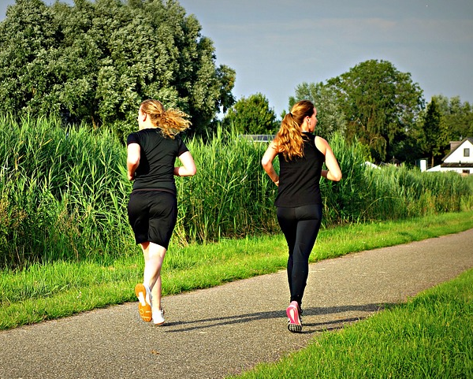
Planning & Problem Solving Barriers
After choosing WHAT to do, consider:
How many days a week? For how long?
When might you be more active? (Pick actual days/times)
What might get in your way?
Notes:
Make sure these are SMART Goals

Slide 21
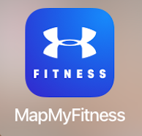
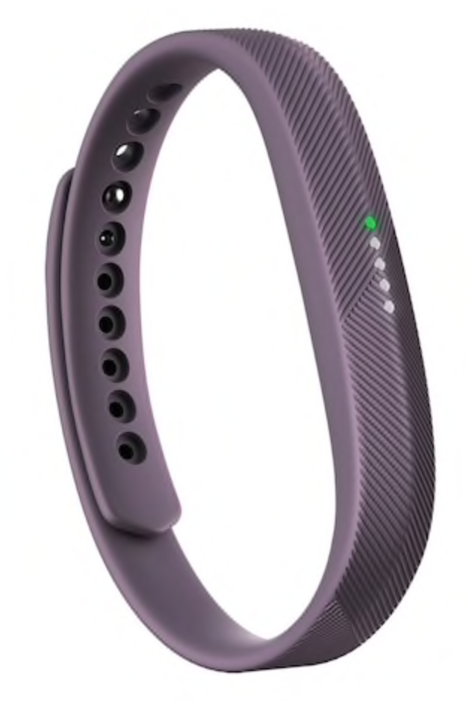
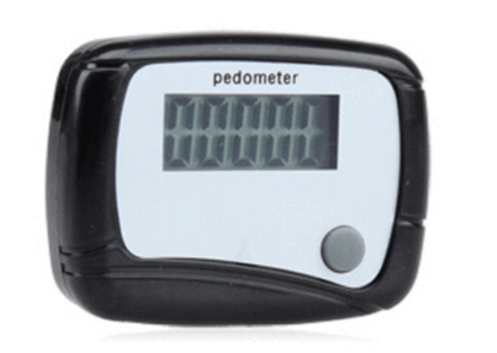
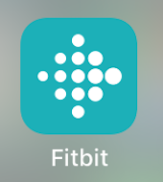
Encourage Self-Monitoring
Notes:
There are many ways to assess physical activity. Patients can keep logs (calendar) tracking duration/type of activity, use devices to measure steps per day (through a pedometer or fitness tracking device), or track their activity through different apps (there are many to choose from)

Slide 22
Physical Activity Prescriptions
exerciseismedicine.org
Guidelines and resources for writing PA prescriptions
Offers treatment recommendation guidelines based on health status
Encourages specific planning and goal setting
Notes:
Exercise is Medicine is an organization that has many guides for prescribing physical activity and is a great resource.

Slide 23
Physical Activity Prescriptions
Activity | Aerobic | Strength Training | Flexibility/Other activities
What? | Any rhythmic, continuous activity | Hand weights, resistance bands, weight machines, or your own body (for example, kitchen counter push-ups or chair squats) | Yoga, Stretching, Tai Chi, Pilates, Balance training
How often? | 3-5 days/week | 2-3 days/week *Rest day in-between | 2-7 days/week
How hard? | Fairly light to somewhat hard | Start with light effort. Build up to medium or hard effort
How much? | Start w/ a few minutes. Gradually build up to 30-60 minutes over the day | 10-15 repetitions to start (for each major muscle group) Build up to 8-12 reps of challenging effort. Repeat 2-4 times. | Hold each stretch for 10-30 seconds (30-60 for older adults)
Notes:
When planning activities, it is good to think about the guidelines for different types of activities and encourage specific type, frequency, intensity, and duration planning.

Slide 24
Change That Matters’ Focus on Values/Meaning in Life

Slide 25
Connect Physical Activity With Values
People who view activity as consistent with their values and enjoy exercise are more likely to be active
Why do you want to be more active?
How will being more active impact your life?

Slide 26
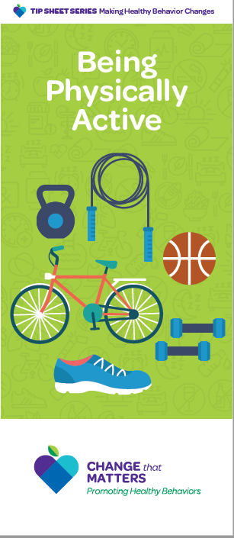
Patient Brochure

Slide 27
Noteworthy Features
Handout encourages reader to:
Reflect on reasons to increase physical activity
Consider activities you might enjoy
Set a SMART goal
Consider who could be an exercise buddy
Define how to track progress
Identify barriers to increasing activity and
how to overcome them

Slide 28
EHR Template

Slide 29
Documentation Template
Assess:
Current exercise or physical activity:
Activities: ***
Days per week: ***
Duration: ***
Reasons to increase activity: {health; mood; family; friends; self-worth; appearance; social activities; clothes fit better; other}
Barriers to regular activity: {safe place to exercise; feeling too tired; low motivation; lacking time; pain; lack of exercise buddy; lack of money/resources; don’t know what to do; embarrassment/shame; dislike exercise, other}

Slide 30
Documentation Template (cont.)
Plan:
Set a specific goal:
Activity: ***
Frequency: ***
Duration: ***
Buddy: ***
Follow up ***
Change that Matters Being Physically Active handout given.
*** minutes spent counseling patient regarding physical activity to improve overall health.

Slide 31
After Visit Summary (AVS) Template
Today we talked about increasing your physical activity
You made a plan to ***.
Here are some helpful tips for being more active
Have fun – choose an activity you like or want to do.
Start slowly and progress gradually.
Find ways to be more active during the day (e.g., park farther away, do exercises during commercials)
Set goals
Keep track of what you do
Reward yourself when you reach a goal
Find an exercise buddy.
Have a plan B – if you can’t do what you planned, have other options.
Have a variety of activities to prevent getting bored.

Slide 32
Structured Practice

Slide 33
Practice Activity
Partner with someone near you
One person will be the patient
One person with be the provider
Think of a patient on your panel that you would like to be more physically active. Imagine him/her for the role play.
Using the pamphlet and EHR template, role play the discussion.
Take about 5 minutes and then switch roles

Slide 34
Responding to Common Challenges

Slide 35
But Doc…
I’m so depressed…
I just don’t feel like doing anything!
Acknowledge the vicious cycle between depression and inactivity.
Don’t wait until you “feel” like doing something – just start small.
Every little bit of activity you get is a positive step.

Slide 36
But Doc…
I’m so out of shape.
I cannot do what I used to enjoy.
I don’t know where to ever begin!
Encourage patients to listen to their bodies and start slowly
Recommend physical therapy or personal trainer at a gym
Explore trying new ways of increasing activity

Slide 37
Resources for Further Learning

Slide 38
American College of Sports Medicine (2017). Guidelines for exercise testing and prescription (10th ed). Wolters Kluwer.
Bully, P., Sanchez, A., Zabaleta-del-Olmo, E., Pombo, H., & Grandes, G. (2015). Evidence from interventions based on theoretical models for lifestyle modification (physical activity, diet, alcohol and tobacco use) in primary care settings: A systematic review. Prev Med, 76 Suppl, S76-93. doi: 10.1016/j.ypmed.2014.12.020
Hooker, S., Punjabi, A., Justesen, K., Boyle, L., & Sherman, M. D. (2018). Encouraging health behavior change: Eight evidence-based strategies. Family Practice Management, 25(2), 31-36.
U.S. Department of Health and Human Services (2018). Physical activity guidelines for Americans (2nd ed).

Slide 39
Change That Matters Team
Stephanie A. Hooker, PhD, MPH (co-PI)
Michelle D. Sherman, PhD, ABPP (co-PI)
Katie Loth, PhD, MPH Jean Moon, PharmD, BCACP
Kacey Justesen, MD Andrew Slattengren, DO
Sam Ngaw, MD Anne Doering, MD
Marc Uy, BA, MPH

Slide 40
Special Thanks
University of Minnesota Academic Health Center
and
National Institute for Integrated Behavioral Health
for financial support for their development and evaluation
of Change that Matters

