Slide 1
Social Isolation
www.ChangeThatMatters.umn.edu

Slide 2
Brief Overview

Slide 3
Defining Terms
Social connection – the “ways one can connect to others socially – through behavioral, social-cognitive, and emotional channels”
Loneliness – the mismatch between a person’s actual and desired social relationships
Notes:
Holt-Lunstad, J., Robles, T. F., & Sbarra, D. A. (2017). Advancing social connections as a public health priority in the United States. American Psychologist, 72(6), 517-530. doi: 10.1037/amp0000103
Masi, C. M., Chen, H.-Y., Hawkley, L. C., & Cacioppo, J. T. (2011). A meta-analysis of interventions to reduce loneliness. Personality and Social Psychology Bulletin, 15(3), 219-266. doi: 10.1177/1088868310377394

Slide 4
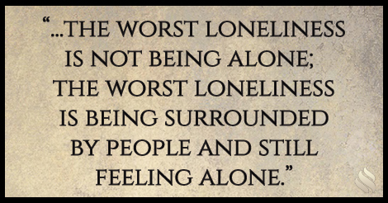
Loneliness ≠ Solitude
Loneliness does not always mean lack of social contacts
Can be surrounded by many people or interact with many people but feel very lonely

Slide 5
Loneliness in Relationships
Intimacy or connection fizzles
Chronic illness
Health problems
Substance abuse
Mental illness
Traveling for work or military deployment

Slide 6
Loneliness in Primary Care
76% | The number of family doctors who report that between 1 and 5 patients a day attend primarily due to loneliness
20% | The prevalence of loneliness across three outpatient primary care practices in the U.S.
Notes:
Jopling, K. (2015). Promising approaches to reducing loneliness and isolation in later life. Retrieved October 3, 2019, from http://www.campaigntoendloneliness.org/wp-content/uploads/Promising-approaches-to-reducing-loneliness-and-isolation-in-later-life.pdf.
Mullen, R. A., Tong, S., Sabo, R. T., Liaw, W. R., Marshall, J., Nease Jr, D. E., . . . Frey III, J. J. (2019). Loneliness in primary care patients: A prevalence study. 2019, 17, 108-115. doi: 10.1370/afm.2358

Slide 7
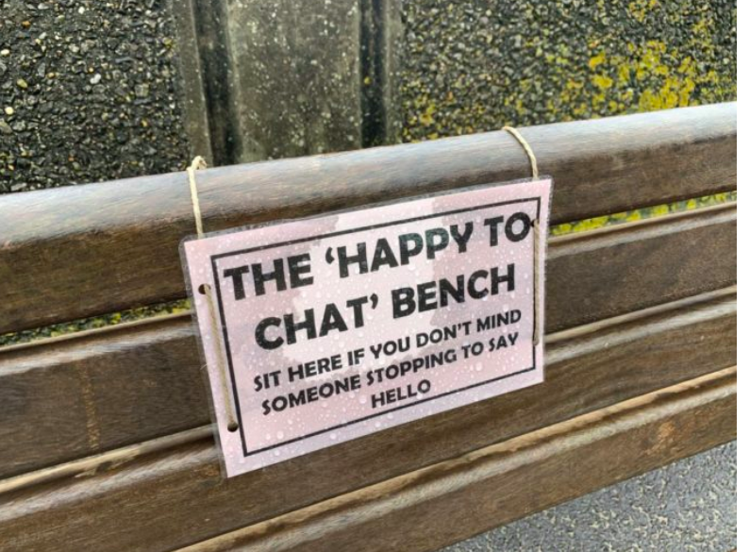
Public Health Campaigns
Tracey Crouch – UK’s first Ministry for Loneliness (2018)
Notes:
UK (campaign to end loneliness), Canada, Australia & other countries are dedicating time and resources to public health campaigns. The USA is doing relatively little
https://www.yahoo.com/lifestyle/police-create-chat-benches-to-combat-loneliness-help-make-life-a-little-better-210135136.html

Slide 8
Grassroots Initiatives
Notes:
Many cities around the world have chapters

Slide 9
Assessment Strategies

Slide 10
Self-report Screening
UCLA 3-item Loneliness Questionnaire
 | Hardly Ever | Sometimes | Often
How often do you feel you lack companionship? | 1 | 2 | 3
How often do you feel left out? | 1 | 2 | 3
How often do you feel isolated from others? | 1 | 2 | 3
*Scores ≥ 6 are considered high loneliness
Notes:
Russell, D. (1996). The UCLA loneliness scale (Version 3): Reliability, validity, and factor structure. Journal of Personality Assessment, 66, 20–40

Slide 11
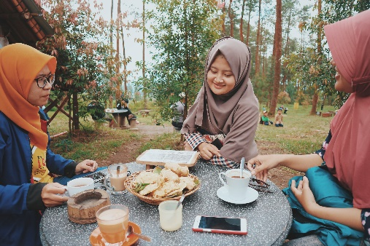
Clinical Interview Questions
Who do you rely on for support?
Emotional support?
Tangible help (e.g., if you were sick and needed a ride to the doctor)?
Advice?
How often do you feel lonely?
How are your relationships with others?

Slide 12
Listen for Situations that Often Evoke Loneliness
Death of a partner
Divorce
Moving -- changing jobs or schools
Working from home
Unemployment
Physical health problems or disability
Mental health problems
Living alone
BUT…
anyone can be lonely at any time!
Notes:
Pyle, E., & Evans, D. (2018). Loneliness - What characteristics and circumstances are associated with feeling lonely?
Analysis of characteristics and circumstances associated with loneliness in England using the Community Life Survey, 2016 to 2017. https://www.ons.gov.uk/peoplepopulationandcommunity/wellbeing/articles/lonelinesswhatcharacteristicsandcircumstancesareassociatedwithfeelinglonely/2018-04-10

Slide 13
Evidence-Based Treatments

Slide 14
Reflection…
Think about a time when you were lonely. Or perhaps you’re dealing with loneliness now? What was that time like for you?
What helped you?
What do you think might most help others who are lonely?

Slide 15
Common Tips
Reach out to someone you’ve lost touch with
Meetup.com
Volunteer
Get a pet
Consider therapy
Decrease time on social media
Do an act of kindness
Exercise (especially with a buddy)
Enjoy nature (walk with a friend)

Slide 16
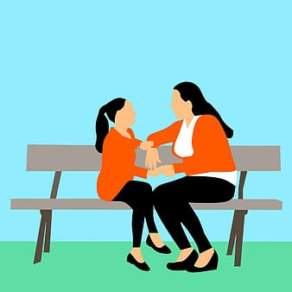
Research Identified 4 Strategies to Reduce Loneliness
Improve social skills
Enhance existing social support
Increase opportunities for new social contact
Address maladaptive social cognitions
Notes:
Masi, C. M., Chen, H.-Y., Hawkley, L. C., & Cacioppo, J. T. (2011). A meta-analysis of interventions to reduce loneliness. Personality and Social Psychology Bulletin, 15(3), 219-266. doi: 10.1177/1088868310377394

Slide 17
Improve Social Skills
Teach people to:
Improve conversational ability
Give and receive compliments
Handle silence
Interpret body language
Approach physical intimacy
Form meaningful relationships
May work best in combination with other approaches, or to help someone with an identified skill deficit
Notes:
Mann, F., Bone, J. K., Lloyd-Evans, B., Frerichs, J., Pinfold, V., Ma, R., . . . Johnson, S. (2017). A life less lonely: The state of the art in interventions to reduce loneliness in people with mental health problems. Social Psychiatry and Psychiatric Epidemiology, 52, 627-638. doi: 10.1007/s00127-017-1392-y

Slide 18
Enhance Existing Social Support
People already have others in their lives, but they may not use their networks effectively
Identify types of support
Emotional
Encouragement, fun, consolation, affiliation, love, spiritual, sharing concerns and fears, reduce feelings of helplessness
Informational
Sharing personal knowledge, assisting with research of needed information for decision-making, promote healthier behaviors
Tangible
Care-taking activities, household help, financial support, work schedule accommodation, job sharing, childcare

Slide 19
Enhance Existing Social Support
Acquaintances
Map out social network
Identify people to strengthen relationships
Spend more time with someone
Express gratitude
Identify gaps
Increase opportunities for social connections
Close relationships
People you can call at 3:00 AM
YOU

Slide 20
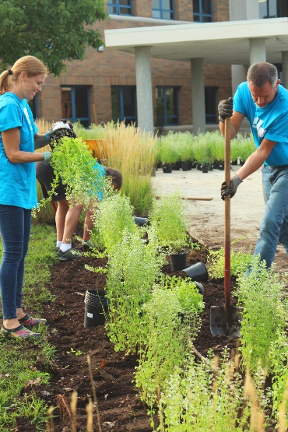
Create Opportunities for New Social Contacts
Encourage people to branch out and find opportunities to develop new social connections
Volunteer
Take a class
Join a group or club
Find a meetup (meetup.com)
Join a gym

Slide 21
Address Maladaptive Social Cognitions
People who feel lonely have particular cognitive biases
In order for people to feel less lonely, they must…
Negatively evaluate others Lack interpersonal trust Expect others to reject them Have low self-worth | Blame themselves for social failures Are more self-conscious in social situations Adopt behaviors that increase likelihood of rejection
Change thoughts
Change social behaviors
Reduce loneliness
Notes:
Mann, F., Bone, J. K., Lloyd-Evans, B., Frerichs, J., Pinfold, V., Ma, R., . . . Johnson, S. (2017). A life less lonely: The state of the art in interventions to reduce loneliness in people with mental health problems. Social Psychiatry and Psychiatric Epidemiology, 52, 627-638. doi: 10.1007/s00127-017-1392-y
Masi, C. M., Chen, H.-Y., Hawkley, L. C., & Cacioppo, J. T. (2011). A meta-analysis of interventions to reduce loneliness. Personality and Social Psychology Bulletin, 15(3), 219-266. doi: 10.1177/1088868310377394

Slide 22
Research Evidence
Meta-analysis of loneliness interventions (Masi et al., 2011)
In 20 RCTs comparing a loneliness intervention to control:
Interventions addressing maladaptive social thoughts had the biggest effect
Interventions enhancing social support also reduced loneliness, but to a lesser extent
Interventions to improve social skills or increase opportunities for social interaction had null effects
Notes:
Masi, C. M., Chen, H.-Y., Hawkley, L. C., & Cacioppo, J. T. (2011). A meta-analysis of interventions to reduce loneliness. Personality and Social Psychology Bulletin, 15(3), 219-266. doi: 10.1177/1088868310377394

Slide 23
Change That Matters’ Focus on Values and Meaning in Life

Slide 24
Relationships Matter
Relationships with others are a primary source of meaning
We often define ourselves by our roles in relation to others
Spouse or partner, parent, sibling, child, friend
Maintaining important relationships with others is key for overall health and well-being
Notes:
Have group reflect on their roles in their lives – how do your roles bring meaning to your life?

Slide 25
Tool for Addressing in Primary Care

Slide 26
Addressing Maladaptive Social Cognitions
People have barriers to social connections
Unhelpful thoughts
“Nobody likes me”
“I’m boring”
“I’m awkward”
“I’m worthless”
“People can’t be trusted”
Unhelpful behaviors
Sleeping too much
Excessive video games or TV
Saying “no” to invitations
Social media
Substance or alcohol misuse

Slide 27
Metaphor of a Brick Wall
Sometimes we think or act in ways that keep us isolated. Imagine these things like bricks in a wall.
Bricks can be ineffective coping tools or negative self-statements.
What are those things for you?

Slide 28
Identify “Bricks”
Step 1: Help the patient identify thoughts and behaviors that get in the way of social connection (“the bricks”).
I always say no when my friends invite me to go out.
I am afraid they will think I’m weird.

Slide 29
Challenge Thoughts
Step 2: Evaluate and challenge the bricks.
Ask yourself:
Is it really true?
Am I being too hard on myself?
What would someone close to me say?
Is this thought helpful or unhelpful?
Step 3: Generate a new, positive or neutral thought.
There are people who will like me for me.

Slide 30
Set Goals
I will invite a friend to go on a walk.
Step 2: Evaluate and challenge the bricks.
Ask yourself:
What can I do differently to be less isolated?
Step 3: Set a small, SMART goal to increase social connection.

Slide 31
What are common responses after an attempt to connect?
It was fun. I look forward to spending time with him/her again…
Or…
It was horrible!
I acted like a fool
Everyone thought I was weird
I felt so anxious
I couldn’t wait to get home
I’ll never do that again!
This just PROVES that I don’t “fit in”
I need to isolate
Feel
lonelier than before!

Slide 32
Why these negative reactions?
Lonely people are often hypervigilant for any possible sign of rejection or disapproval. They may misinterpret a lack of response.
Example:
I texted a co-worker to see if she wanted to go to lunch together; she never responded.
Immediate Interpretation: She doesn’t like me. She wouldn’t want to be seen out with me. I shouldn’t have reached out to her. I made a fool of myself for even asking.
Challenge: Perhaps she had a lunch meeting?

Slide 33
Debrief after patient attempt at connection
Praise effort. Explore what went WELL.
Explore how patient can continue and/or expand on effort.
Explore and challenge patient explanations for disappointing outcomes
Encourage patience and persistence
Forming meaningful relationships takes time.
Not everyone is going to like you – that’s ok!
Keep trying…

Slide 34
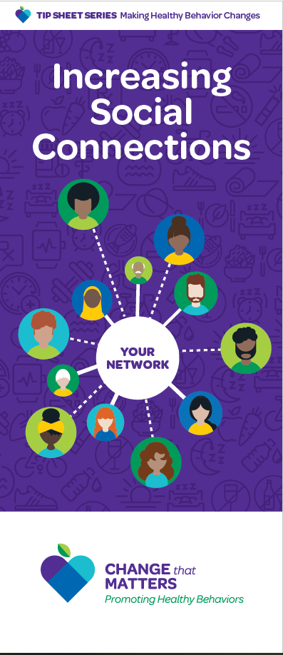
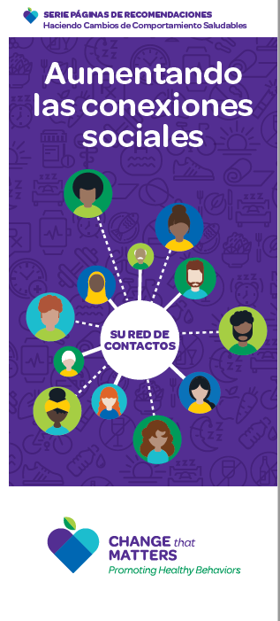
Patient Handout

Slide 35
Noteworthy Features of the Handout
Importance of increasing social connection
Identifying bricks
Evaluating and challenging thoughts and behaviors
Setting a goal
Tips to increase social connection
Positive encouragement

Slide 36
EHR Templates

Slide 37
Documentation Template
Assess: Current support network: ***
Thoughts that keep patient isolated: ***
New or positive thought: ***
Isolating behaviors: ***
Goal to increase social connection: ***
Plan: Specific goal: ***
Referrals: {Behavioral health, Outside mental health facility, Psychiatry, Intensive Outpatient program, Other}
Follow-up: ***
Change that Matters Increasing Social Connection handout given.
*** minutes spent counseling patient on decreasing social isolation to improve overall health

Slide 38
After Visit Summary (AVS) Template
Today we talked about ways to increase your social connections.
You set a goal to ***
We will follow up on this plan at your next appointment.
Here are some other ideas to help overcome loneliness and have more meaningful relationships in your life:
Do an act of kindness for a friend or stranger.
Reach out to someone you have lost contact with or to an acquaintance you would like to get to know better.
Attend events and classes
Find a Meetup (meetup.com) or similar website that lists activities that interest you in your community.
Volunteer.
Decrease time on social media.
Get a pet.
Be patient. Remember that relationships take time and work.
Consider therapy to help challenge your negative thoughts and change the behaviors that keep you isolated

Slide 39
Structured Practice

Slide 40
Practice Activity
Partner with someone near you
One person will be the patient
One person with be the provider
Think of a patient on your panel that is quite lonely. Imagine him/her for the role play.
Using the handout and EHR template, role play the discussion.
Take about 5 minutes and then switch roles

Slide 41
Responding to Common Challenges

Slide 42
But Doc…
I KNOW people won’t like me. I’ve tried meeting new people and getting out more, but it’s failed every time. I end up feeling even worse!
Empathize with patient’s fear and pain
Challenge “brick” (“no one will like me”)
Encourage small steps
Switch focus to helpfulness – how much does this thought help or hurt them in reaching their goals?

Slide 43
But Doc…
I’ve had a really difficult past. People who I thought I could trust later hurt me. I’m not sure I want to risk putting myself out there again…
Acknowledge it takes courage to keep trying!
Encourage patient to consider therapy to help deal with traumatic past
Empower patient it’s his/her choice…and to take small steps.
Validate qualities you appreciate in the patient (e.g., good sense of humor)
Instill hope!

Slide 44
Resources for Further Learning

Slide 45
Resources
Holt-Lunstad, J., Robles, T. F., & Sbarra, D. A. (2017). Advancing social connections as a public health priority in the United States. American Psychologist, 72(6), 517-530.
Mann, F., Bone, J. K., Lloyd-Evans, B., Frerichs, J., Pinfold, V., Ma, R., . . Johnson, S. (2017). A life less lonely: The state of the art in interventions to reduce loneliness in people with mental health problems. Social Psychiatry and Psychiatric Epidemiology, 52, 627-638.
Masi, C. M., Chen, H.-Y., Hawkley, L. C., & Cacioppo, J. T. (2011). A meta-analysis of interventions to reduce loneliness. Personality and Social Psychology Bulletin, 15(3), 219-266.

Slide 46
Change That Matters Team
Stephanie A. Hooker, PhD, MPH (co-PI)
Michelle D. Sherman, PhD, ABPP (co-PI)
Katie Loth, PhD, MPH Jean Moon, PharmD, BCACP
Kacey Justesen, MD Andrew Slattengren, DO
Sam Ngaw, MD Anne Doering, MD
Marc Uy, BA, MPH

Slide 47
Special Thanks
University of Minnesota Academic Health Center
and
National Institute for Integrated Behavioral Health
for financial support for their development and evaluation
of Change that Matters

