Slide 1
Smoking Cessation
www.ChangeThatMatters.umn.edu

Slide 2
Brief Overview

Slide 3
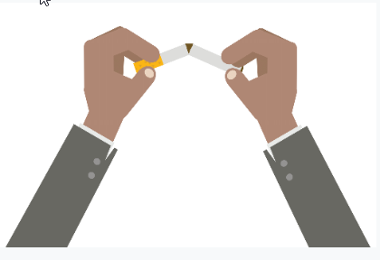
Prevalence
About 15% of adults smoke cigarettes
Substantial reduction from the 1960’s (about 44%)
Tobacco dependence is considered a chronic disease that requires repeated interventions and efforts to quit
Notes:
Jamal et al., 2015
Fiore et al., 2008

Slide 4
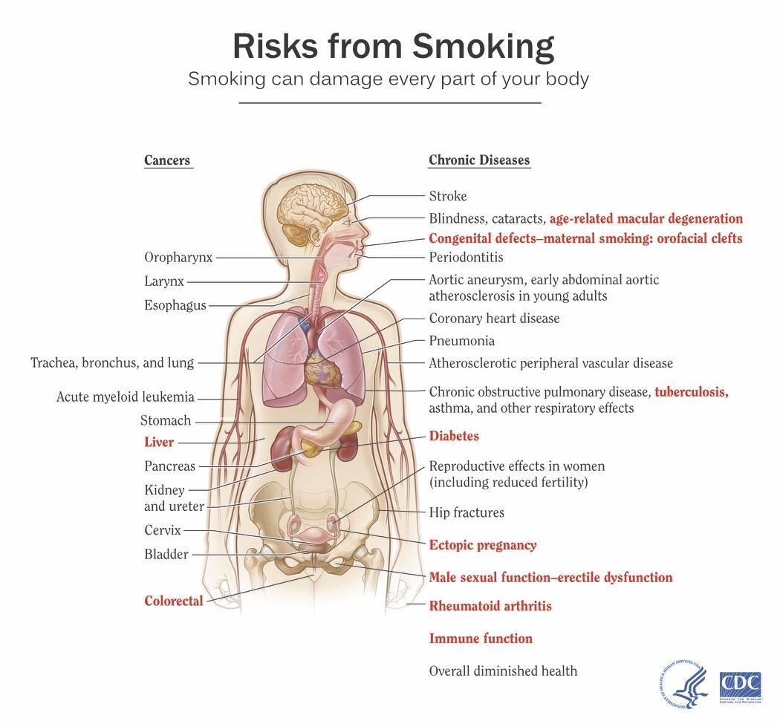
The risks of smoking are well-known
Smoking affects nearly every body system

Slide 5
Quitting is hard!
70% of US smokers say they want to quit
44% try to quit each year
4-7% are successful on their own

Slide 6
Treatments
Brief interventions of 1-3 min have been shown to be effective (rates of cessation = 14.4%)
Combination of pharmacotherapy and behavioral counseling is the gold standard of treatment
Notes:
Fiore et al., 2008

Slide 7
Evidence-Based Treatments

Slide 8
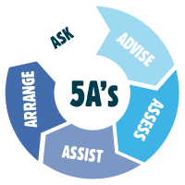
Brief intervention: 5 A’s Approach
Notes:
Five Major Steps to Intervention (The "5 A's"). Content last reviewed December 2012. Agency for Healthcare Research and Quality, Rockville, MD.
https://www.ahrq.gov/prevention/guidelines/tobacco/5steps.html

Slide 9
Step 1: Ask About Smoking
Screen all patients for tobacco use
Ask about current use and past quit attempts

Slide 10
Step 2: Advise to Quit
Be clear: It is important that you quit smoking now, and I can help you.
Be strong: As your physician, I need you to know that quitting smoking is the most important thing you can do to protect your health now and in the future.
Be personalized: Continuing to smoke makes your asthma worse, and quitting could dramatically improve your health.

Slide 11
Step 3: Assess Willingness to Quit
Are you willing to give quitting a try?
Yes: Go to Step 4
No: Go to Step 3a

Slide 12
Step 3A: Motivational Interviewing
Explore importance
How important is it for you to quit smoking?
Normalize concerns
It’s hard to quit smoking.
Support autonomy
I hear you saying you are not ready to quit right now. I’m here to help when you are ready.
Promote Motivation

Slide 13
Step 3A: Motivational Interviewing
Highlight discrepancy between behavior and patients values/goals.
It sounds like you are very devoted to your family.
How does your smoking affect your children?
Support change talk
You realize that smoking affects your breathing and makes it hard to keep up with your kids.
Develop Discrepancy

Slide 14
Step 3A: Motivational Interviewing
Back off
Sounds like you are feeling pressured about your smoking.
Empathize
You are worried about how you would manage withdrawal symptoms.
Ask permission
Would you like to hear some strategies that can help you address that concern when you quit?
Roll with Resistance

Slide 15
Step 3A: Motivational Interviewing
Identify and build on past successes.
You were able to stay off cigarettes for 2 months last time you quit!
Offer options for small change steps
Calling the Quitline
Reading about quitting benefits and strategies
Changing smoking patterns (not smoking in the house)
Support Self-Efficacy

Slide 16
5 R’s
Relevance: Why is quitting smoking personally relevant to the patient?
Risk: Advise about negative consequences about continuing to smoke.
Rewards: Identify benefits of quitting smoking.
Roadblocks: Identify barriers to quitting.
Repeat: Continue to address at every visit.
Notes:
Patients Not Ready To Make A Quit Attempt Now (The "5 R's"). Content last reviewed December 2012. Agency for Healthcare Research and Quality, Rockville, MD.
https://www.ahrq.gov/prevention/guidelines/tobacco/5rs.html

Slide 17
Step 4: When ready to quit: Assist
Set a quit date (ideally within 2 weeks)
There is no evidence that gradually cutting back is easier than quitting all at once
Tell family, friends, and coworkers about quitting, and request understanding and support
Anticipate challenges
Remove tobacco products from the environment
Avoid smoking in places you spend a lot of time
Make home smoke-free

Slide 18
Step 4: Assist With Quitting
Offer medication: first line
Buproprion SR
Nicotine gum
Nicotine inhaler
Nicotine lozenge
Nicotine nasal spray
Nicotine patch
Varenicline

Slide 19
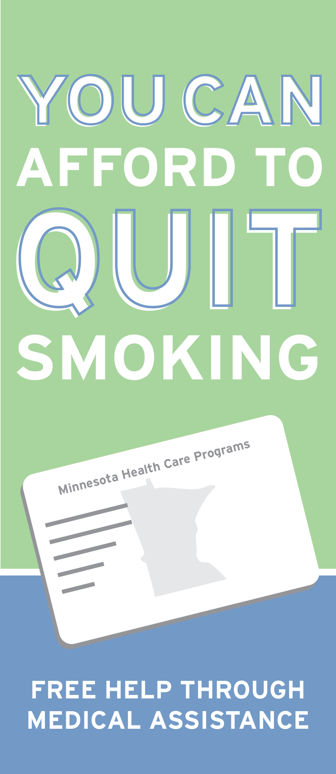
Step 4: Assist With Quitting
Practical counseling approaches (in handout)
Provide social support
Provide supplementary resources
QuitPlan (1-800-QUIT-NOW)
Referral to behavioral health [BH] or pharmacy if needed (BH can help with stress management, if that is a major barrier to quitting)

Slide 20
Step 5: Arrange Follow-up within 1 week
Visit goals:
Congratulate those who have been abstinent on their success
For those who have smoked, review circumstances and look for recommitment
Identify problems encountered
Assess medication use and problems
Review support options
Arrange for a second follow-up visit within the first month

Slide 21
Change That Matters’ Focus on Values/Meaning in Life

Slide 22
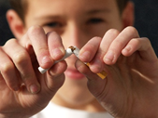
Connect Quitting Smoking to
Life Meaning and Purpose
Invite patient to reflect upon:
Why do you want to make this change?
How will quitting smoking impact your life?
How will this change allow you to engage in other, meaningful areas of your life?

Slide 23
Patient Handout

Slide 24
Noteworthy Features
Handout encourages reader to:
Reflect on personal reasons to quit smoking
Tie quitting smoking to values
Consider readiness to quit
Define barriers to quitting
Set quit date
Identify triggers and define plan to cope with them
Consider who could help

Slide 25
EHR Template

Slide 26
Documentation Template
Assess:
Currently smokes/uses: *** type/amount
Previous attempts to quit: ***
Barriers to quitting: {Stress management, Habit, Social benefit, Nicotine addiction, Family/friends smoke, Other)
Reasons to quit smoking: {Health, Mood, Family, Friends, Self-worth, Appearance, Save money, More energy, Other)
Family/friends who can offer support: ***
Advise: “Quitting smoking is the most important thing you can do to improve your health now and in the future.”
Willing to quit now?: YES/NO

Slide 27
Documentation Template (cont.)
Plan: Ask patient to write specific goal on back page of handout
Quit date: ***
Medications prescribed: ***
Follow up (preferably within 1 week of quit date) ***
Change that Matters Quitting Smoking handout given.
*** minutes spent counseling patient regarding quitting smoking to improve overall health.

Slide 28
After Visit Summary (AVS) Template
Today we talked about quitting smoking. This can be tough, but is one of the BEST things you can do for your health!
You stated you want to ***. To do this, you plan to ***.
Here are some helpful tips for quitting smoking:
Set a goal to quit completely.
Think about past quit experiences.
Anticipate triggers or challenges.
Limit alcohol while you are trying to quit.
Limit contact with other smokers.
Consider joining the QuitPlan (1-800-QUIT-NOW) or online resources like www.SmokeFree.gov

Slide 29
Structured Practice

Slide 30
Practice Activity
Partner with someone near you
One person will be the patient
One person with be the provider
Think of a patient on your panel that you would like to quit smoking. Imagine him/her for the role play.
Using the pamphlet and EHR template, role play the discussion.
Take about 5 minutes and then switch roles

Slide 31
Responding to Common Challenges

Slide 32
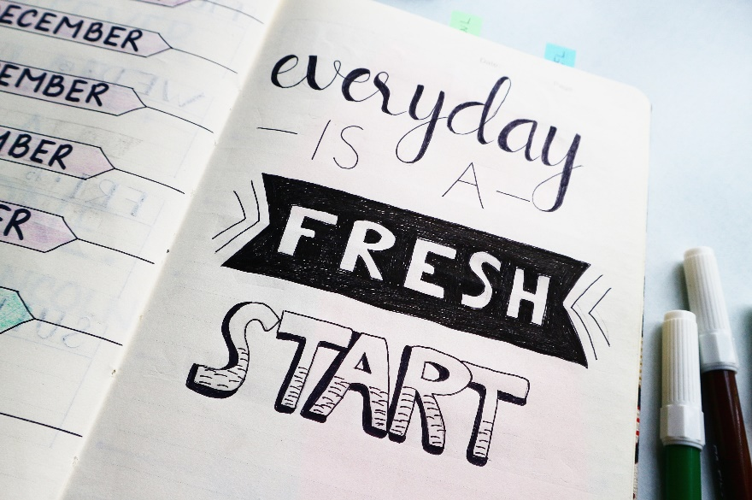
But Doc….
I’ve tried many times in the past...
I just start smoking again!
It usually takes several quit attempts to stop for good.
Every day you don’t smoke is a positive step.

Slide 33
But Doc….
I’m too stressed to quit! Smoking helps me relax.
Smoking is a habit. It’s perhaps your primary way to cope with stress.
Would you be open to trying other ways of managing stress?

Slide 34
Resources for Further Learning

Slide 35
Resources
SmokeFree.gov https://smokefree.gov/
Fiore, M. C., Jaén, C. R., Baker, T. B., Bailey, W. C., Benowitz, N. L., Curry, S. J., ... & Henderson, P. N. (2008). Treating tobacco use and dependence: 2008 update. Rockville, MD: US Department of Health and Human Services.
For Clinicians. Content last reviewed October 2019. Agency for Healthcare Research and Quality, Rockville, MD.
https://www.ahrq.gov/prevention/guidelines/tobacco/clinicians/index.html

Slide 36
Change That Matters Team
Stephanie A. Hooker, PhD, MPH (co-PI)
Michelle D. Sherman, PhD, ABPP (co-PI)
Katie Loth, PhD, MPH Jean Moon, PharmD, BCACP
Kacey Justesen, MD Andrew Slattengren, DO
Sam Ngaw, MD Anne Doering, MD
Marc Uy, BA, MPH

Slide 37
Special Thanks
University of Minnesota Academic Health Center
and
National Institute for Integrated Behavioral Health
for financial support for their development and evaluation
of Change that Matters

