Slide 1
Healthy Eating
www.ChangeThatMatters.UMN.edu

Slide 2
Brief Overview

Slide 3
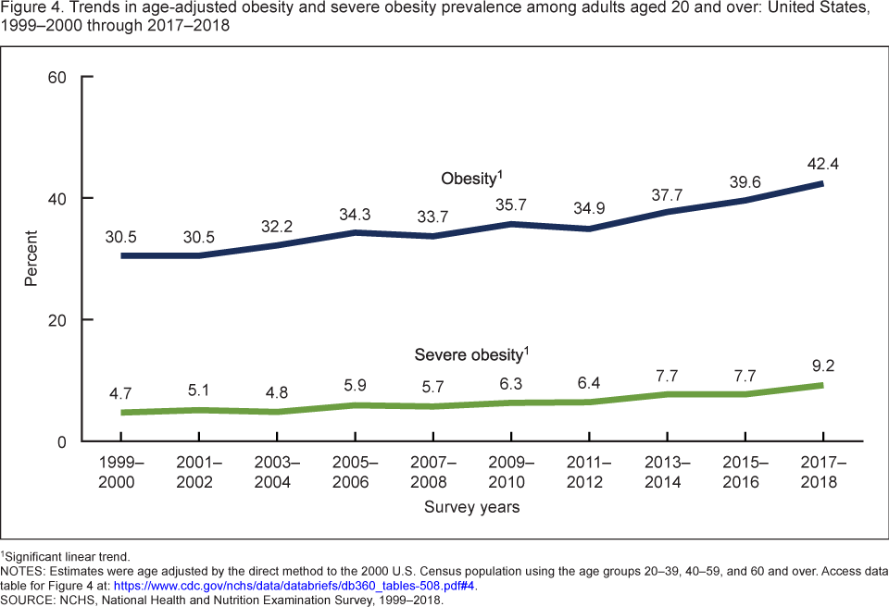
Obesity Trends
Notes:
Hales CM, Carroll MD, Fryar CD, Ogden CL. Prevalence of obesity and severe obesity among adults: United States, 2017–2018. NCHS Data Brief, no 360. Hyattsville, MD: National Center for Health Statistics. 2020
Body mass index (BMI) is calculated as weight in kilograms divided by height in meters squared. Obesity is defined as a BMI ≥30. Severe obesity is a BMI ≥ 40.

Slide 4
Gap Between Recommendations & Typical Practice
Physicians recognize obesity as a problem
However, obesity and overweight are not consistently recognized or diagnosed
Primary care providers largely do not adhere to treatment guidelines
Further, some guidelines may be unrealistic for everyone:
June 2017 USPSTF Guidelines: all children 6 years and older who are found to be obese are to be referred to or offered comprehensive behavioral programs with 26 or more contact hours
Notes:
Guo, H., Pavek, M., & Loth, K. (2017). Management of childhood obesity and overweight in primary care visits: gaps between recommended care and typical practice. Current Nutrition Reports, 6(4), 307-314.
Heintze, C., Metz, U., Hahn, D., Niewohner, J., Schwantes, U., Wiesner, J., & Braun, V. (2010). Counseling overweight in primary care: an analysis of patient-physician encounters. Patient Educ Couns, 80(1), 71-75. doi: 10.1016/j.pec.2009.10.016

Slide 5
Physician Barriers
Reimbursement
Providers may be discouraged by low rates and billing
Self-efficacy
Sensitive and uncomfortable to discuss. Lacking effective therapeutic strategies to help patients control weight
Training
Few opportunities to learn specific behavioral strategies most useful in counseling for obesity
Time
Short encounters and lack of time and resources to effectively manage obesity
Complexity
Multifaceted management: lifestyles, social norms, socioeconomic factors, access to nutritional foods
Language
Misuse of language can offend and place blame on patients, further causing stigmatization
Notes:
There are many possible barriers for physicians to engage in counseling for eating and obesity. This presentation specifically addresses the training needed to effectively counsel patients on eating habits.
Barlow, S. E., & Dietz, W. H. (2002). Management of child and adolescent obesity: summary and recommendations based on reports from pediatricians, pediatric nurse practitioners, and registered dietitians. Pediatrics, 110(Supplement 1), 236-238.
Davoli, A. M., Broccoli, S., Bonvicini, L., Fabbri, A., Ferrari, E., D’Angelo, S., ... & Romani, G. (2013). Pediatrician-led motivational interviewing to treat overweight children: an RCT. Pediatrics, 132(5), e1236-e1246.
Story, M. T., Neumark-Stzainer, D. R., Sherwood, N. E., Holt, K., Sofka, D., Trowbridge, F. L., & Barlow, S. E. (2002). Management of child and adolescent obesity: attitudes, barriers, skills, and training needs among health care professionals. Pediatrics, 110(Supplement 1), 210-214.
Turner, K. M., Shield, J. P., & Salisbury, C. (2009). Practitioners' views on managing childhood obesity in primary care: a qualitative study. Br J Gen Pract, 59(568), 856-862.
Van Gerwen, M., Franc, C., Rosman, S., Le Vaillant, M., & Pelletier‐Fleury, N. (2009). Primary care physicians' knowledge, attitudes, beliefs and practices regarding childhood obesity: a systematic review. Obesity Reviews, 10(2), 227-236.
Walker, O., Strong, M., Atchinson, R., Saunders, J., & Abbott, J. (2007). A qualitative study of primary care clinicians' views of treating childhood obesity. BMC family practice, 8(1), 50.

Slide 6
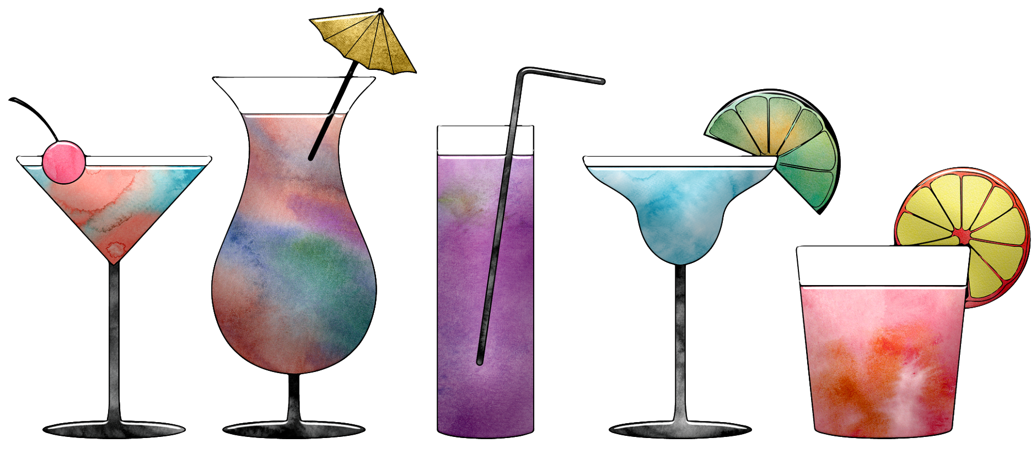
Challenges to Addressing Eating
Daily behavior that requires consistent effort to change
Socially determined
Culturally determined
Many factors determine what people eat
Familiarity
Variety
Taste preferences
Income/Availability
Beliefs

Slide 7
Assessment Strategies

Slide 8
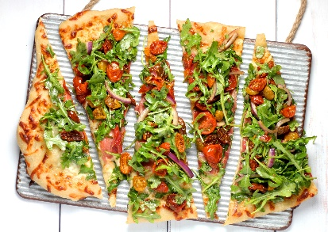
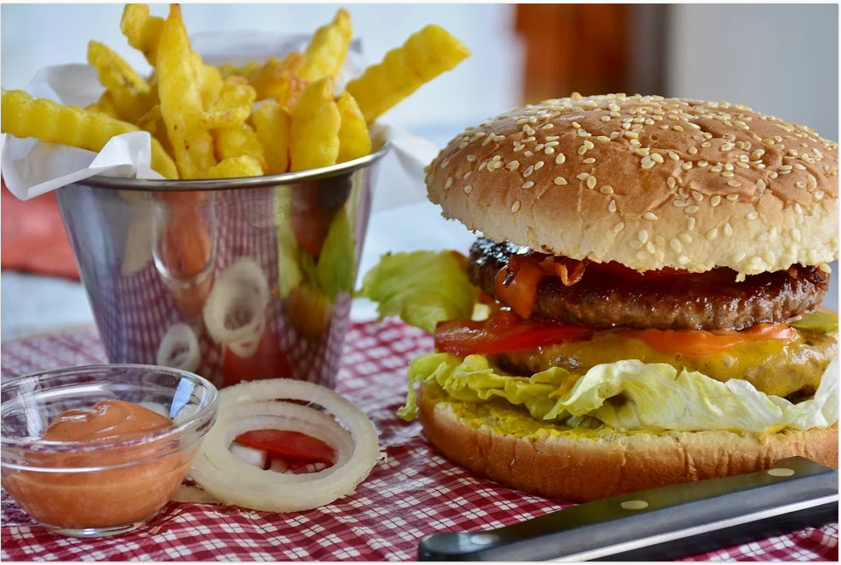
Assessment of Eating Behavior
Food diaries
24-hour recall
Apps
Special eating disorder screening questions

Slide 9
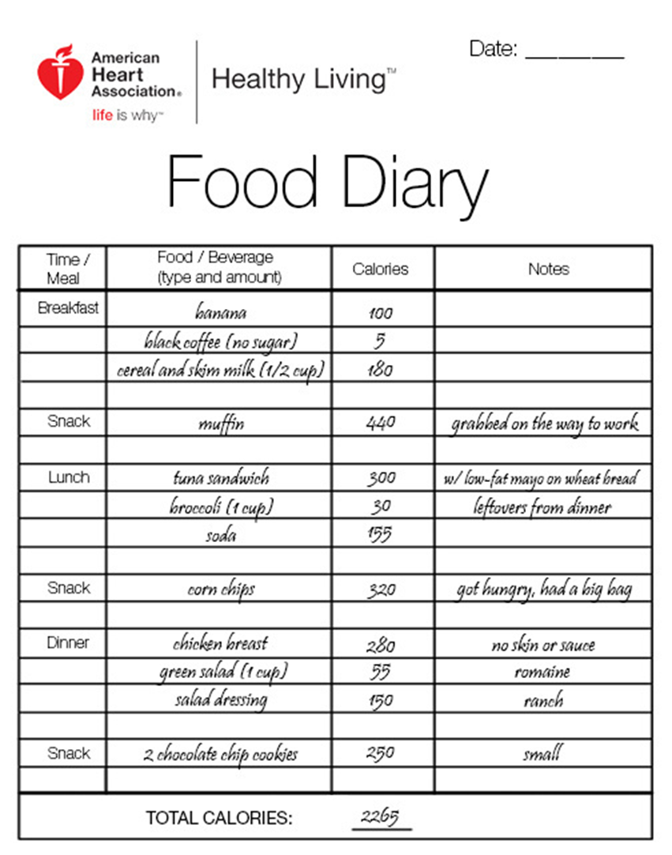
Food Diaries
Multiple types of diaries
Tailor to the patient
Key things to track
Food/drink
Quantity
When consumed
Calorie counting can be stressful
Need 3 - 7 days for accuracy
Review log with patient - ask what they noticed
Notes:
Food diary: https://www.heart.org/en/healthy-living/healthy-eating/eat-smart/nutrition-basics/food-diary-how-to-keep-track-of-what-you-eat

Slide 10
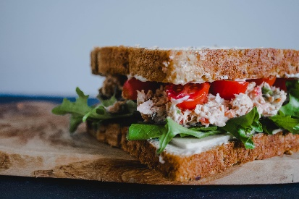
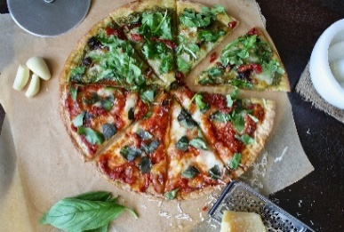
24-Hour Recall
“Tell me about what you ate yesterday. Let’s start with the morning. What time did you wake up?”
Carefully walk through the day sequentially
Ask about gaps in the day (did you have a snack between breakfast and lunch?)
What, how much
Was yesterday a typical day for you?

Slide 11
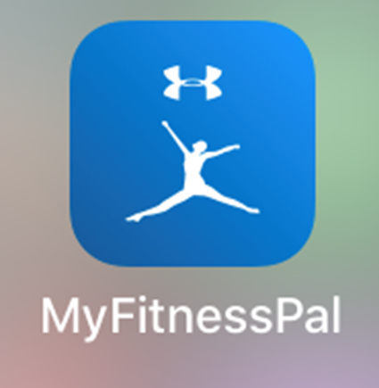
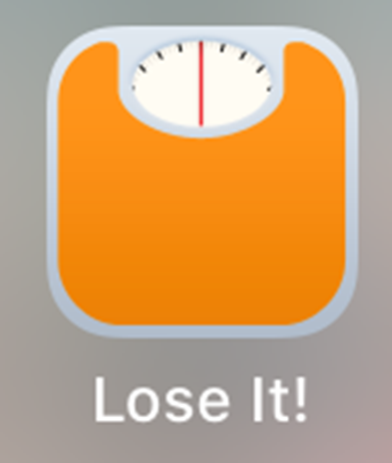
Apps
Many apps are available for free to track eating behavior
SparkPeople
Lose It!
My Fitness Pal
Come with pre-loaded calorie content/serving sizes

Slide 12
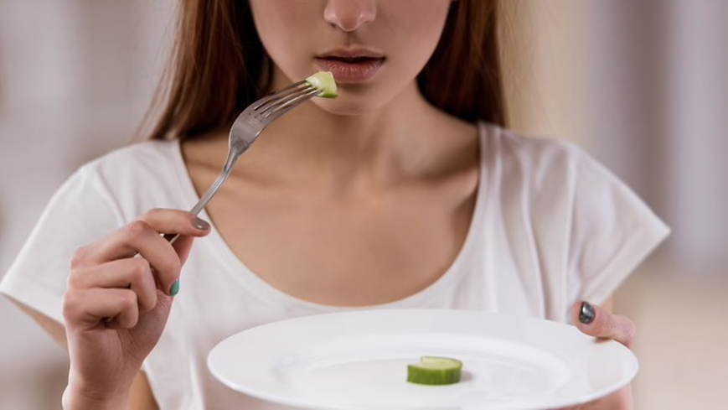
Special Questions to Screen for Eating Disorders
Binge eating
Do you ever eat a large amount of food in a short amount of time, and feel like you lose control over your eating?
Purging
Do you ever throw up, use laxatives, or restrict your eating to make up for eating a large amount of food?
Stress eating/emotional eating
Do you ever eat to cope with stress or overwhelming emotions?
Notes:
If eating disorders are identified, refer to specialty eating disorder treatment.
+ Binge eating and – for purging = possible binge eating disorder
+ Binge eating and + for purging = possible bulimia nervosa
Stress eating/emotional eating is not a DSM diagnosis, but can contribute to difficulty losing or maintaining weight

Slide 13
Evidence-Based Interventions

Slide 14
Interventions
Motivational interviewing
Plate method
Small changes
Schedule meals and snacks
Suggest family changes
Continued self-monitoring

Slide 15
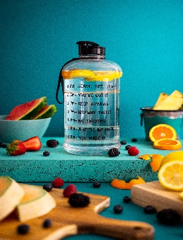
Motivational Interviewing
Elicit change talk (using open-ended questions)
What are the reasons you want to make this change?
Develop discrepancy
Highlight differences between what patient wants to do and what they are doing
Support self-efficacy
Find past successes to build confidence in current change

Slide 16
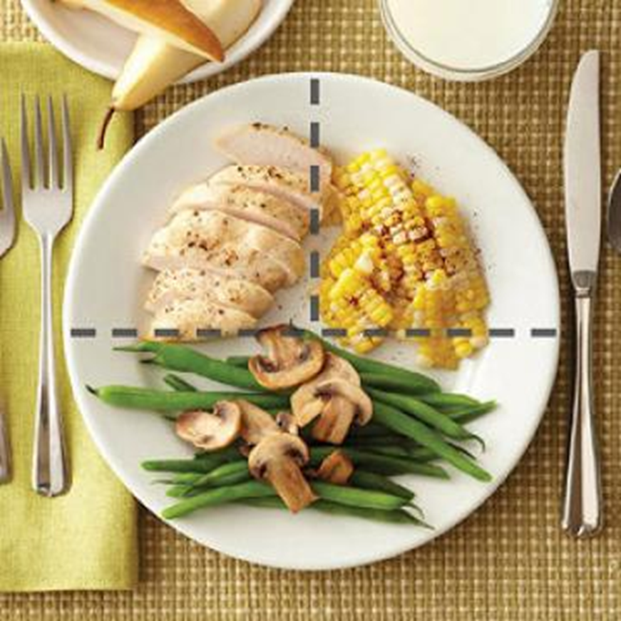
Plate Method
Teach patients how to structure their plates to make sure they are getting the right proportion of food from different food groups
½ - fruits & veggies (emphasize veggies)
¼ - lean protein
¼ - starch or grain
Notes:
Have patients generate ideas for what types of foods can go in each category
Correct knowledge gaps (e.g., potato as a vegetable)
Plate size is important - not the largest plate they can think of!
Have patient identify how to make their “typical” meal like one of these meals

Slide 17
Small Changes
*Adapted from Kahan & Manson (2017) JAMA
Dietary Pattern | Reasonable Change Target | Example of realistic small solutions
Fast food meals or snacks | Decrease by 1 fast food meal per week | Replace 1 fast food meal per week with a prepared food from supermarket or sandwich from home
Fruit | Increase by 1 serving per day | Add fresh, frozen, or canned fruit to yogurt
Vegetables | Increase by 1 serving per day | Add fresh, frozen, or canned vegetables to yogurt smoothie
Regular sodas, juices, or other sugary beverages | Decrease by 1 sugary beverage per day | Replace a sugared soda with water or flavored water, lightly sweetened tea, or coffee
Servings of beans, nuts, chicken or fish | Increase fish/seafood by 1 serving per week | Replace fast food entrée or processed meat sandwich with tuna fish sandwich
Regular snack chips or crackers | Decrease by 1 serving per week | Replace 1 serving of snack chips or crackers with a handful of nuts
Desserts and other sweets | Decrease by 1 serving per week | Replace 1 sugary sweet or dessert with a fruit or a handful of nuts
Use of butter or meat fat | Decrease trans and saturated fats as seasoning | Replace butter with light drizzle of olive oil and/or spices
Notes:
Find easy targets in the diet to change
Encourage people not to drink their calories (juice, soda, and other sugary beverages)
Kahan, S., & Manson, J. E. (2017). Nutrition Counseling in Clinical Practice: How Clinicians Can Do Better. JAMA, 318(12), 1101-1102. doi: 10.1001/jama.2017.10434

Slide 18
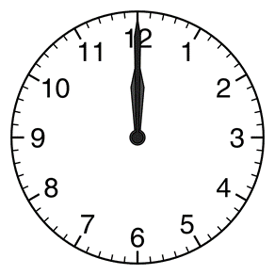
Schedule Meals and Snacks
Establish a regular eating pattern (specific times don’t matter but can be helpful)
Breakfast
Mid-morning snack
Lunch
Mid-afternoon snack
Evening meal
Evening snack
Encourage patients to plan ahead for these meals and snacks

Slide 19
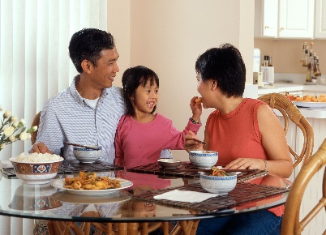
Suggest Family Changes
It is difficult to make changes as a single person in a couple or family unit
Encourage patients think about changes they can make as a family
Family dinners
Cooking classes

Slide 20
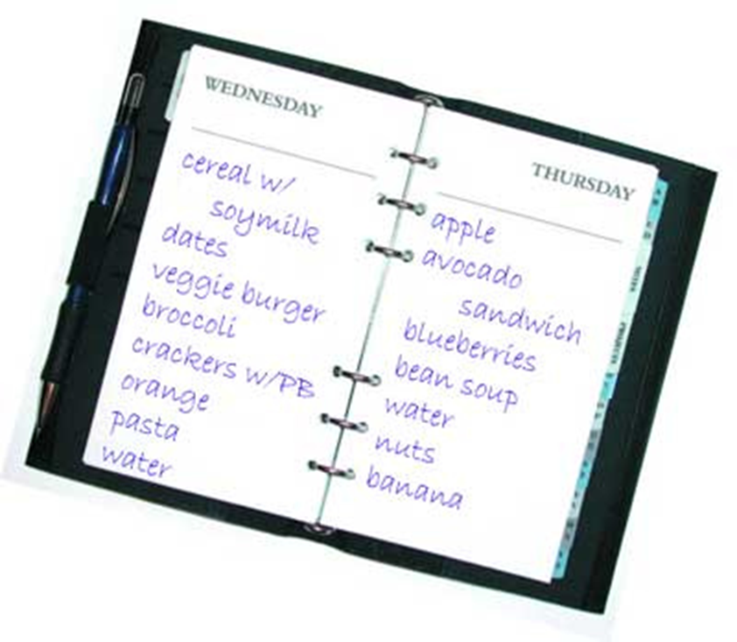
Encourage Continued Self-Monitoring
Use food diaries or apps to monitor food intake
Just having to write down or record what one eats changes behavior

Slide 21
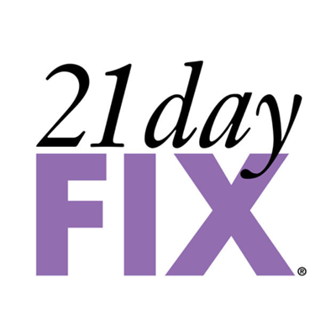
Wait… what about Diet X?
You will likely get questions about specific diets
How do you answer those questions?
Encourage long-term healthy lifestyle changes vs. time-limited special diets
Notes:
There is not one “diet” that works best for everyone. The best diet is the one you can stick to. For most people, this is a lifestyle change approach rather than a time-limited, low calorie diet. In general, a Mediterranean diet rich in fruits and vegetables, healthy fats, and lean protein is recommended.

Slide 22
Referrals
Dietitian (what)
Learn about what foods are healthy
Learn about specific diets for health conditions (e.g.,
diabetes, hypertension, GERD, gout)
Behavioral health (how)
Behavioral changes (timing, modifying the food
environment, etc.)
Modifying thoughts about eating
Suspected eating disorders (e.g., binge eating,
emotional eating, night eating)
Community resources for food insecurity

Slide 23
Change That Matters’ Focus on Values/Meaning in Life

Slide 24
Connect Healthy Eating to Values and Meaning
Invite patient to reflect upon:
Why do you want to eat healthy foods?
How will eating in a healthy way impact your life?
How will this change allow you to engage in other, meaningful areas of your life?

Slide 25
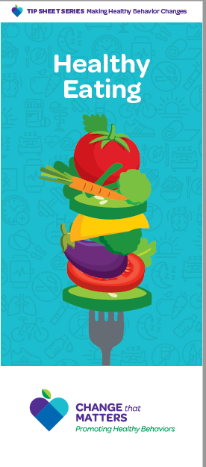
Patient Handout

Slide 26
Noteworthy Features
Handout encourages reader to:
Reflect on reasons to make healthy food choices
Identify challenges to healthy eating
Plan a meal with food from each category (Plate Method)
Set one small goal for the week
Consider who could help
Consider tracking food intake

Slide 27
EHR Templates

Slide 28
Documentation Template
Assess:
Eating on a Typical Day:
B: ***
L: ***
D: ***
Snacks: ***
Barriers to healthy eating: {access, price, not knowing how to prepare food, liking highly palatable foods, picky eating, time management, family, knowledge, other}
Reasons to eat healthy foods: {health, mood, family, self-worth, appearance, other}

Slide 29
Documentation Template (cont.)
Plan:
Set specific goal: ***
Offer referrals: {behavioral health, dietitian, other}
Follow up ***
Change that Matters Healthy Eating handout given.
*** minutes spent counseling patient regarding healthy eating to improve overall health.

Slide 30
After Visit Summary (AVS) Template
Today we talked about eating healthy foods.
You stated you want to ***. To do this, you plan to ***.
Here are some other ideas to help with healthy eating:
Schedule regular meals and snacks.
Use a smaller plate.
Strive to INCREASE:
o Lean protein
o Fruits and vegetables
Strive to DECREASE:
o Fast food meals
o Sugary beverages, juice, and regular soda (Drink more water instead!)
o Snack chips or crackers
o Desserts and other sweets
o Use of butter and meat fats when cooking
Keep track of your progress on a food diary or smart phone app

Slide 31
Structured Practice

Slide 32
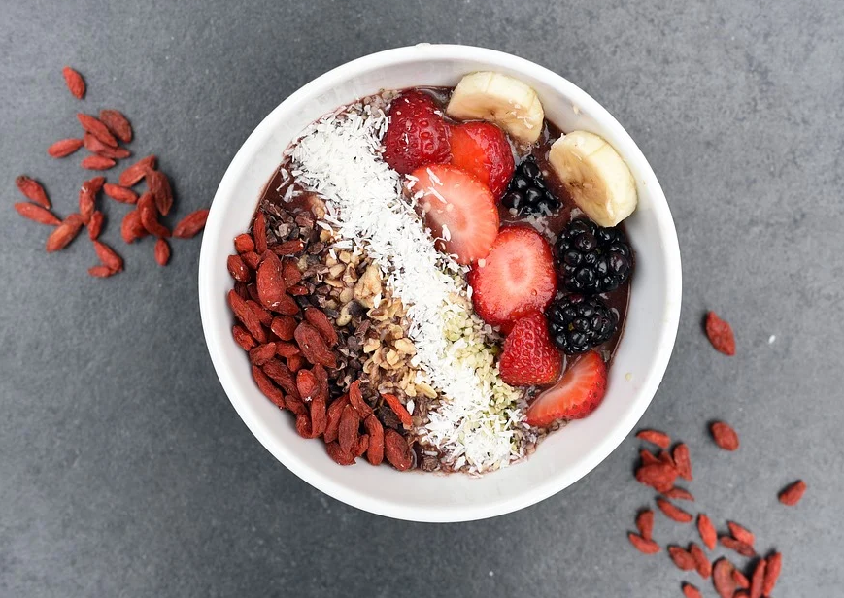
Practice Activity
Partner with someone near you
One person will be the patient
One person with be the provider
Think of a patient on your panel that you would like to make healthier choices in food. Imagine him/her for the role play.
Using the pamphlet and EHR template, role play the discussion.
Take about 5 minutes and then switch roles

Slide 33
Responding to Common Challenges

Slide 34
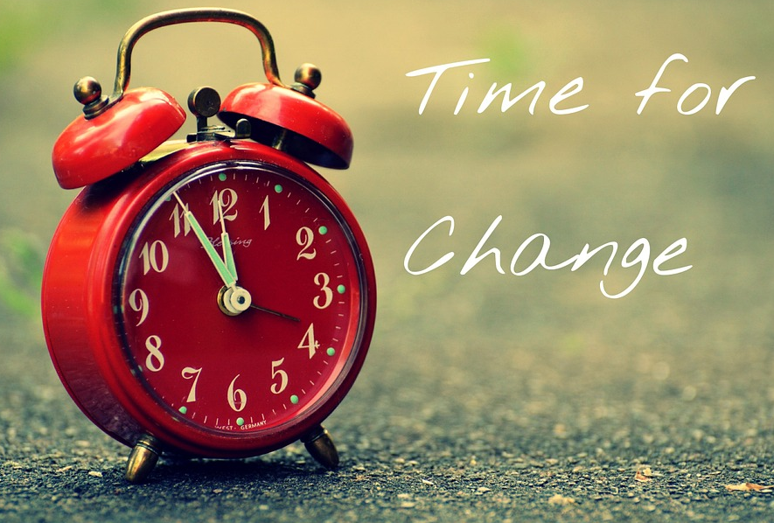
But Doc…
I’ve tried eating better and
exercising more in the past,
but I just go back to my old habits!
Acknowledge changing and sustaining
new eating patterns is difficult.
Remember this is a lifelong journey – you will always have to eat! Focus on one day at a time; every healthy choice you make is a WIN!

Slide 35
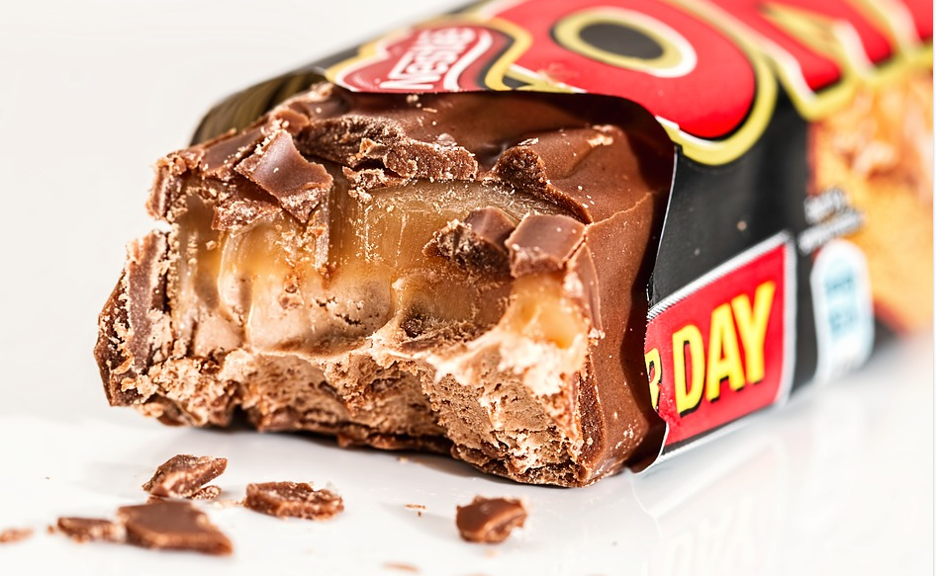
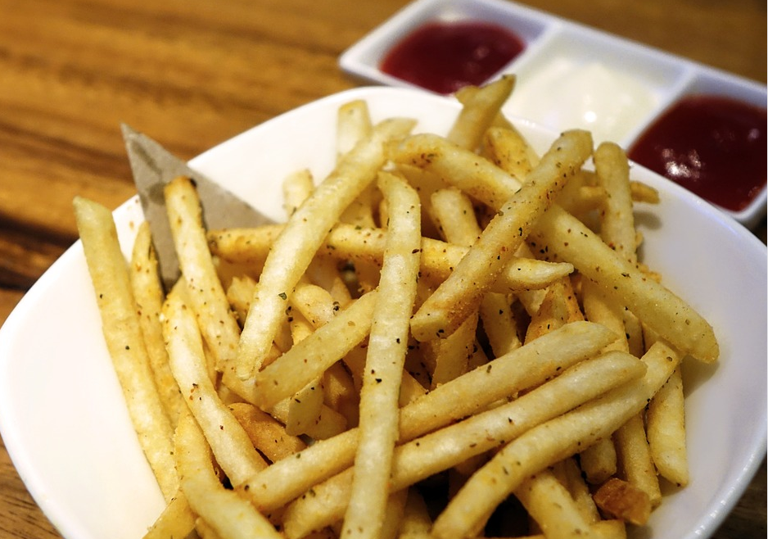
But Doc…
I like junk food…It tastes good!
Good news: You don’t have to totally eliminate treats from your diet.
Would you be open to trying to increase the fruits/veggies and start cutting back on the number and size of sweets per day?

Slide 36
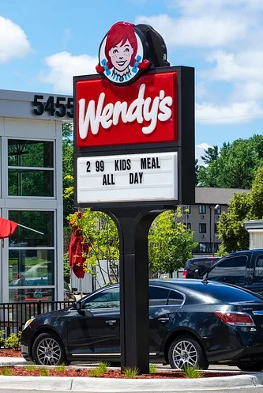
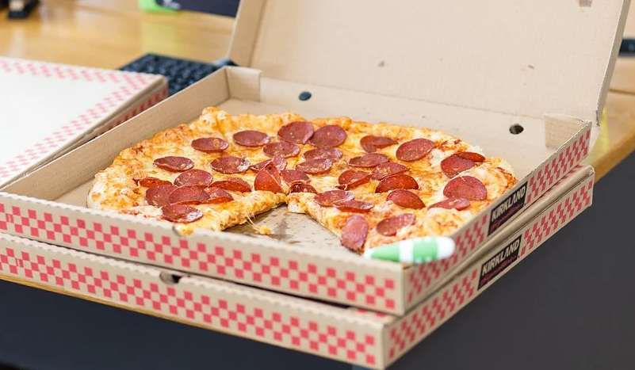
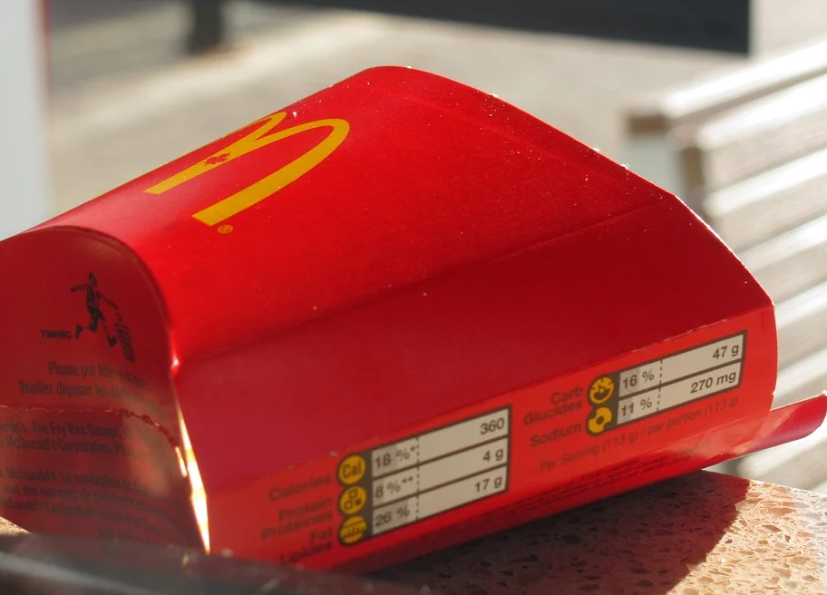
But Doc…
I don’t have time to cook healthy foods. Going through the drive-through or getting pizza delivered is much easier.
Fast food can be an occasional treat, but it has high levels of fat and sodium.
Taking time (perhaps on weekends) to meal plan and have food for weeknights can be helpful.

Slide 37
Resources for Further Learning

Slide 38
CDC’s Division of Nutrition, Physical Activity, and Obesity: https://www.cdc.gov/nccdphp/dnpao/index.html
Hooker, S., Punjabi, A., Justesen, K., Boyle, L., & Sherman, M. D. (2018). Encouraging health behavior change: Eight evidence-based strategies. Family Practice Management, 25(2), 31-36.
Kahan, S., & Manson, J. E. (2017). Nutrition Counseling in Clinical Practice: How Clinicians Can Do Better. JAMA, 318(12), 1101-1102. doi: 10.1001/jama.2017.10434
Nutrition in Medicine online course: https://www.nutritioninmedicine.org/
Reims, K., & Ernst, D. (2016). Using motivational interviewing to promote healthy weight. Family Practice Management, 23(5), 32-38
U.S. Department of Health and Human Services and U.S. Department of Agriculture. 2015–2020 Dietary Guidelines for Americans. (8th Ed. December 2015.

Slide 39
Change That Matters Team
Stephanie A. Hooker, PhD, MPH (co-PI)
Michelle D. Sherman, PhD, ABPP (co-PI)
Katie Loth, PhD, MPH Jean Moon, PharmD, BCACP
Kacey Justesen, MD Andrew Slattengren, DO
Sam Ngaw, MD Anne Doering, MD
Marc Uy, BA, MPH

Slide 40
Special Thanks
University of Minnesota Academic Health Center
and
National Institute for Integrated Behavioral Health
for financial support for their development and evaluation
of Change that Matters

